Slide 1
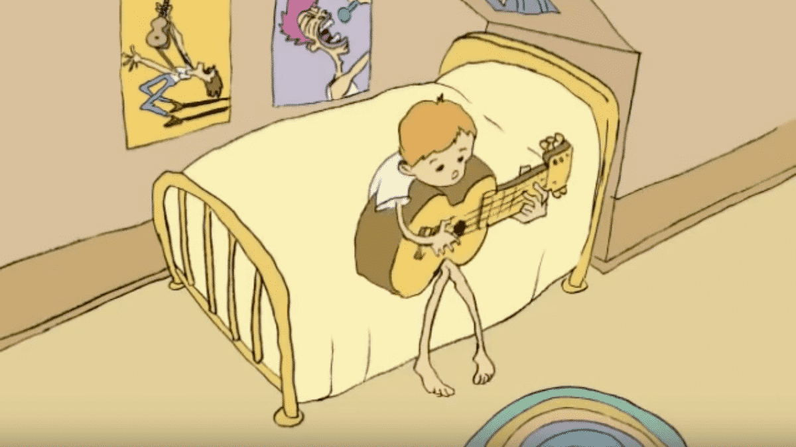
Class 5
Intellectual Property
Keith A. Pray
socialimps.keithpray.net
Notes:
Weird Al Yankovic “Don’t Download This Song” (3:53)
2006-08-21 released exclusively as digital download
https://www.youtube.com/watch?v=zGM8PT1eAvY
Some Analysis Points:
- Slippery Slope Fallacy
- CDs were most common way to obtain music
- Winner take all society
- Virtue ethics, guilt, shame

Slide 2
Papers
Use template, saves time
Quantify
  Not terms like: less, more, a lot, huge, great, big, tiny, drastic, quicker, faster, easier, etc.
Avoid absolutes
  Terms like: all, none, always, never
  Difficult to prove, easy to show false
Cite as specified [1]
Read paper aloud to proof
http://socialimps.keithpray.net/assignments/paper-guidelines/
We will release grades this weekend and review the average next class.
Notes:
Save for next time:
Define terms
Quantify
Not terms like: less, more, a lot, huge, great, big, tiny, drastic, etc.
Avoid absolutes
Terms like: all, none, always, never
Difficult to prove, easy to show false
Read paper aloud to proof
Read assignment
many time lines missing (and space used describing history instead of providing argument)
many conclusions did not answer prompt
Be sure to put quotes around entire quote
State a strong, clear conclusion
First statement preferred
Provide Counter Point and Rebuttal
Counter Point and Rebuttal should directly relate
Print 2 sided and save a tree
Hyperbole is the best thing ever!
but not in these papers
Be wary of counter point strawman fallacy
Text book is not a primary source
Use template, saves time
Beware of fallacies
Avoid blogs, encyclopedias, and text book. These are generally not primary and high quality sources.

Slide 3
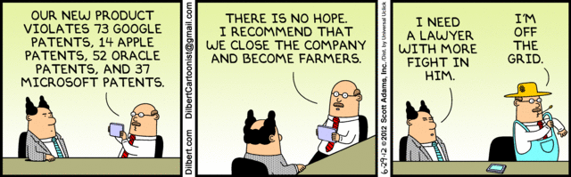
Overview
Review
Assignment
Students Present
Notes:
Comments, observations, questions on IP Chapter?

Slide 4
My Reading Notes
pp. 172 “not have bothered to invent it.“ or had the time. Any music entering public domain, not just classical. Why does orchestra budget matter? Public domain year 1997/1999 from source published in 1996?
pp. 174 SaaS, Google Search example? “…before he gave them the plot.”? “…cannot erase the memories...” Paycheck (2003)
pp. 176 When was instant photography invented?
pp. 177 $134 billion, copyright leading export 2010, now?
pp. 178 ”not profited” but violated right to distribute and reproduce…
pp. 179 Mickey Mouse – CGP Grey “Copyright: Forever Less One Day”
pp. 180 $150K for VP seems low.
pp. 182 Felicity is also an affected party.
pp. 185 4.4 #2 preferred assuming means published works more likely fair use. See pp. 190
pp. 190 Will Google do the same for music and movies as books?
pp. 191 What about lawsuits over a single hook sample? Revenue != profit. (also pp. 201)
pp. 195 Blocking 100% seems impossible.
pp. 199 Any legitimate BitTorrent use examples since 2005?
pp. 2021 How many subscribe now compared to 2015?
pp. 202 “licensing agreement … hardware”? Confidential source code very outdated.
pp. 203 4.7.3 references?
pp. 204 2021-04-05 Supreme Court find fair use in favor of Google [1]
pp. 207 What did the smartphone patent wars cost consumers?
pp. 208 Pouring can of tomato juice into ocean != hard work/labor
pp. 210 Developers often need the tool they make and share. Good reputation can lead to more financial remuneration. Producers are currently allowed to share, just not forced. 3rd claim used by opposing argument too.
pp. 212 Perhaps friends should not ask you to break the law?
pp. 213 With Dev/Sec/Ops adoption trending is long release cycles still true? Any successful businesses operate as a support service? Shift to service may be most compelling.
pp. 214 Is Perl still most popular? Source? Quality study from 2003, change?
pp. 215 who uses tape?
pp. 216 “human-readable, lawyer-readable…” How strong is Creative Commons chain of reasoning?
pp. 229 Interview has nothing to do with computing
Questions I liked: 20
Notes:
SaaS = Software As A Service
[1] 2021-04-05: SUPREME COURT OF THE UNITED STATES Syllabus GOOGLE LLC v. ORACLE AMERICA, INC.
https://www.supremecourt.gov/opinions/20pdf/18-956_d18f.pdf
Accessed 2021-09-09

Slide 5
Group Quiz
For each On the left answer a–d on Right
Trademark
Copyright
Patent
Trade Secret
What does it protect?
Qualifications required?
How long does protection last?
Specific example currently protected?
Notes:
Trademark
Used to denote a product or service.
Apply in specific areas of commerce. Only applies in specified area of business
Indefinite term as long as in use and protected against becoming a common noun or verb.
You do not have to register a trademark unless you want to bring litigation before a federal court (there are other benefits too, but what are they?)
Copyright
Expression, not ideas: Fuzzy. E.g. derivative works, characters, merchandising, plots.
Mickey Mouse, Tarzan.
US Default : Original Author, Exception: work for hire, Transferred: yes
Rights: Publication, Performance / exhibition, Adaptation to other media, Excerpting, Attribution, Derivative works
US Term: Lifetime of author plus 70 years., 95 years for companies.
Governed by US law and international treaties (e.g. WIPO).
Fair Use: News reporting, reviews, etc., Scholarly / educational use, Private, non-commercial use, Lending libraries and archives
Fair Use restrictions: Admission charge, Re-transmission
In general, you can: Read, view, play, etc., Copy for personal use., Time-shift, Space-shift
In general, you cannot: Copy for others., Transfer to someone else but keep a copy., Show / perform it publicly.
What about video rentals?
Rationale: Encourage creativity. Encourage dissemination. Balance between private and public good. It’s a social contract.
Patent
A mechanism, process, or composition of matter.
Must be: Novel. Useful. Non-obvious. Described clearly. Must do what it says.
Usual term 20 years.
Utility and plant patents: 20 years.
Design patents last 14 years. (ornamental design of functional item)
Provisional patent gives 1 year, before full patent
Trade Secret
You must take steps.
Enforceable by: Contracts, Laws against industrial espionage.

Slide 6
Group Quiz
For each On the left answer a–d on Right
Trademark
Copyright
Patent
Trade Secret
What does it protect?
Qualifications required?
How long does protection last?
Specific example currently protected?
Notes:
Trademark
Used to denote a product or service.
Apply in specific areas of commerce. Only applies in specified area of business
Indefinite term as long as in use and protected against becoming a common noun or verb.
You do not have to register a trademark unless you want to bring litigation before a federal court (there are other benefits too, but what are they?)

Slide 7
Group Quiz
For each On the left answer a–d on Right
Trademark
Copyright
Patent
Trade Secret
What does it protect?
  Mark denoting product or service
Qualifications required?
  Unique in specific area of commerce
How long does protection last?
  While in use and protected against common noun or verb usage. Need to register to sue.
Specific example currently protected?
Notes:
Trademark
Used to denote a product or service.
Apply in specific areas of commerce. Only applies in specified area of business
Indefinite term as long as in use and protected against becoming a common noun or verb.
You do not have to register a trademark unless you want to bring litigation before a federal court (there are other benefits too, but what are they?)

Slide 8
Group Quiz
For each On the left answer a–d on Right
Trademark
Copyright
Patent
Trade Secret
What does it protect?
Qualifications required?
How long does protection last?
Specific example currently protected?
Notes:
Copyright
Expression, not ideas: Fuzzy. E.g. derivative works, characters, merchandising, plots.
Mickey Mouse, Tarzan.
US Default : Original Author, Exception: work for hire, Transferred: yes
Rights: Publication, Performance / exhibition, Adaptation to other media, Excerpting, Attribution, Derivative works
US Term: Lifetime of author plus 70 years., 95 years for companies.
Governed by US law and international treaties (e.g. WIPO).
Fair Use: News reporting, reviews, etc., Scholarly / educational use, Private, non-commercial use, Lending libraries and archives
Fair Use restrictions: Admission charge, Re-transmission
In general, you can: Read, view, play, etc., Copy for personal use., Time-shift, Space-shift
In general, you cannot: Copy for others., Transfer to someone else but keep a copy., Show / perform it publicly.
What about video rentals?
Rationale: Encourage creativity. Encourage dissemination. Balance between private and public good. It’s a social contract.

Slide 9
Group Quiz
For each On the left answer a–d on Right
Trademark
Copyright
Patent
Trade Secret
What does it protect?
  Expression, not ideas. Derivative work, publication, performance
Qualifications required?
  Original
How long does protection last?
  Author lifetime + 70 years, 95 years for companies
Specific example currently protected?
Notes:
Copyright
Expression, not ideas: Fuzzy. E.g. derivative works, characters, merchandising, plots.
Mickey Mouse, Tarzan.
US Default : Original Author, Exception: work for hire, Transferred: yes
Rights: Publication, Performance / exhibition, Adaptation to other media, Excerpting, Attribution, Derivative works
US Term: Lifetime of author plus 70 years., 95 years for companies.
Governed by US law and international treaties (e.g. WIPO).
Fair Use: News reporting, reviews, etc., Scholarly / educational use, Private, non-commercial use, Lending libraries and archives
Fair Use restrictions: Admission charge, Re-transmission
In general, you can: Read, view, play, etc., Copy for personal use., Time-shift, Space-shift
In general, you cannot: Copy for others., Transfer to someone else but keep a copy., Show / perform it publicly.
What about video rentals?
Rationale: Encourage creativity. Encourage dissemination. Balance between private and public good. It’s a social contract.

Slide 10
Group Quiz
For each On the left answer a–d on Right
Trademark
Copyright
Patent
Trade Secret
What does it protect?
Qualifications required?
How long does protection last?
Specific example currently protected?
Notes:
Patent
A mechanism, process, or composition of matter.
Must be: Novel. Useful. Non-obvious. Described clearly. Must do what it says.
Usual term 20 years.
Utility and plant patents: 20 years.
Design patents last 14 years. (ornamental design of functional item)
Provisional patent gives 1 year, before full patent

Slide 11
Group Quiz
For each On the left answer a–d on Right
Trademark
Copyright
Patent
Trade Secret
What does it protect?
  Mechanism, process, composition of matter
Qualifications required?
  Novel, useful, non-obvious, described clearly, must function
How long does protection last?
  Utility and plant: 20 years
  Design: 14 years
  Provisional adds 1 year
Specific example currently protected?
Notes:
Patent
A mechanism, process, or composition of matter.
Must be: Novel. Useful. Non-obvious. Described clearly. Must do what it says.
Usual term 20 years.
Utility and plant patents: 20 years.
Design patents last 14 years. (ornamental design of functional item)
Provisional patent gives 1 year, before full patent

Slide 12
Group Quiz
For each On the left answer a–d on Right
Trademark
Copyright
Patent
Trade Secret
What does it protect?
Qualifications required?
How long does protection last?
Specific example currently protected?
Notes:
Trade Secret
Anything with business value
You must take steps to keep it secret: Non Disclosure Agreement, protected storage, compartmentalization, etc.
As long as the secret is kept
Enforceable by: Contracts, Laws against industrial espionage.

Slide 13
Group Quiz
For each On the left answer a–d on Right
Trademark
Copyright
Patent
Trade Secret
What does it protect?
  Anything
Qualifications required?
  Must take steps to keep secret, e.g. Non-Disclosure Agreements, contracts
How long does protection last?
  As long as kept secret
Specific example currently protected?
Notes:
Trade Secret
Anything with business value
You must take steps to keep it secret: Non Disclosure Agreement, protected storage, compartmentalization, etc.
As long as the secret is kept
Enforceable by: Contracts, Laws against industrial espionage.

Slide 14


Overview
Review
Assignment
Students Present
Notes:
But first take a look at:
CGP Grey
Copyright: Forever Less One Day (6:27)
https://www.youtube.com/watch?v=tk862BbjWx4
Tom Scott
http://tomscott.com
Welcome To Life (2:44)
https://www.youtube.com/watch?v=IFe9wiDfb0E&feature=youtu.be

Slide 15
Assignment - Self Search 1/3
What Really
Is You?
1 Page
Paper
Filter
Inspiration
Search Methods
…
…
…
…
Filter
Profile
Could Be You

Slide 16
Assignment - Self Search 2/3
Discussion Board
Post search techniques
  Do not repeat entries.
Use techniques listed to produce a profile that could be you.
  Not responsible for techniques posted less than 24 hours before due
Filter first profile so that the information is for you.
Provide as paper appendix
  Summary is fine. No details needed unless you for making a point.
Consider:
  Exactly how did the data get there?
  How can this data be used?
  Is this a secondary use?
  Did you authorized use of the data? If not and you want to, request its use be discontinued and share the experience.
Be creative, anyone can type a name into Google
Do not pay for search services
Subscribe to the Discussion Board

Slide 17
Assignment - Self Search 3/3
1 Page Paper
Decide how, if at all, you, or people in general, should change their online activities.
Example considerations:
  What impression would the profile make on a potential employer?
  What would an elder family member (or equivalent) think?
  Are you comfortable with what you found or did not find?
  Do you believe protecting your privacy is important or needed?
Refer to search results to support your conclusion
5 High quality sources still required
  Sites used in search techniques do not count

Slide 18
Overview
Review
Assignment
Students Present

Slide 19
Owning digital Media
Kenneth Smith
Notes:
Argument: Digital media use has increased over the years with social media online streaming of music, tv shows and movies. This digital media bullrush has led to the increase of piracy and piracy negatively affects the owners of content.

Slide 20
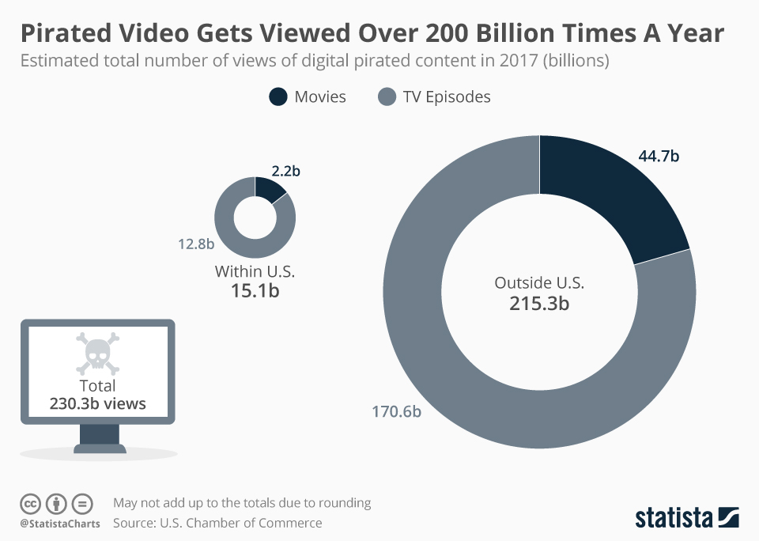
Digital media isn’t good for intellectual property
Kenneth Smith
Digital consumption is at an all time high
Pirating has become much more popular[1]
More and more piracy occurs when more and more content is pushed out
<Graphic as big as will fit>
[5]
Notes:
All of the content that we enjoy nowadays has been transferred online. The way we listen to music, the way we watch programs and movies and how we entertain ourselves with social media
People are finding ways to pirate digital media every time a new outlet or trend occur. Its important to know how prevalent digital media has become
Piracy has been happening for many years

Slide 21
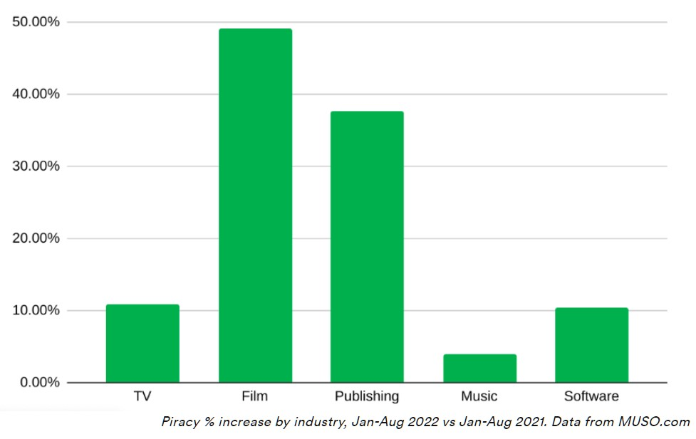
How piracy affects the entertainment industry
Kenneth Smith
Fewer people are watching movies in theaters nowadays
People download more movies and less people go into theaters
Fewer people in theaters which leads to fewer profits[2]
Writers and actors are on strike right now
<Graphic as big as will fit>
[1]
Notes:
It is harder for movies to reach higher box office numbers in comparison to the amount they spend to make and produce movies due to piracy
Since the pandemic, more and more people are pirating movies and shows off illegal websites so they don’t have to go out and pay to watch a show or a movie
Since less people will pay to stream or watch movies in theaters, less profits are made so less money can go to actors and content creators
The less money they get paid especially for the work conditions they are in, the more they get annoyed. This has lead to the writers strike recently which has delayed many shows and movies

Slide 22
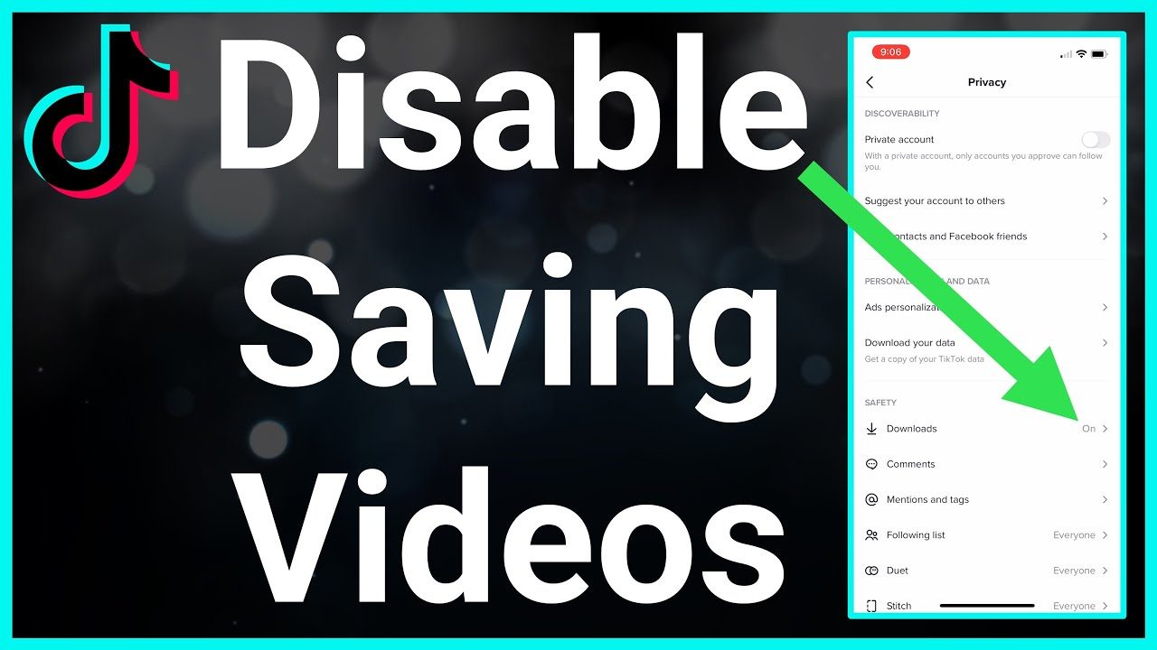
Piracy in social media
Kenneth Smith
You can download Tiktok’s and view offline
Online video downloaders to save without a watermark[3]
Creators won’t generate as much from their content
<Graphic as big as will fit>
[4]
Notes:
TikTok is this new social media outlet that lets you create videos and slideshows based off skits and dances
Creators have the ability to let their viewers save their videos but with a watermark so if they share the video, then the recipients of the videos can notice who made the video and possibly check out their content
But there are now TikTok video downloaders online so that they can get rid of the watermark so creators wont get any recognition anymore and people can post the same content and they wont be able to profit off their original content they put out
The creators make less money so they might be less inclined to make more videos, so less content is created

Slide 23
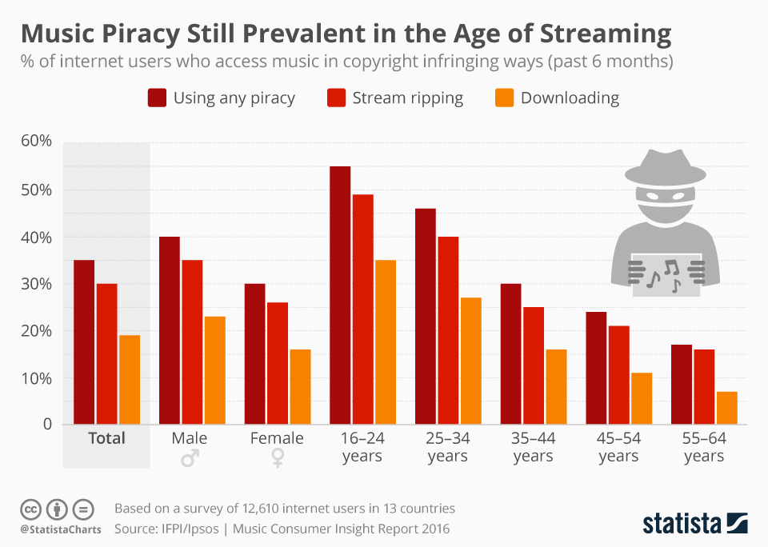
Piracy in Music
Kenneth Smith
People have been pirating music for years
People have used music downloaders to save music and not let artists collect streams[7]
Artists make less and less go to their pockets since they must split a lot of their money with their record companies
<Graphic as big as will fit>
[6]
Notes:
People have been illegally downloading music off websites for 2+ decades
When people illegally download music, the artists don’t get credit off that stream
So artists make less money
Many artists are in bad record deals so they lose even more money since a lot of their profits go to the record company and not the artists themselves

Slide 24
References
Kenneth Smith
[1] der Sar, Ernesto Van. “Online Piracy Continues to Rise With the US Firmly in the Lead.” TorrentFreak, 11 October 2022, https://torrentfreak.com/online-piracy-continues-to-rise-with-the-us-firmly-in-the-lead-221011/. Accessed 5 September 2023
[2] “Piracy in the Entertainment Industry & Legal Penalties.” Justia, 7 July 2023, https://www.justia.com/entertainment-law/piracy-in-the-entertainment-industry/. Accessed 6 September 2023.
[3] “Is It Ethical and Legal to Download TikTok Videos?” Plagiarism Checker, 2 January 2023, https://www.duplichecker.com/blog/is-it-ethical-and-legal-to-download-tiktok-videos.php. Accessed 6 September 2023.
[4] Nace, Trevor. “How To Turn Off Save Video On TikTok.” YouTube, 24 August 2022, https://www.youtube.com/watch?app=desktop&v=ujzWqrU202w. Accessed 6 September 2023.
[5] McCarthy, Niall. “Infographic: Pirated Video Gets Viewed Over 200 Billion Times A Year.” Statista, 26 June 2019, https://www.statista.com/chart/18507/stimated-total-number-of-views-of-digital-pirated-content/. Accessed 7 September 2023.
[6] Richter, Felix. “Infographic: Music Piracy Still Prevalent in the Age of Streaming.” Statista, 10 April 2017, https://www.statista.com/chart/8910/prevalence-of-music-piracy/. Accessed 7 September 2023.
[7] “The Effects of Piracy on Artists?” SharePro, 29 April 2023, https://www.sharetopros.com/blog/the-effects-of-piracy-on-artists.php. Accessed 7 September 2023.
…
Notes:
Links for my references
https://torrentfreak.com/online-piracy-continues-to-rise-with-the-us-firmly-in-the-lead-221011/#:~:text=Piracy%20is%20on%20the%20rise,after%20the%20 Covid%20release%20 slowdown. (der Sar)
https://www.justia.com/entertainment-law/piracy-in-the-entertainment-industry/#:~:text=Impact%20of%20Piracy%20on%20the%20Entertainment%20Industry&text=The%20entertainment%20industry%20loses%20billions,jobs%20and%20careers%20at%20risk. (“Piracy in the Entertainment Industry & Legal Penalties”)
https://www.duplichecker.com/blog/is-it-ethical-and-legal-to-download-tiktok-videos.php
https://www.youtube.com/watch?app=desktop&v=ujzWqrU202w (Nace)
https://www.statista.com/chart/18507/stimated-total-number-of-views-of-digital-pirated-content/ (McCarthy)
https://www.statista.com/chart/8910/prevalence-of-music-piracy/ (Richter)
https://www.sharetopros.com/blog/the-effects-of-piracy-on-artists.php#:~:text=Labels%20and%20artists%20and%20the,enough%20funding%20from%20the%20consumers.

Slide 25
The Fast, The Funny, and The Fair USE:
The Ethics of Short-Term Reaction Videos
Caleb French
Notes:
The fast, the funny, and the fair use: the ethics of short-term reaction videos

Slide 26
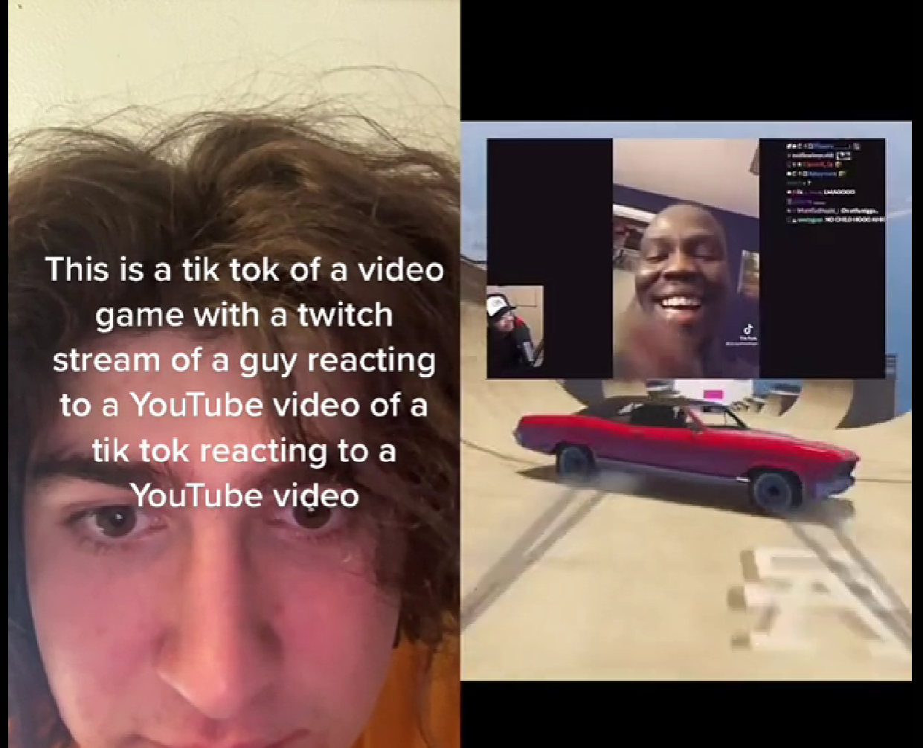
Short-Form reaction videos are abusing the notion of Fair use for profit
Caleb French
Do not substantially weigh enough into the 4 points of the Copyright Act to be considered “Fair Use”.[1]
Content is not nearly “transformative” enough to stand on its own
An ironic photo regarding reaction channels. [2]
Notes:
I think it’s safe to assume that everyone here at least generally knows what a tiktok is.
Most students know the general layout of a tiktok
A reaction is when you insert yourself into someone else’s video to presumable make some kind of comment of the media.
This photo is a man on tik tok reacting …
I believe content is not nearly “transformative” enough to stand on it’s own.

Slide 27
Section 107 of the Copyright ACT: Fair Use
Caleb French
What is the purpose and character of the use?
What is the nature of the work being copied?
How much of the copyrighted work is being used?
How will this use affect the market for the copyrighted work?
Notes:
So lets get into those four points. When weighing whether a case is fair use, Section 107 of the copyright act weighs the following:
What is the purpose and character of the use? What is the nature of the work being copied? How much of the copyrighted work is being used? And How will this use affect the market for the copyrighted work?
I believe that short form reactions weigh into the negative for enough of these questions to be considered as not fair use.

Slide 28
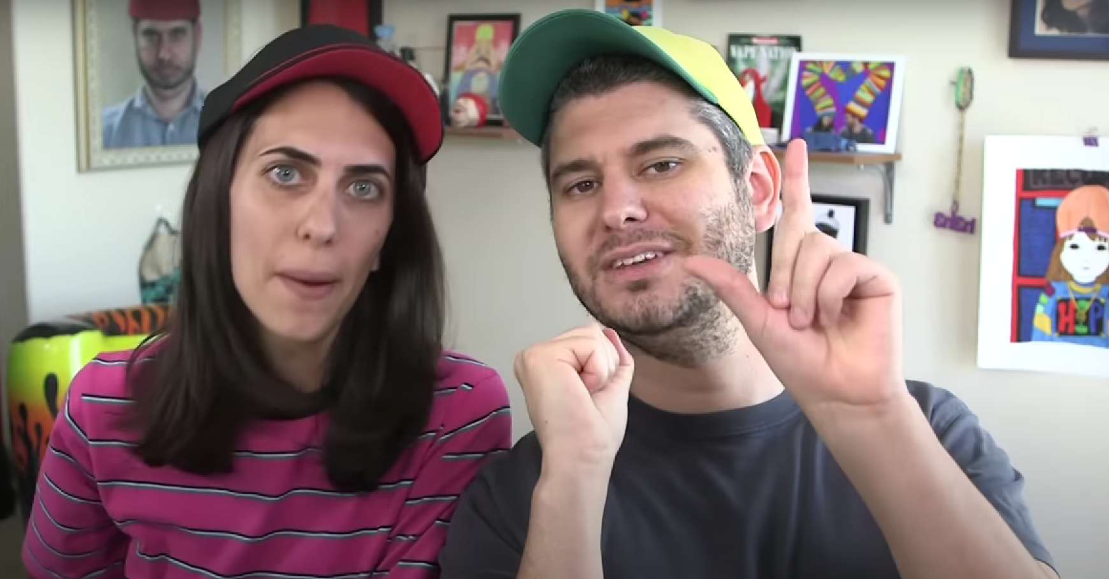
What Is The purpose and character of the USE?
Caleb French
Claims to be “commentary” have heavy weighing's on the “purpose and character” of the use [3]
Matt vs. Kleins included DMCA charge as well as a later defamation claim
Reactions are usually giving their own reactions, rather than actual criticism or commentary on the video itself.
Ethan and Hila Klein after winning landmark case. [4]
Notes:
The first question to be asked is “what is the purpose and character of the use.” in the past, the two categories that would be most relevant to be accepted as fair use would be if the content was some kind of either commentary (such as a criticism) or was transformative in nature. In 2016, in the Matt vs. Kleins case, Ethan and Hila Klein, also known on youtube as h3h3 productions, were prompted to takedown their video by another youtuber named Matt after he issued them a DMCA order, claiming a video they had made criticizing his video and using clips of was not fair use. Later, when they made a video talking about the case, he also send them a defamation claim. However, the Kleins stood their ground, and the court ruled that their commentary was found to be under fair use with heavy weighing on the “purpose and character” of the use, and because the video was a criticism of another, it was considered to be a classic example of criticism for fair use. Reaction do not necessarily fall under this category, since they are the people’s reactions, rather than actual criticism, which usually provide very little actual insight into the video itself brining to question the actual purpose of the use.

Slide 29
What Is The purpose and character of the USE?
Caleb French
Claim to be “transformative” in nature, with their reaction providing enough creativity to make it distinct.
Equals Three v. Jukin Media, 17 of 18 videos ruled “highly creative” through not only commentary but also voice over + creative editing [5]
Reaction videos show themselves in half of screen, not altering the actual video itself.
Notes:
Another claim could be that reaction videos are somehow “transformative” in nature, with the reaction providing enough creativity to make it distinct. In the Equals Three v. Jukin Media case, Equals three was sent a letter by Jukin Media indicating that they had infringed on their copyright by uploading videos containing clips that they had obtained licensing for. Equals Three responded by requesting the court to state that there videos were in fact fair use. In the ruling, they found 17 of the 18 videos to be “highly creative” through not only commentary but also voice overs and creative editing. Think taking something like clips of cats yawing and maybe drawing a mustache on it and making it say “man, am I so tired!” Reaction vidoes would also not fall into this “transformative” content section, as they will only show themselves on half of the screen, making no attempt to alter the video itself, and provide their reaction rather than actual commentary. Thus, there is not substantial evidence for reaction videos to have a clear purpose or character when creating their content.

Slide 30
What is the nature of work being copied?
Caleb French
This tends to vary greatly, since reaction channels will “react” to just about anything
Generally, only react to a single clip at a time.
Equals Three v. Jukon Media considered as slight weight. [5]
Mashups, with A vs. B versus a sophisticated mashup [1]
Notes:
The second point to consider is the nature of the work being copied. This can vary greatly, since reaction channels by nature will react to just about anything. What’s important to consider is that generally, they will only react to a single clip at a time. To look at how this section has been view in the past, we can look to the Equals three v. Jukon Media and find that it was considered only as slight weight. Still, in the book there was mention of Mashups, and while there is no official court case pertaining to them, it is generally viewed that something like an A vs. B mashup, which is comparable to a reaction tiktok since they are only reacting to a single clip, as apposed to a sophisticated maship where they would take many different clips to transform it into something new.

Slide 31
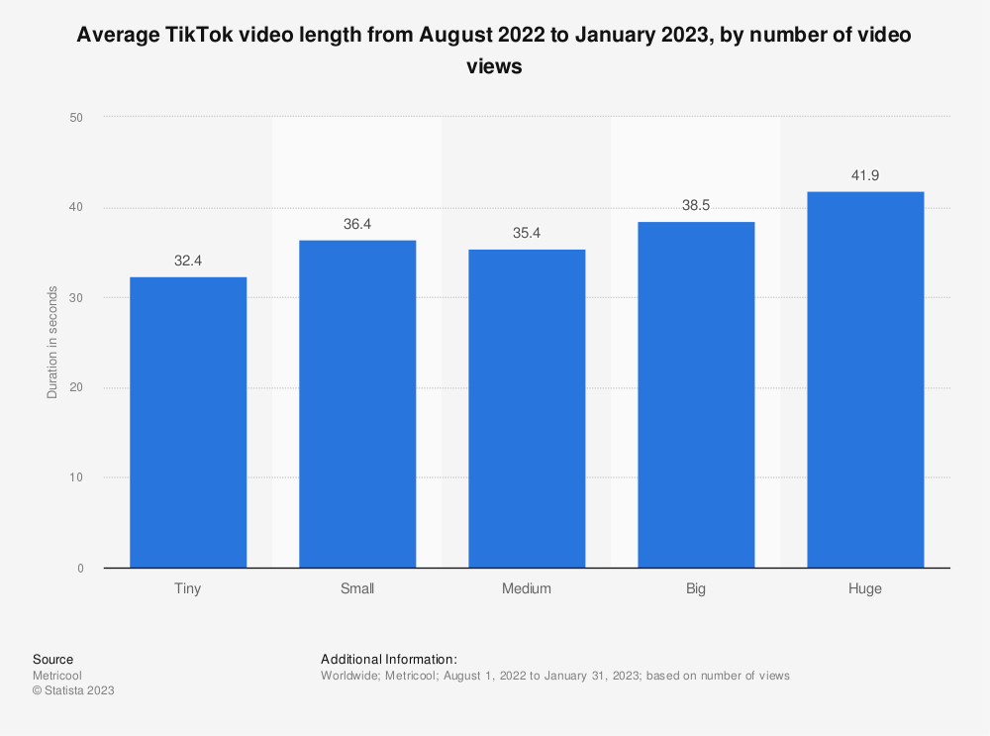
How much of Copyrighted Content is being used?
Caleb French
React channels will almost never show a work in its entirety, usually limiting to 10-15 seconds at best
The average length of a TikTok video is 35.4 seconds, half of the entire video is the content being reacted to [6]
Is it possible to make content that is transformative enough to be its own work in such a short timeframe?
Statistics on the average TikTok video Length. [6]
Notes:
Another being point when comparing fair use is how much of the copyrighted content is being used. While it’s true most react channels will almost never show a copyrighted work in it’s entirety, maybe 10-15 seconds at best, it’s important to consider the full length of the actual short-term video itself. The average length of tiktok in 2022 is 35.4 seconds, or in other words, at best half of the entire video is spent showing the copyrighted content on screen. While it makes sense, especially during a critism, to show a small clip of the work to be critisised and then spend a few minutes digesting what has just been shown and then giving your opinion on the matter, these videos are people simply talking over a video being played. This does bring into question if it is even possible to make content that is transformative enough to be its own work in such a short timeframe.

Slide 32
How will this use affect the market for the copyrighted work?
Caleb French
The main monetary issue posed by using others work in “reactions” is it will reduce views for the original creator
The actual amount of money generated by views alone is not significant when compared to the total income a reactor makes (only about $40-$50 per 1M views) [7]
The reaction channel may even give some exposure to the smaller channel
Notes:
Now, onto what I believe to be one of the more important parts behind short-term reactions and a large motivation for their existence: monetization. The question of “how will this use affect the market for the copyrighted work? A counter argument for this is that reaction channels actually don’t earn that much money from the views themselves. The actual payout for views on TikTok is .02 to .04 cents per 1000 views, meaning only about $40-50 per 1M views. Instead, they make most money through branding and sponsorships they do on their channel. They also could bring attention to smaller channels by showing the content, and bringing in a larger audience to enjoy the work.

Slide 33
How will this use affect the market for the copyrighted work?
Caleb French
While possible, it is not required to credit individuals who created original clips, so credit may not be given.
Most of the ways channels do make views is based off view count, with monetization through sponsorships will pay depending on views. [8]
By taking away views from smaller channels that are arguable more in need of those views, they are substantially affecting the market.
Notes:
These theories fall apart in practice, however. While it is possible for a channel to get exposure from their clips being played, it is not strictly required for credit to be given to the creators of videos in the reactions, and even when they are on a fast-moving platform like TikTok users are unlikely to spend the time searching for the account of the user who originally created the content. Also, most ways that users make money like Sponsorship or Branding almost always require a minimum view count and subscriber count to be considered, and for channels that create original content on such a fast moving platform, every view counts when they post, and by bigger channels taking away those views, they are substantially affecting the market.

Slide 34
References
Caleb French
[1] Michael J. Quinn, Ethics in the information age. (Addison-Wesley, 2020), pp. 469, 457
[2] willswagmoney; youtube.fe4r; imdontai; jaden smith; bigboi, #duet with @ttvfe4r_me_ this is also a tik tok… #mycrazyplayground, (TikTok, 4/30/2020), https://www.tiktok.com/@willswagmoney/video/7092553665176816939) 9/7/2023
[3] Lisa Danay, Critical Commentary Video Found To Be Fair Use, (E-TIPS ISSUE, 9/6/2017) https://www.dww.com/articles/critical-commentary-video-found-to-be-fair-use 9/7/2023
[4] Ethan Klein; Hila Klein, WE WON THE LAWSUIT!, (Youtube, 8/23/2017) https://www.youtube.com/watch?v=9eN0CIyF2ok&ab_channel=h3h3Productions 9/7/2023
[5] Jason Harow, Fair Use, Viral Videos, and Correcting the Record About the Jukin Case (Tremaine LLP., September 2016) https://www.dwt.com/blogs/media-law-monitor/2016/07/fair-use-viral-videos-and-correcting-the-record-ab 9/7/2023
[6] Ceci L, TikTok: video duration 2022-2023, by video views, (Statista, 3/17/2023) https://www.statista.com/statistics/1372569/tiktok-video-duration-by-number-of-views/#:~:text=From%20August%202022%20to%20January,around%2036.4%20seconds%20in%20length 9/7/2023
[7] Kelsey McLellan, How Much Does TikTok Pay You?, (The Leap, 6/2/2023) https://www.theleap.co/blog/how-much-does-tiktok-pay/#:~:text=Top%20creators%20say%20that%20TikTok,more%20monetization%20tips%20for%20creators. 9/7/2023
[8] Neal Schaffer, How Much Does TikTok Pay Content Creators and Influencers? (WordPress, 8/5/2023) https://nealschaffer.com/how-much-does-tiktok-pay/ 9/7/2023

Slide 35
Who owns AI Art?
Nicholas Giangregorio

Slide 36
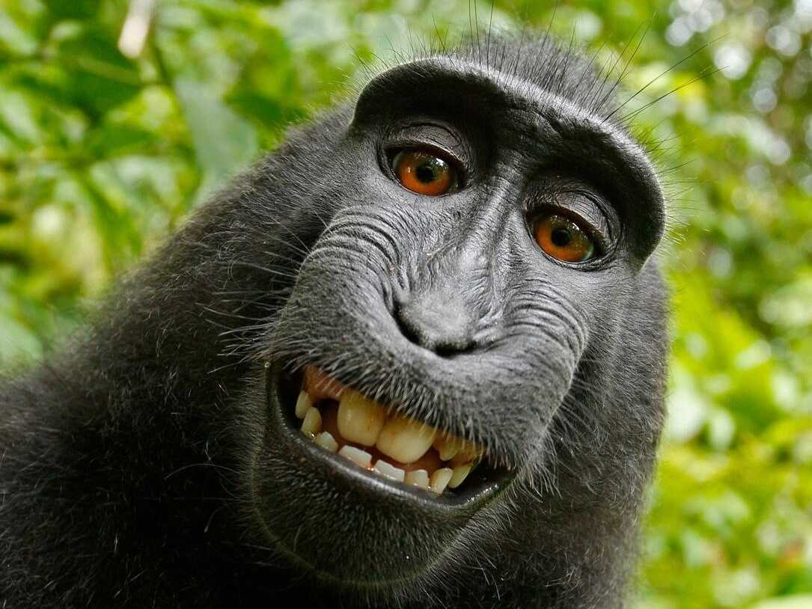
Can non-humans own copyrighted material?
Nicholas Giangregorio
Consider the case of Naruto the Macaque
PETA sued, claiming that the photo belongs to the monkey [1]
Courts ruled in favor of photographer David Slater
The same can almost certainly be applied to machines
One of the many photos taken by Naruto [1]
Notes:
- 2011
- Took a photographer’s camera and took multiple selfies, possibly unintentional
- PETA argued that since the monkey took the picture, the photographer didn’t own it
- Clearly shows that an ai cannot own an image or other work
- The right to own a copyright is reserved to humans only

Slide 37
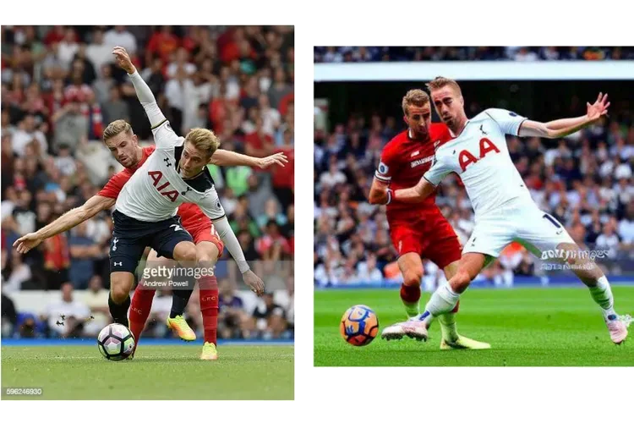
What about the images that train AI models?
Nicholas Giangregorio
In January Getty Images sued Stability AI [2]
Around the same time, three artists filed a class action lawsuit against multiple AI developers [3]
Is this considered a “derivative work”?
A comparison between photo on Getty Images and an image generated using Stable Diffusion [2]
Notes:
- AI models need to be trained with sample images
- How can this affect if AI images can be copyrighted?
- Stability AI created Stable Diffusion, one of the most popular
- Artists sued Stability and Midjourney
- AI images could accurately mimic the style of an artist
- No answers yet
- Although they probably won’t win, this could help to support that these images cannot be copyrighted

Slide 38
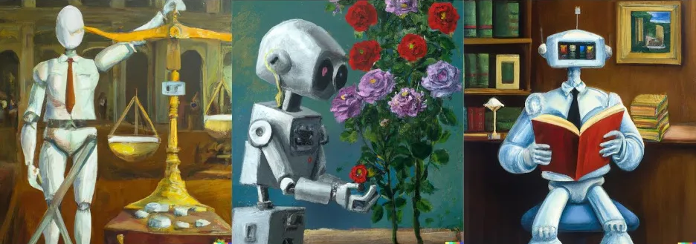
Simple conclusion
Nicholas Giangregorio
AI art cannot be copyrighted by itself.
According to copyright.gov, copyrighted works need to have “a human author and have a minimal degree of creativity” [4]
Interestingly, AI generated content can be used for a copyrighted work [5]
A series of artistic images generated using DALL·E 2 [5]
Notes:
- Thankfully when it comes to copyright laws
- Very clear that AI art by itself cannot be copyrighted
- AI art can be used as part of a larger work if it meets a certain amount of originality and human creativity
- Picture is AI generated, and therefore not copyrighted

Slide 39
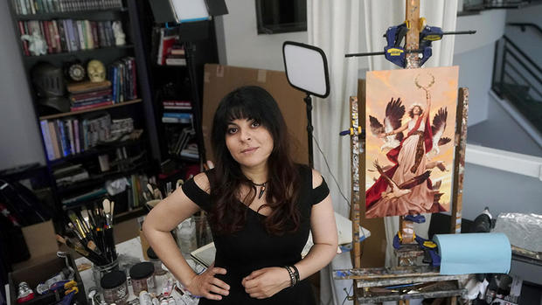
There are still many questions
Nicholas Giangregorio
Who actually OWNS these images?
Think back to Kelly v. Arriba Soft… [6]
People who created the model, or the people who wrote the prompts?
Only time will tell
Karla Ortiz, currently suing multiple AI companies [3]
Notes:
- While copyright had a simple answer, it’s hard to say from a moral standpoint
- Although there isn’t a lot of things to compare this to (very modern problem)…
- Was in the reading
- Judge ruled that the use of Kelly’s images was fair, so this could too
- It is quite likely that this lawsuit will have the same outcome, Getty lawsuit is more likely to be successful
- Pictured is Karla Ortiz, one of the three artists suing Stable Diffusion and Midjourney
- If the artists don’t own the work, then who should?
- We don’t have the answers yet, these events are unfolding in real time

Slide 40
References
Nicholas Giangregorio
[1] Jason Slotkin, “'Monkey Selfie' Lawsuit Ends With Settlement Between PETA, Photographer”, (9/12/17), https://www.npr.org/sections/thetwo-way/2017/09/12/550417823/-animal-rights-advocates-photographer-compromise-over-ownership-of-monkey-selfie
[2] James Vincent, “Getty Images sues AI art generator Stable Diffusion in the US for copyright infringement”, (02/06/23) https://www.theverge.com/2023/2/6/23587393/ai-art-copyright-lawsuit-getty-images-stable-diffusion
[3] CBS News. “Visual artists sue AI companies in SF federal court for repurposing their work”, (08/21/23) https://www.cbsnews.com/sanfrancisco/news/ai-visual-artists-fight-back-repurposing-work-sf-federal-court/
[4] “What is Copyright?” https://www.copyright.gov/what-is-copyright/
[5] Atreya Mathur, “Art-istic or Art-ificial?”, (11/21/23) https://itsartlaw.org/2022/11/21/artistic-or-artificial-ai/
[6] United States Court of Appeals for the Ninth Circuit. Leslie A. Kelly
v. Arriba Soft Corporation, 336 F.3d 811 (July 7, 2003).

Slide 41
Class 5
The End
Keith A. Pray
socialimps.keithpray.net
Notes:
This is the end. Any slides beyond this point are for answering questions that may arise but not needed in the main talk. Some slides may also be unfinished and are not needed but kept just in case.

Slide 42
what works well Online With Zoom
Sign in with First and Last Name
Stay muted unless you are going to speak
To speak use the raise your hand feature
To answer yes/no questions use the “yes” ”no” buttons
Turn your camera on
Wait until the end of student presentations to ask questions
  Write them down so you don’t forget

