Slide 1
Class 14
Last Day
Keith A. Pray
socialimps.keithpray.net

Slide 2
Notes:
Automation Paper results. This term’s additions in RED

Slide 3
Papers
Good improvement
More Clear Conclusions
Significant Counter Points
Notes:
Save for next time:
Clearly state conclusion
First statement preferred
Absolute statements are difficult to prove
Avoid: all, always, any, every, everyone, never, none… unless you can show it
Be sure to put quotes around entire quote
Hyperbole is the best thing ever!
but not in these papers
Print 2 sided and save a tree
Use template, saves time (and -1 point)
Include Counter Point and Response
Include Author, Title, Publish Date, Publisher for references
Read paper aloud to proof

Slide 4
Grades
To Date
70 Max Possible
- Discussion 1-13
- Papers 1-4

Slide 5
Overview
Reminder: Course and Group Evaluations
Class 14:
  Students Present
  Students’ Choice

Slide 6
Planned Obsolescence in Tech
And Why it Isn’t Cool
Alexandra McFann

Slide 7
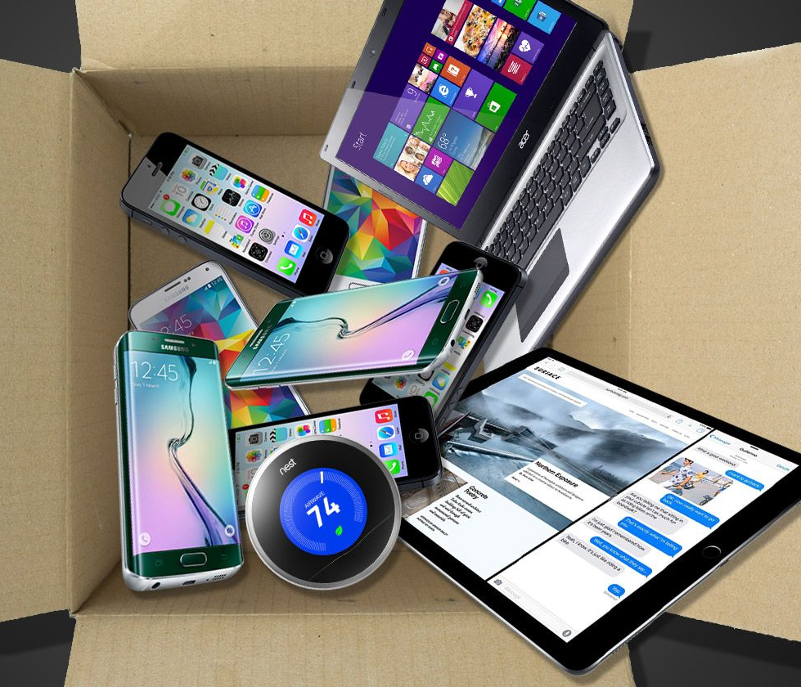
What is Planned Obsolescence?
Alexandra McFann
The business tactic of producing goods that will become obsolete and need replacing with a new product.
Strategies include stopping production on replacement parts, using poor materials, not allowing third party repairs, pushing out new models with minor changes, etc. [1]
<Graphic as big as will fit>
Notes:
The business tactic of producing goods that will become obsolete and need replacing with a new product.
Strategies include stopping production on replacement parts, using poor materials, not allowing third party repairs, pushing out new models with minor changes, etc. [1]es include stopping production on replacement parts, using poor materials, not allowing third party repairs, pushing out new models with minor changes, etc. [1]

Slide 8
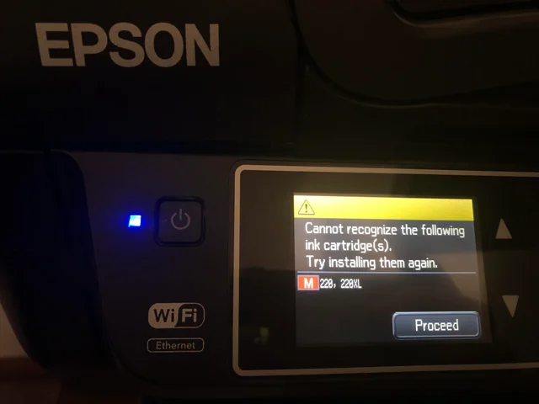
Who is Profiting From This?
Alexandra McFann
The largest tech companies benefit massively from planning their own products’ deaths, or ‘persuading’ previous buyers to upgrade.
Printers are also notorious for these actions, refusing services, when ‘low’ on ink not being used in the print, etc.
<Graphic as big as will fit>
Notes:
The largest tech companies benefit massively from planning their own products’ deaths, or ‘persuading’ previous buyers to upgrade.
Printers are also notorious for these actions, refusing services, when ‘low’ on ink not being used in the print, requiring part replacements to be used, or even sensing cartridges not made by the printer’s manufacturer.

Slide 9
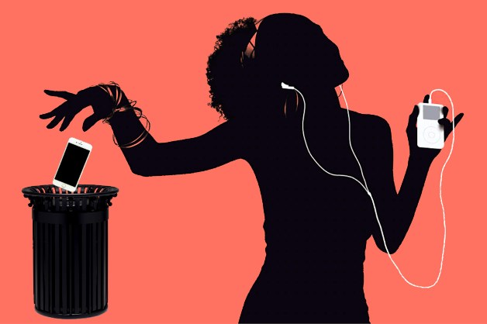
Who is Profiting From This?
Alexandra McFann
Apple sued in 2021, by Portuguese organization Deco Proteste for pushing updates that slow iPhones from generation 6.[3]
Apple sued a Norwegian small business owner for, ‘importing counterfeit phone screens’ for repairing local iPhones.
  Business owner Henrik Huseby believes “This is a big victory for companies like Apple who want to shut down small businesses like mine and control the prices of repair. They can claim that the cost of changing a screen will be the same as buying a new one, so there is no value in repairing. “ [4]
Notes:
Apple sued in 2021, by Portuguese organization Deco Proteste for pushing updates that Apple did not mention would slow performance of iPhones from generation 6.[3]
Apple sued a Norwegian small business owner for, what they claim, ‘importing counterfeit phone screens’ for repairing local iPhones.
Local court ruled in his favor in 2018.
However the court of appeal and the Supreme Court ruled in Apple’s favor in 2019.
Business owner Henrik Huseby believes “This is a big victory for companies like Apple who want to shut down small businesses like mine and control the prices of repair. They can claim that the cost of changing a screen will be the same as buying a new one, so there is no value in repairing. “ [4]

Slide 10
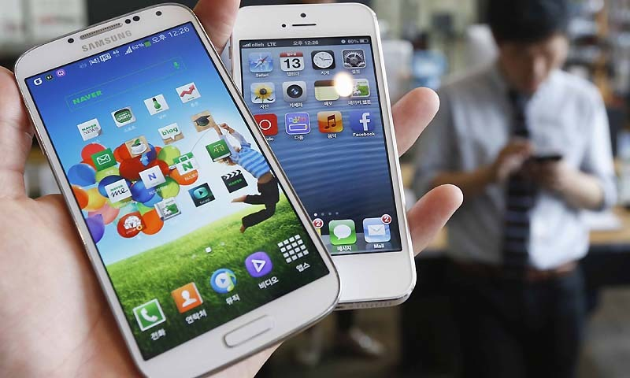
Who is Profiting From This?
Alexandra McFann
Samsung fined $5.7 million in 2018 in Italy, for pushing updates that slow older phone models, similar to Apple. [5]
Samsung phone batteries are frequently glued down, making it impossible to replace or repair without special equipment or knowledge. [6]
Notes:
Samsung fined $5.7 million in 2018, by the Italian Authority for Market and Competition, for pushing updates that slow older phone models, similar to Apple. [5]
Samsung phone batteries are frequently glued down, making it impossible to replace or repair without special equipment or knowledge. [6]

Slide 11
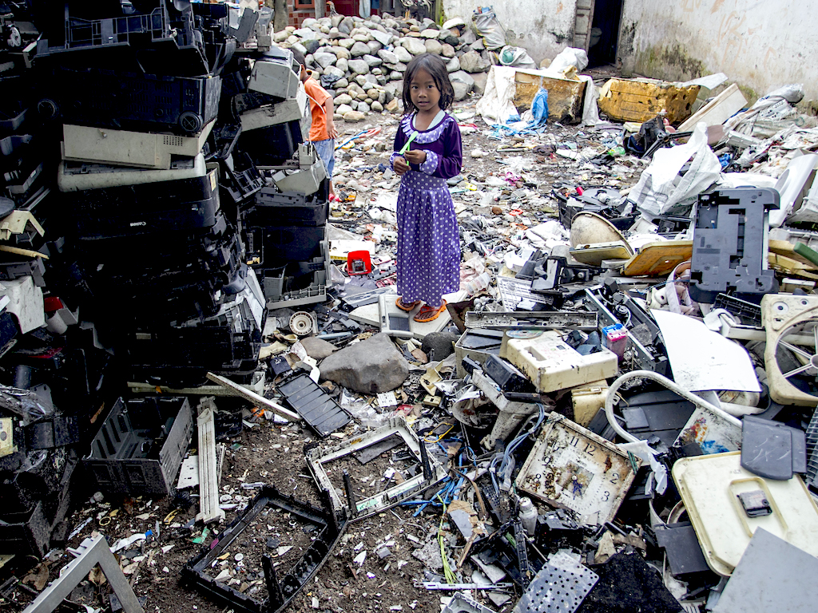
Other Than Dishonest Practices, What Else is Wrong With This?
Alexandra McFann
50 million tons of e-waste, discarded electronic parts, was created in 2019 alone, only 20% got recycled. [2]
Processed metals used in these electronics, like copper, lithium, and mercury, leach into and poison the environment.
<Graphic as big as will fit>
Notes:
50 million tons of e-waste, discarded electronic parts, was created in 2019 alone, only 20% got recycled. [2]
Processed metals used in these electronics, like copper, lithium, and mercury, leach into and poison the environment.

Slide 12
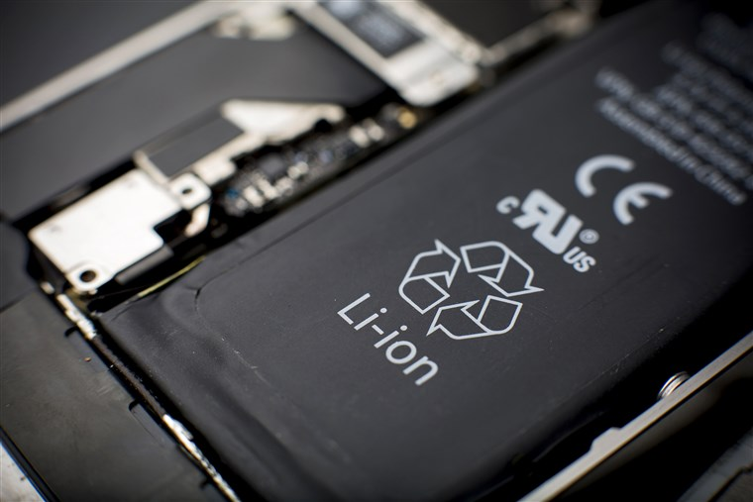
More Trouble With Waste!
Alexandra McFann
Lithium-ion batteries, used in modern electronics for their efficiency, may light fires in transport or at the landfills they end up in. [7] Unfortunately, only 5% of lithium-ion batteries get recycled. [8]
Notes:
Lithium-ion batteries, frequently used in modern electronics, may light fires in transport or at the landfills they end up in. [7] Unfortunately, only 5% of lithium-ion batteries get recycled. [8]

Slide 13
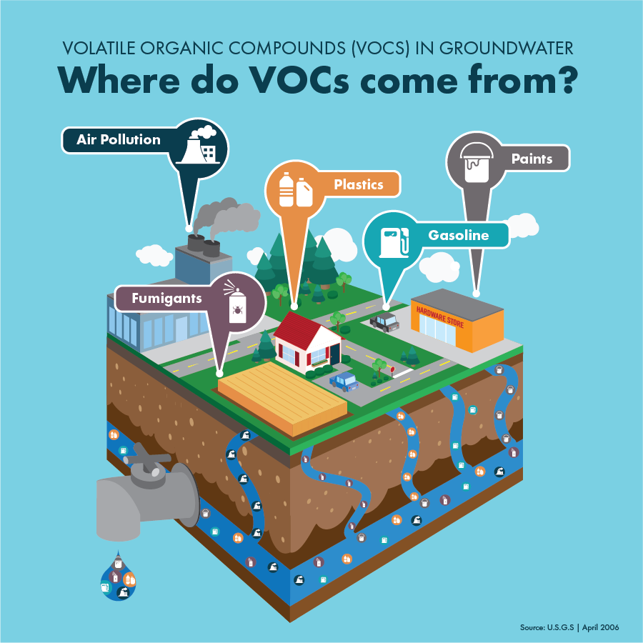
More Trouble With Waste!
Alexandra McFann
Printers and their cartridges are also a chemical hazard. Commercial cartridges use volatile organic compounds, which easily evaporate into the air, get into the soil, and contaminate water. [9]
The mining of metals used in the mass production of the products contaminates the environment. [11]
Notes:
Printers and their cartridges are also a chemical hazard. Many popular ink cartridges use volatile organic compounds, which easily evaporate into the air, get into the soil, and contaminate water. [9] The non-biodegradable plastic in non-refillable and non-reusable cartridges also cause a lot of greenhouse gas emissions in their productions.
The mining of metals used in the products causes tailings, the waste materials after the target mineral is extracted, which seeps into the environment and contaminates it, and then the smelting process also releases pollutants into the air and earth.

Slide 14
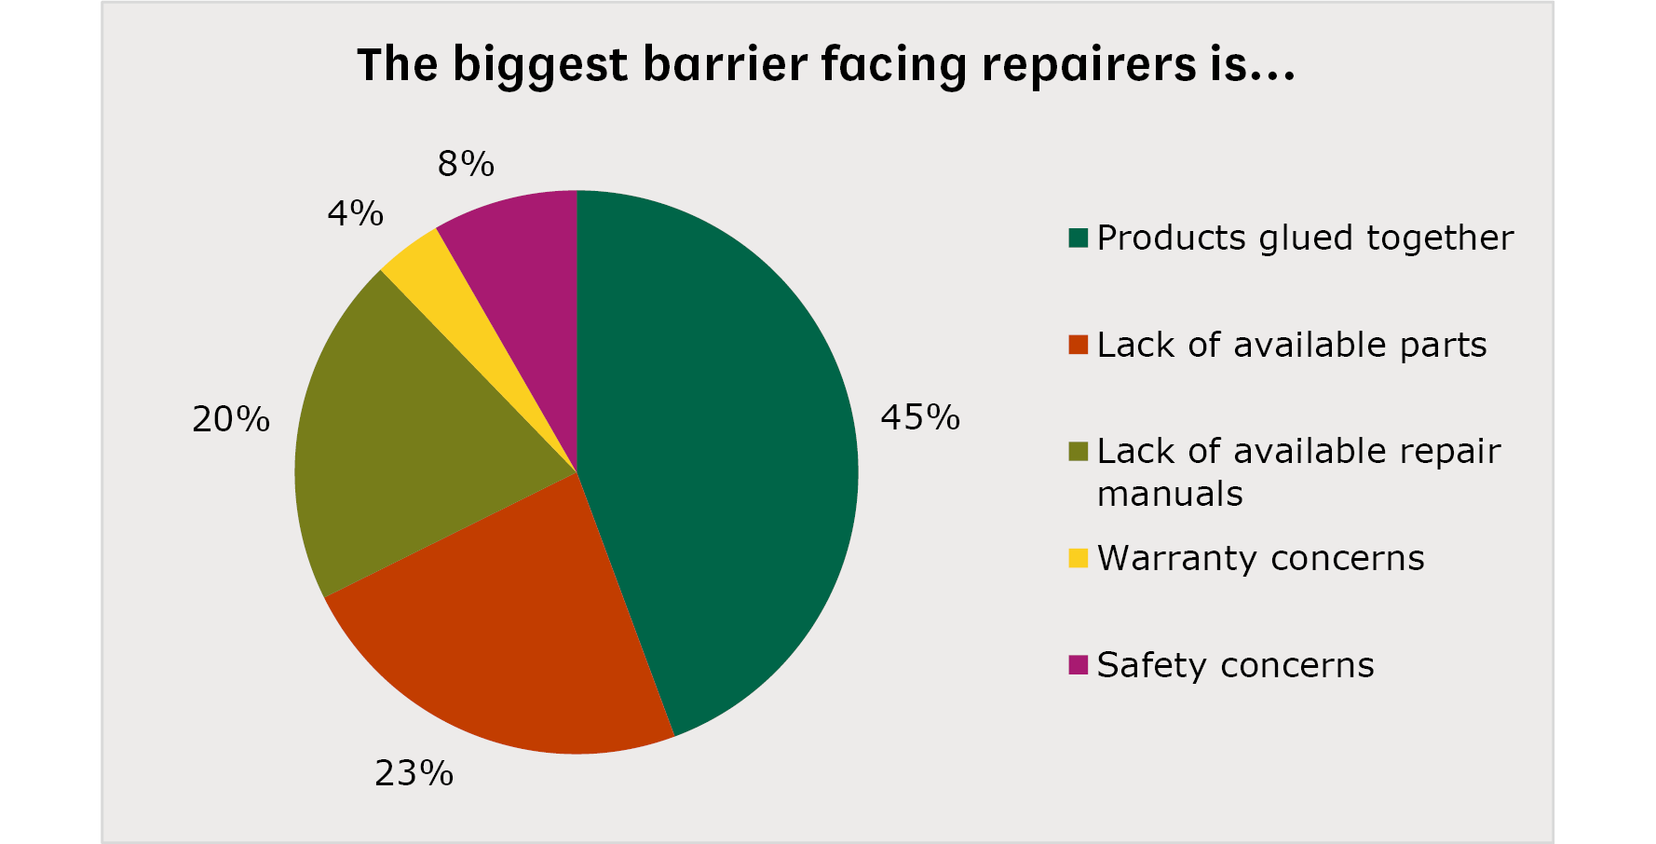
So How Could Tech Companies Change This?
Alexandra McFann
Improve electronic product durability, reducing the need for part replacements and waste.
  “...extending the lifetime of all washing machines, smartphones, laptops and vacuum cleaners in the EU by one year would lead to annual savings of around four million tonnes of carbon dioxide by 2030…”[10]
Increase fines against producers that decrease effectiveness of old products intentionally.

Slide 15

So How Could Tech Companies Change This?
Alexandra McFann
Encouraging their consumers to bring back their old products to be recycled, reducing e-waste and putting material into products to reduce costs.
Make repair easier
  Not use unique screw shapes.
  Not glue down parts.
  Not remove warranty benefits for third-party repairs.

Slide 16
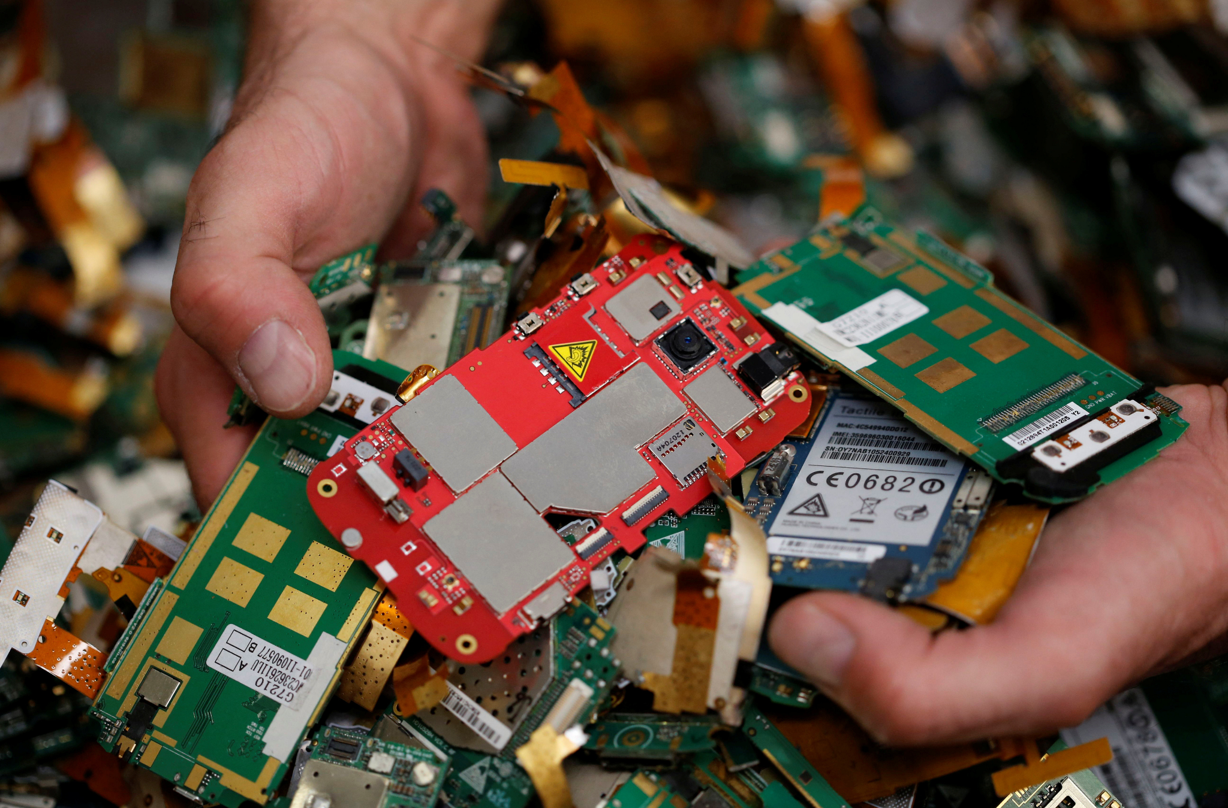
So How Could Tech Companies Change This?
Alexandra McFann
While, as consumers, we don’t have a lot of power over producers, we can still work together to push for change.
We can encourage lawmakers and enforcers to pass legislation to protect consumers and the environment, and punish tech companies that place profits over the earth.

Slide 17
REFERENCES
Alexandra McFann
[1] Kramer, K.-L. (n.d.). Planned obsolescence. Planned Obsolescence - an overview | ScienceDirect Topics. Retrieved May 2, 2022, from https://www.sciencedirect.com/topics/computer-science/planned-obsolescence
[2] Harris, J. (2020, April 15). Planned obsolescence: The outrage of our electronic waste mountain. The Guardian. Retrieved May 2, 2022, from https://www.theguardian.com/technology/2020/apr/15/the-right-to-repair-planned-obsolescence-electronic-waste-mountain
[3] Adorno, J. (2021, March 1). Apple hit with new lawsuit over alleged iPhone 'planned obsolescence,' this time in Portugal. 9to5Mac. Retrieved May 2, 2022, from https://9to5mac.com/2021/03/01/apple-lawsuit-portugal-planned-obsolescence/
[4] Mikolajczak, C. (2020, June 5). Apple crushes one-man repair shop in Norway's Supreme Court, after three-year battle. Right to Repair Europe. Retrieved May 2, 2022, from https://repair.eu/news/apple-crushes-one-man-repair-shop/
[5] Young, S. D. (n.d.). Samsung fined millions for slowing down phones through updates. ConsumerAffairs. Retrieved May 2, 2022, from https://www.consumeraffairs.com/news/samsung-fined-millions-for-slowing-down-phones-through-updates-102518.html
[6] Purdy, K. (2020, September 24). What you should know before you fix: Samsung Phones: IFixit News. iFixit. Retrieved May 2, 2022, from https://www.ifixit.com/News/44164/what-you-should-know-before-you-fix-samsung-phones#:~:text=There's%20a%20whole%20batch%20of,applying%20chemicals%2C%20then%20applying%20force.
[7] Environmental Protection Agency. (n.d.). Frequent Questions on Lithium-ion Batteries. EPA. Retrieved May 2, 2022, from https://www.epa.gov/recycle/frequent-questions-lithium-ion-batteries#:~:text=Lithium%2Dion%20(Li%2Dion,or%20at%20landfills%20and%20recyclers.

Slide 18
REFERENCES
Alexandra McFann
[8] Wallace, J. (2021, October 27). Wave of investment just the beginning for EV Battery Recycling. Waste Dive. Retrieved May 2, 2022, from https://www.wastedive.com/news/lithium-ion-battery-recycling-ev-li-cycle-retriev/608778/#:~:text=The%20industry%20is%20familiar%20with,recycled%2C%20according%20to%20the%20DOE.
[9] How do printers impact the environment. WiZiX Technology Group. (2020, September 9). Retrieved May 2, 2022, from https://wizixtech.com/printing-impacts-on-the-environment/#:~:text=Ink%20Cartridges&text=The%20chemicals%20in%20printer%20ink,landfill%20or%20worse%2C%20the%20ocean.
[10] Electronic waste and the circular economy. Preventing E-waste and Using Resources Better. (n.d.). Retrieved May 2, 2022, from https://publications.parliament.uk/pa/cm5801/cmselect/cmenvaud/220/22007.htm
[11] How can metal mining impact the environment? American Geosciences Institute. (2019, July 12). Retrieved May 2, 2022, from https://www.americangeosciences.org/critical-issues/faq/how-can-metal-mining-impact-environment#:~:text=If%20not%20prevented%20or%20controlled,impact%20stream%20habitats%20and%20groundwater.&text=At%20some%20sites%2C%20gas%20and,health%20concerns%20and%20environmental%20impacts.

Slide 19
Social Media Is a vector for Propaganda and Misinformation
Matthew Adragna

Slide 20

Political misinformation AND PROPAGANDA
Matthew Adragna
<raphic as big as will fit>
2016 Russian interference in US Election
  263,769,228 engagements with Russian backed content[1].
  Misinformation across the political spectrum.
Russian misinformation campaigns employed falsehoods to influence the public
  Lies spread faster than the truth.
The post that drew the most attention featuring Trump – based off a conspiracy theory that Obama had refused to ban Sharia law. This photo was shared 312,632 times.[1]
Notes:
2016 Russian interference in US Election
263,769,228 engagements with Russian backed content[1].
The amount of engagement was extremely significant.
Example:
The photo on the right which shows how something as easily fact checkable as this was widely spread without any research
-- People are unlikely to check if something is true before spreading it
An estimated 4.9% of and 6.2% of the liberal and conservative users respectively were bots.[2]
Although the misinformation has been seen as a mostly conservative problem it actually affects both sides and achieved its goal of creating discord between the two major sides of the American political system.
Russian misinformation campaigns employed falsehoods to influence the public
According to a 2018 MIT study falsehoods are 70% more likely to be retweeted than the truth and reach their first 1500 people 6 times faster[2].
This is extremely concerning as it shows that people do not infact check before they spread and that people will not only believe false information but also spread it at such a large scale shows how big of a problem this is and can become.

Slide 21
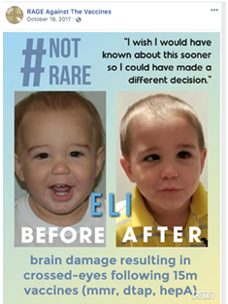
SOCIAL MEDIA USED TO SPREAD Medical MISINFORMATION
Matthew Adragna
COVID-19 Vaccine Misinformation
  Social media was a breeding ground for misinformation during the pandemic.
People rely on social media to search for health information
  Many people in the U.S. use social media as a way of researching health information.
False information on Facebook[6]
Notes:
COVID-19 Vaccine Misinformation
Google searches from the US for Vaccination yielded only 29% pro-vaccination and 71% anti-vax pages[4].
An estimated 58 million followers on anti-vax pages across social media[4].
Pro-vaccination videos received more views but anti-vax videos were shared and liked by more users[6].
It’s worrying that not only was there some much interaction inside of these vaccine misinformation groups but that the algorithms that recommend pages such as google’s* had recommended these as often as they did.
mention Warnings of misinformation by companies such as youtube and twitter
People who already bought into the mentality of these groups unlikely to care
People rely on social media to search for health information
In the U.S. 8/10 internet users search for health info online and 74% of those users use social media to access health information[4].
Whilst looking online for health info is not necessarily a bad thing, trusting your unqualified peers to spread that info certainly is. People should not be using social media as a way to access health information as social media is meant for social interactions and not as a medical forum.
People should look at more reliable and qualified sources when researching such important topics and should look for second or third confirmations to what they have read from similarly trusted sources.

Slide 22
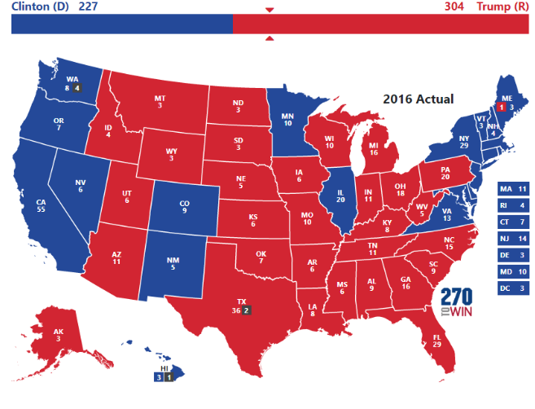

Does it even matter
Matthew Adragna
Misinformation’s influence on the 2016 election
  Knowing the exact impact of Russia’s misinformation campaign is impossible.
Medical Misinformation
  In 2019, the World Health Organization listed vaccine hesitancy in the top ten biggest threats to global health.[6]
  Anti-Vax population greatly increased.
2016 election map.
Descriptive statistics of spreaders, i.e., users who retweeted Russian trolls.
Notes:
Misinformation’s influence on the 2016 election
Knowing the exact impact of Russia’s misinformation campaign is impossible.
However the impact did not have to be huge as
Trump won Michigan Pennsylvania and Wisconsin by a margin of 77,744 votes combined.
The close election results in certain swing stats shows that even if the impact was small that does not mean it was insignificant so it’s highly possible that the misinformation campaign had successfully swung the result of the election.
Medical Misinformation
Proportion of anti-vaccine users doubled (8.1% -> 16%) from 2015-2018[6]
In 2019, the World Health Organization listed vaccine hesitancy in the top ten biggest threats to global health.[6]
Social media has been integral to the growth of communities surrounding misinformation leading to such growth as ( Proportion of anti-vaccine users doubled (8.1% -> 16%) from 2015-2018[6] ).
This growth has led to unidentifiable amounts of problems such as the unknown number of people who may have died of Covid due to their beliefs in spread misinformation.
The World Health Organization’s listing of vaccine hesitancy as such a huge threat shows how large the issue has become uncontrolled.

Slide 23

Conclusion
Matthew Adragna
Social Media has become a hub for spreading misinformation.
  People should be more mindful of what they read on social media and should instead seek news from trusted outlets.
Notes:
Conclusion:
Social Media has become a hub for spreading misinformation.
While social media is the medium for the spread of misinformation it is not the only issue.
People should be more mindful of what they read on social media and should instead seek news from trusted outlets.
Social media should also have more review tools and warnings for misinformation or alternatively could seek to educate their users to some extent on the unverifiability of truth from posts made on their platform.
Social media should be used as a place to allow for social interaction in places or times where we would otherwise be disconnected from each other, not as a place that is used to gather information and form our opinions.
Twitter -> elons plans (free speech?)

Slide 24
References
Matthew Adragna
1. (Ken Dilanian and Ben Popken, Russia favored Trump, targeted African-Americans with election meddling, reports say)https://www.nbcnews.com/politics/politics-news/russia-favored-trump-targeted-african-americans-election-meddling-reports-say-n948731
2. (Sara Brown, MIT Sloan research about social media, misinformation, and elections
)https://mitsloan.mit.edu/ideas-made-to-matter/mit-sloan-research-about-social-media-misinformation-and-elections
3. (Adam Badawy, Emilo Ferrara, Kristina Lerman, Analyzing the Digital Traces of Political Manipulation: The 2016 Russian Interference Twitter Campaign
)https://ieeexplore.ieee.org/abstract/document/8508646
4. (Staci L Benoit, Rachel F. Maudlin, The “anti-vax” movement: a quantitative report on vaccine beliefs and knowledge across social media
)https://bmcpublichealth.biomedcentral.com/articles/10.1186/s12889-021-12114-8
5. (Steven Lloyd Wilson, Charles Wiysonge, Social media and vaccine hesitancy)https://gh.bmj.com/content/5/10/e004206
6. (Rachel Jaffe, Social media's effect on vaccination rates
)http://d-scholarship.pitt.edu/37767/
7. (Phillip Elliot, The Mueller Report Is Embarrassing for Trump. But It Doesn't Call Into Question His 2016 Win
)https://time.com/5573537/mueller-report-russia-election-interference/

Slide 25
Robot Surgeon FOR ME!
Matthew Amodea

Slide 26

Would you receive surgery from a Robot?
Matthew Amodea
2 scenarios to consider
  Appendix removal in the current era
  Removal of brain tumor in the future
My answer
  I would opt for surgery with robotic assistance in both scenarios.
Notes:
Image source: https://www.bbc.co.uk/bbcthree/article/4a466b39-8b03-4717-bde8-822760b430fa

Slide 27
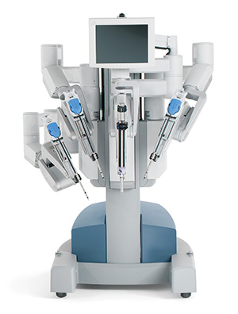
Robotics in current medical industry
Matthew Amodea
Teleoperated manipulators
  DaVinci Surgical System
“Keyhole Surgery”
  Typical procedure examples:
    Gallbladder removal
    Cancer removal
    Mitral valve repair
    Kidney transplant
Notes:
Image source: https://www.uchealth.com/services/robotic-surgery/patient-information/davinci-surgical-system/
current age surgery robots are not technically robots, rather they are highly precice teleoperated manipulators
“Keyhole surgery” also known as laparoscopic surgery
faster recovery time than traditional open surgery
Gallbladder removal
Tubal ligation
Hysterectomy
Mitral valve repair
Kidney transplant
Cancer removal
between their advent in 2008 to 2019, over 110,000 operations have been completed in china

Slide 28
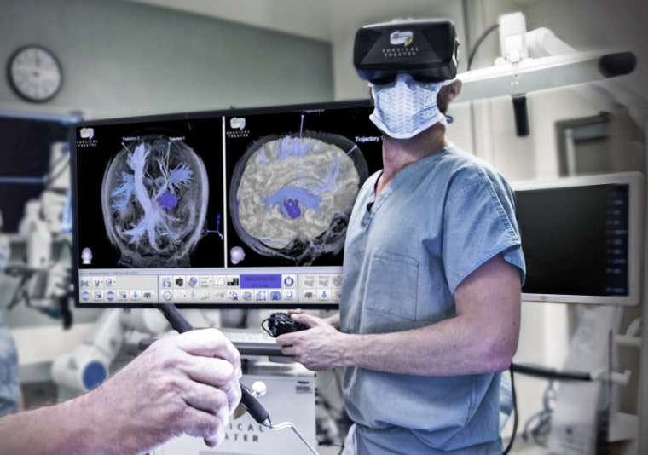
Future of robotics and Ai in surgery
Matthew Amodea
It is unlikely that the surgeon will be removed entirely from the operating room
  Humans are smart, not perfect.
  Robots are “perfect”, not smart.
Researchers' current goals?
  Human in the loop assisted surgery
    Visual movements
    Heart rate
    Sweating
    Posture
    Brain activity
Notes:
Image source: https://www.nbcnews.com/mach/science/3-ways-virtual-reality-transforming-medical-care-ncna794871
Future of robotics and AI in surgery?
removing the surgeon from the equation
unlikely, because humans are smart not perfect, robots are perfect, not smart
feedback between ai robot and surgeon in the near future.
the ideal senero involves
human in the loop assisted surgery
check slide for paramerters the robot will consider from the surgeon
this will create a feedback loop between surgeon and robot
The idea is to have the human and the computer algorithms collaborate. The computer offers the ability to recognize and identify patterns in large data sets. The surgeon will be able to make sense of the “messiness” of the human body. This collaboration will raise surgery standards from their current levels.

Slide 29
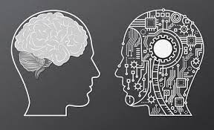
Issues of surgical ai and robotics
Matthew Amodea
What is to become of the surgeon?
  Supplementary role?
Loss of surgical skills across the profession
AI and morality
  Decisions during surgery are often made by those present in the operating room, and the pros and cons of pre and post op care are weighed to create a morally agreed upon group decision
  Will the AI have the moral agency to make these types of decisions?
Notes:
Image source: https://www.mygreatlearning.com/blog/can-a-i-mimic-the-human-brain/
Issues that come as a result of the future with robotics
What becomes of the surgeon?
supplemtary role?
delegated to only making high level decisions?
will the ai have a sense of ethics and morals if trusted to make decisions?
most decisions in surgery are decided based on pros and cons and their pre post op care are weighed up
this is often a collaborative process including surgical and nursing staff
loss of surgical skills due to dependency of the robot assistance. The skills involving classic open surgery may fade over time
could an Ai have the moral agency to make these types of decisions
if so, the robot would have to show proof of self reflection to prove it is capibale of sustaining and refining its personal moral compass.

Slide 30
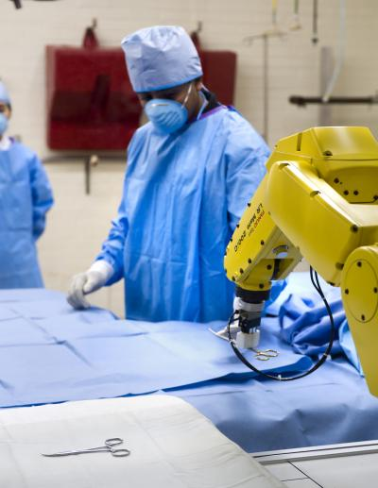
Robots in surgery are here to stay
Matthew Amodea
Any reduction of risk to the patient justifies the development of this technology
The current benefits now include
  Reduction of operating time
  Increase in surgical dexterity and precision
The technical medical industry is a closely monitored industry
  Best for the patient
“A small share of doctors, 11%, accounted for 25 percent of surgical complications”
Notes:
Image source: https://www.eurekalert.org/news-releases/476131
Why robots will stay in medical industry
if the technology can reduce risk in any way to the patient, there is no reason to not invest in the techs research and development
the benefits offered even now with reduction of procedure time, surgical dexterity and no fatigue
These decisions will be made based on what is best for the patient
A small share of doctors, 11 percent, accounted for about 25 percent of the complications
In the future, the feedback loop between system and surgeon will result in a “raising of the skill floor” as those surgeons that are most likely to cause complications will be assisted by the technology at their disposal.

Slide 31
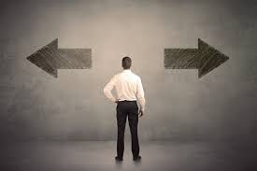
Would you receive surgery from a Robot?
Matthew Amodea
2 scenarios to consider
  Appendix removal in the current era
  Removal of brain tumor in the future
Notes:
https://corporatefinanceinstitute.com/resources/knowledge/other/ethical-dilemma/

Slide 32
References
Matthew Amodea
[1] Dr. George Mylonas, Would you trust a robot surgeon? | The Royal Society, (YouTube (The Royal Society), 7/11/2021), https://www.youtube.com/watch?v=WiiamYp2WuU&ab_channel=TheRoyalSociety (5/2/2022)
[2] Bo Yi , Guohui Wang , Zheng Li , Liyong Zhu , Pengzhou Li , Weizheng Li , Song Zhi , Shaihong Zhu & Jianmin Li, The future of robotic surgery in safe hands (Nature Research Custom, 5/13/2020 https://www.nature.com/articles/d42473-020-00176-y#:~:text=These%20robots%20offer%20clearer%20imaging,for%20patients%2C%20enabling%20faster%20recovery (5/2/2022)
[3] Arthur Saniotis, Maciej Henneberg, Neurosurgical robots and ethical challenges to medicine (Inter-Research Science Publisher, 2021) https://www.int-res.com/articles/esep2021/21/e021p025.pdf (5/2/2022)
[4] Ann Sayburn, Will the machines take over surgery? (Royal College of Surgeons of England, March 2017) https://publishing.rcseng.ac.uk/doi/pdf/10.1308/rcsbull.2017.87 (5/2/2022)
[5] Marshall Allen, Olga Pierce, Making the cut. Why choosing the right surgeon matters even more than you know (ProPublica, 7/13/2015) https://www.propublica.org/article/surgery-risks-patient-safety-surgeon-matters (5/2/2022)

Slide 33
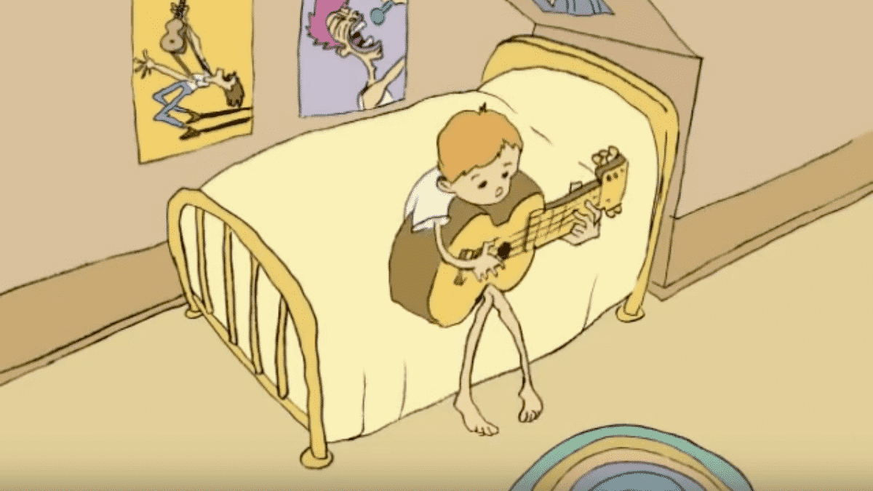

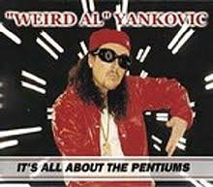

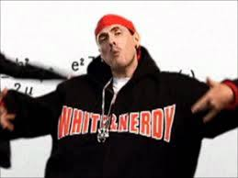
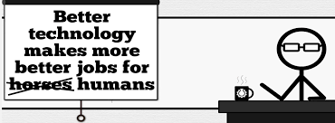
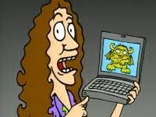


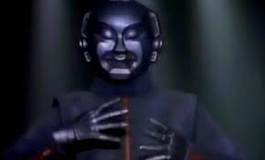
Student Choice – Interesting Videos (1/2)
  Don’t Download This Song (2006)
  - Weird Al (3:53)
  It’s All About The Pentiums (1999)
  - Weird Al (3:34)
  White and Nerdy (2006)
  - Weird Al (2:50)
  Virus Alert (2006)
  - Weird Al (3:43)
  Why Electronic Voting is a BAD Idea (2014)
  - Computerphile (Tom Scott) (8:20)
  Welcome To Life (2012)
  - Tom Scott (2:44)
  Copyright: Forever Less One Day (2011)
  - CGP Grey (6:27)
  Humans Need Not Apply (2014)
  - CGP Grey (15:00)
  This Video Will Make You Angry (2015)
  - CGP Grey (7:25)
  Mr. Roboto (1983)
  - Styx (5:34)
Notes:
TODO: Update Voting video
All Last Accessed 2018-10-04
CGP Grey
Copyright: Forever Less One Day (6:27)
https://www.youtube.com/watch?v=tk862BbjWx4
CGP Grey
Humans Need Not Apply (15:00) – 2014-08-13
http://www.youtube.com/watch?v=7Pq-S557XQU
Last access 2016-04-22
CPG Grey
This Video Will Make You Angry [Thought Germs] (7:25) – 2015-03-10
https://www.youtube.com/watch?v=rE3j_RHkqJc
Why Electronic Voting is a BAD Idea – Computerphile (Tom Scott) (8:20)
https://www.youtube.com/watch?v=w3_0x6oaDmI
Weird Al – It’s All About The Pentiums (3:34)
https://www.youtube.com/watch?v=qpMvS1Q1sos
TODO: Tie into Ray Kurzweil Singularity
Epic Rap Battles of History: Steve Jobs vs. Bill Gates (If class ok with obscene lyrics) (2:47)
https://www.youtube.com/watch?v=njos57IJf-0
Also Work links on web site http://socialimps.keithpray.net/documents/
-----
Tom Scott
http://tomscott.com
Welcome To Life (2:44)
https://www.youtube.com/watch?v=IFe9wiDfb0E&feature=youtu.be
Passphrases (2:08 need to give context for video)
https://firstlook.org/theintercept/2015/03/26/passphrases-can-memorize-attackers-cant-guess/
If not shown during first class
What "Orwellian" really means - Noah Tavlin (5:31)
http://ed.ted.com/lessons/what-orwellian-really-means-noah-tavlin
Weird Al – White and Nerdy (2:50) and look at lyrics
https://www.youtube.com/watch?v=N9qYF9DZPdw
Weird Al Yankovic “Don’t Download This Song” (3:53)
2006-08-21 released exclusively as digital download
https://www.youtube.com/watch?v=zGM8PT1eAvY
Styx - Mr. Roboto (1983) (5:34)
https://www.youtube.com/watch?v=uc6f_2nPSX8

Slide 34
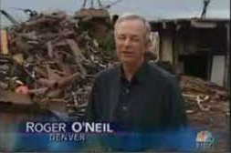

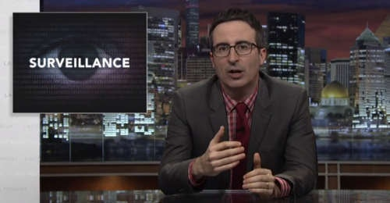
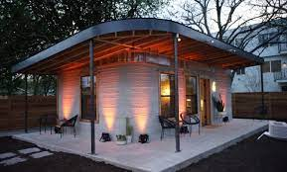

Student Choice – Interesting Videos (2/2)
  MSNBC on Denver's Automated Baggage System (2010) (2:27)
  Last Week tonight with John Oliver (2015) Snowden (33:14)
  3D Printed Homes (2018)
  - News Story (1:28)
  The Game Of Trust (2017) - Nicky Case
  What "Orwellian" really means (2015)
  - Noah Tavlin (5:31)
Notes:
All Last Accessed 2018-10-04
Last Week tonight with John Oliver – Patriot Act, Edward Snowden (33:14)
http://www.upworthy.com/john-oliver-flew-10-hours-to-russia-to-interview-edward-snowden-and-get-him-on-record?c=ufb1
TODO: Tie into Ray Kurzweil Singularity
Epic Rap Battles of History: Steve Jobs vs. Bill Gates (If class ok with obscene lyrics) (2:47)
https://www.youtube.com/watch?v=njos57IJf-0
Also Work links on web site http://socialimps.keithpray.net/documents/
-----
Passphrases (2:08 need to give context for video)
https://firstlook.org/theintercept/2015/03/26/passphrases-can-memorize-attackers-cant-guess/
If not shown during first class
What "Orwellian" really means - Noah Tavlin (5:31)
http://ed.ted.com/lessons/what-orwellian-really-means-noah-tavlin
MSNBC on Denver's Automated Baggage System 2010-08-23 (2:27)
https://www.youtube.com/watch?v=xx8f4x6C_KY
Accessed 2019-04-09
These 3D printed homes can be constructed for $4,000 (3:00 – 2018-04-02)
http://www.businessinsider.com/3d-printed-homes-constructed-icon-new-story-tech-charity-4000-dollars-2018-3
https://www.youtube.com/watch?v=SvM7jFZGAec (1:28)
Last access 2018-04-22

Slide 35
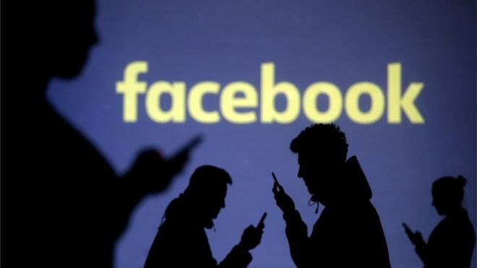
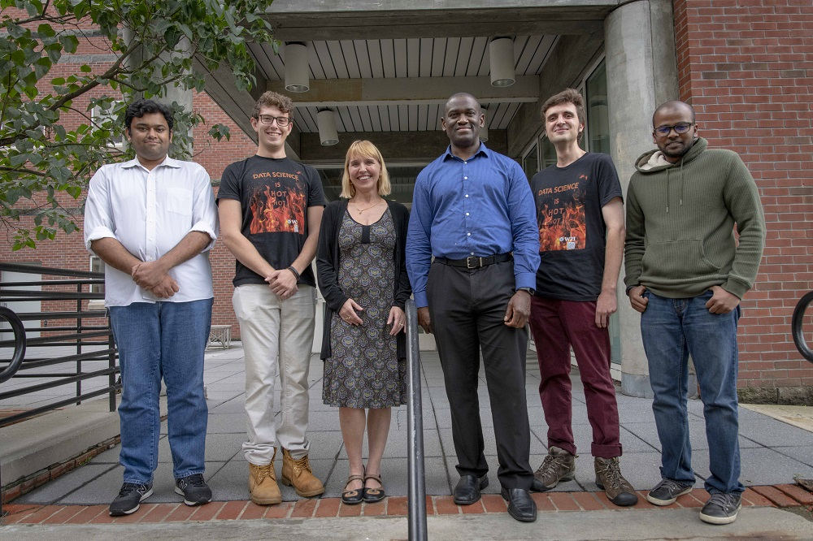

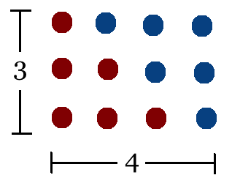
Student Choice – Interesting Articles 1/2
Communications of The ACM – Latest edition (through library)
Facebook security breach: Up to 50m accounts attacked - Dave Lee, North America technology reporter, 2018-09-29
WPI Secures $2.8 Million to Develop a Smartphone App to Help Assess the Health of Soldiers, 2018-09-24
Quantified Toilets, 2014, Quantified Toilets LLC
What a Toilet Hoax Can Tell Us About the Future of Surveillance – Jennifer Golbeck, The Atlantic, 2014-04-29
What Did Ada Lovelace's Program Actually Do? - Sinclair Target, 2018-08-18 (First Programming Bug 1843?)
Notes:
All Last Accessed 2021-04-03

Slide 36
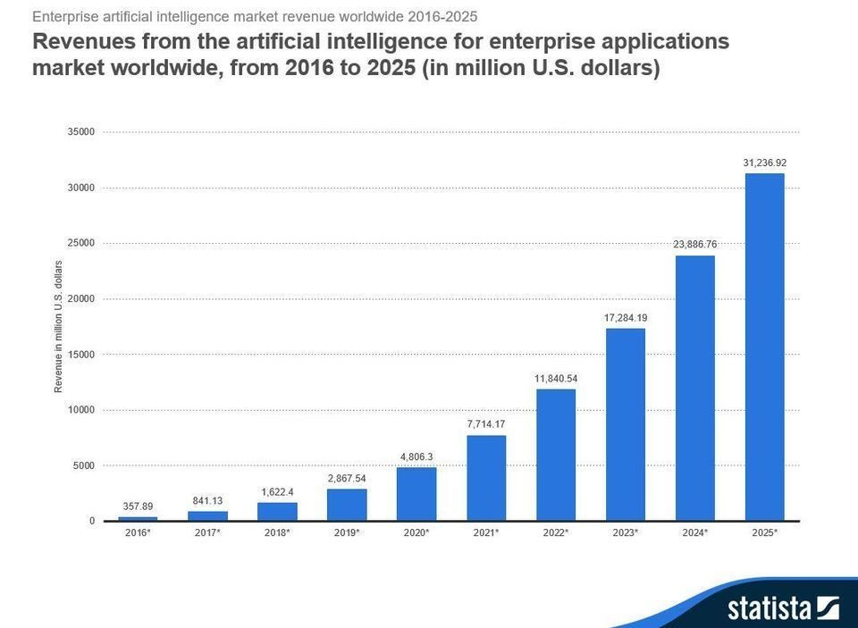
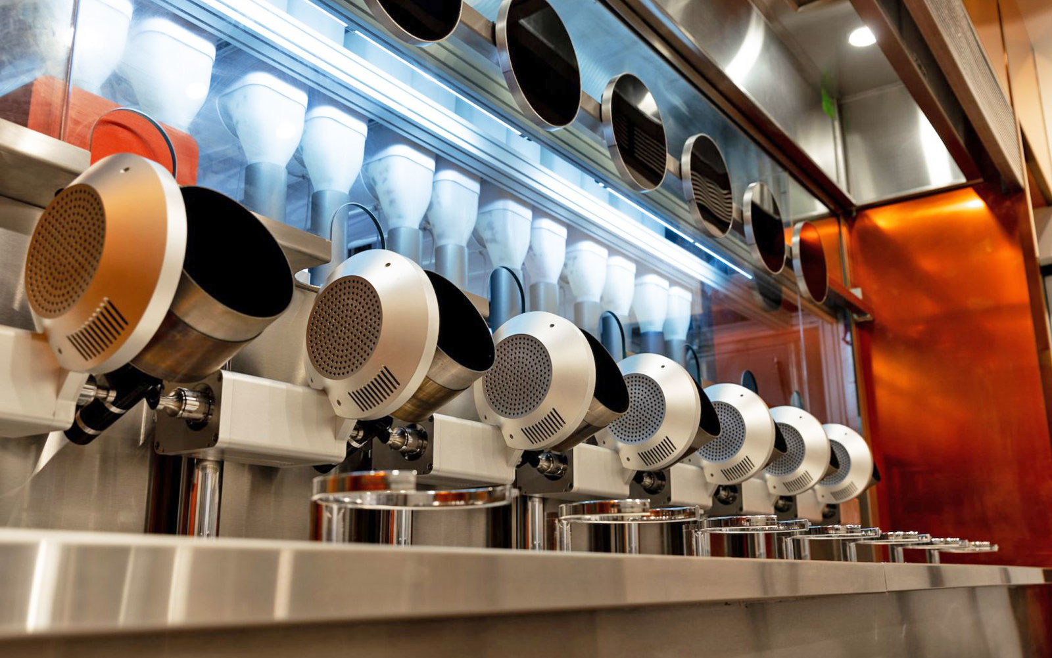
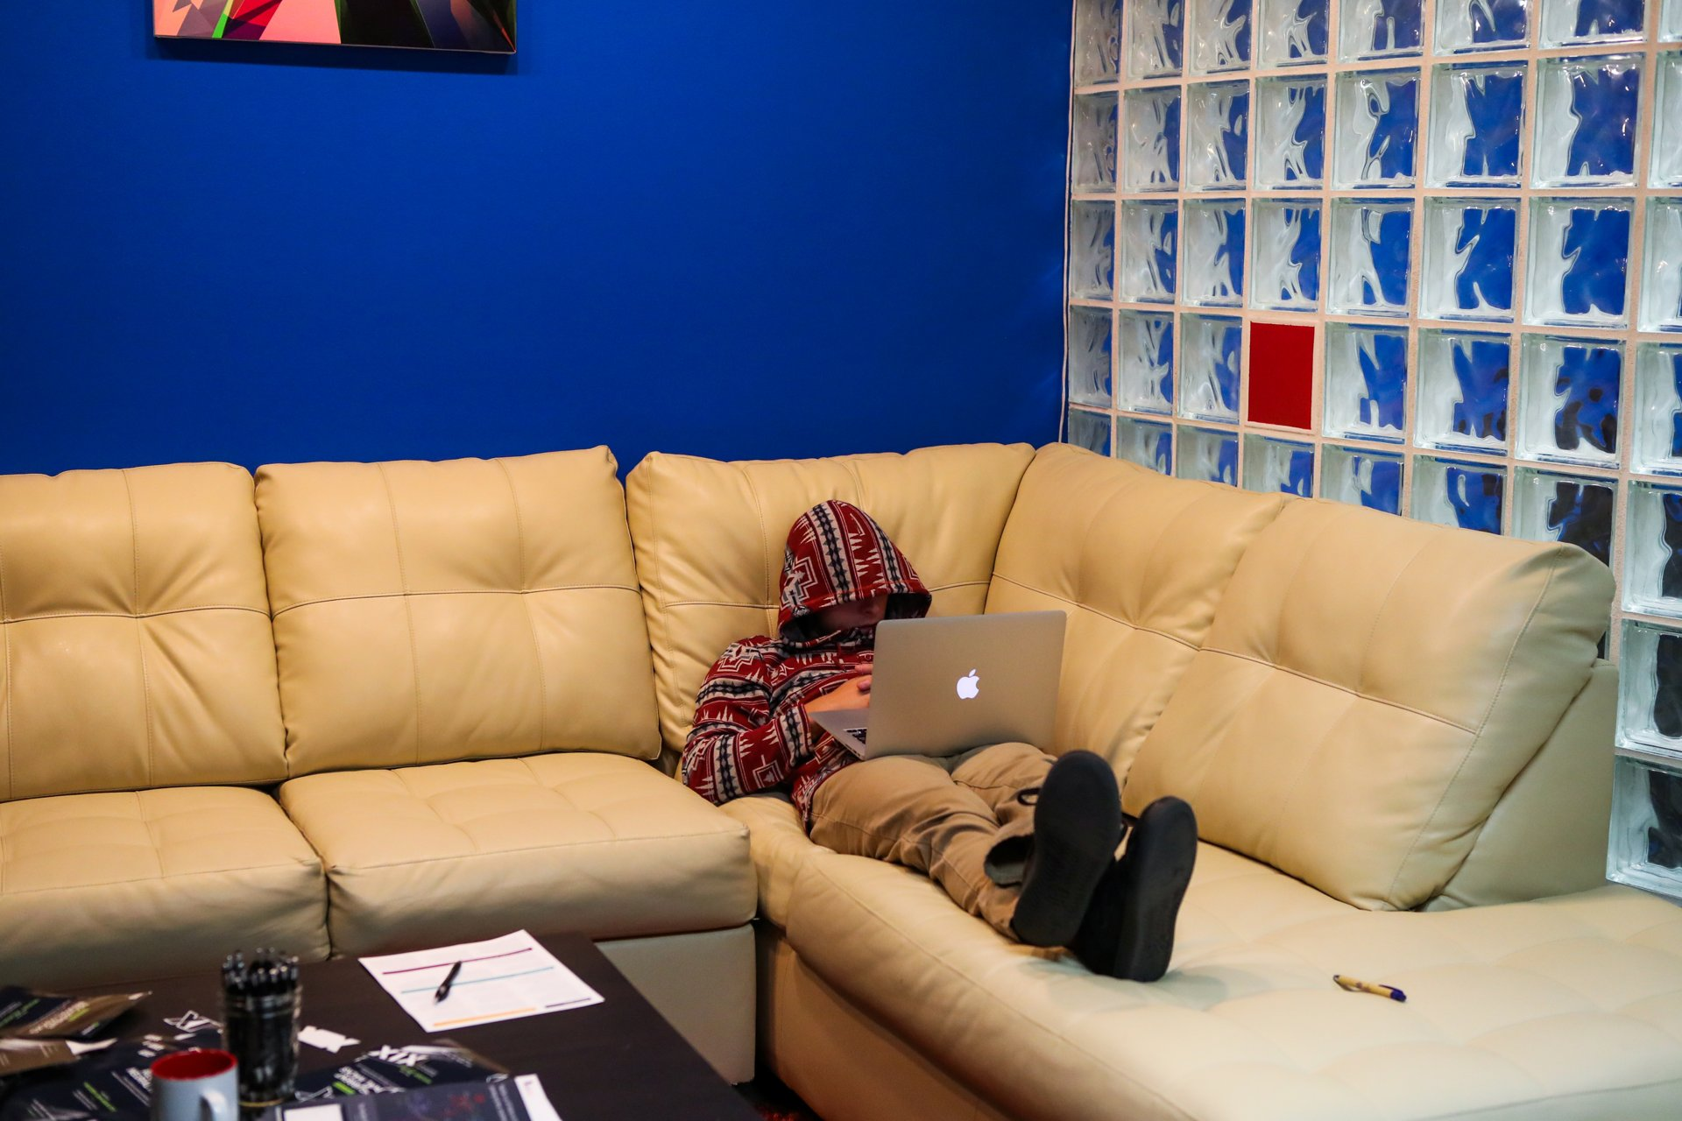
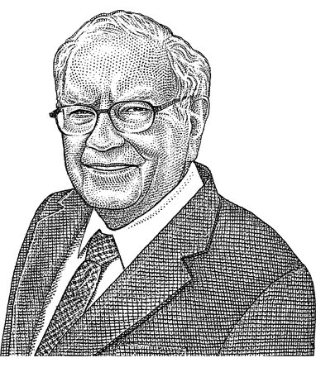
Student Choice – Interesting Articles 2/2
We know ethics should inform AI. But which ethics? - Mauro Guillen, World Economic Forum, 2018-07-26
MIT-born Spyce raises $21M to open new robotic restaurants - Lucia Maffei, BostInno, 2018-09-07
The Coders Programming Themselves Out of a Job - Brian Merchant, The Atlantic, 2018-10-02
Berkshire Hathaway’s Stock Price Is Too Much for Computers - Alexander Osipovich, The Wall Street Journal, 2021-05-05 (approaching $429,496.7295 32 bit limit) (access limited)
Notes:
All Last Accessed 2021-04-03
Spyce image: https://www.engadget.com/2018/05/04/boston-robotic-kitchen-spyce/ , 2018-05-04
Coders Programming Themselves Out of a Job image: Gabrielle Lurie, Reuters (date unknown)

Slide 37
Class 14
The End
Keith A. Pray
socialimps.keithpray.net

