Slide 1
Class 7 Privacy and Government
Keith A. Pray
Instructor
socialimps.keithpray.net
Notes:
After this class we will be half done with the course… very sad I know.
Play Somebody’s Watching Me (1984) – Rockwell (3:36)
https://www.youtube.com/watch?v=7YvAYIJSSZY
Be the envy of all your classmates if you know the band and/or year:
Rockwell (1984) Michael Jackson sings chorus and Jermaine Jackson on backing vocals.

Slide 2
what works well Online With Zoom
Sign in with First and Last Name
Stay muted unless you are going to speak
To speak use the raise your hand feature
To answer yes/no questions use the “yes” ”no” buttons
Chat is fine for questions
Turn your camera on
Wait until the end of student presentations to ask questions
Write them down so you don’t forget
Others?

Slide 3
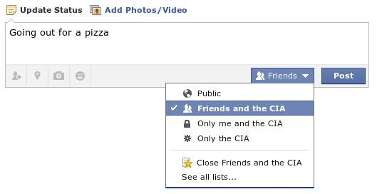
Overview
Review
Assignment
Students Present
Notes:
Review before debate in case anyone unsure of something in reading.
Let’s see who said the government should make a law requiring ID for Internet access. Let’s debate!
Image source?

Slide 4
My Reading Notes
pp. 276 Any examples from the last 25 years? Arrests, altering and deleting records are violations of privacy?
pp. 277 Why not try to verify and correct records?
pp. 278 Figure does not show # cameras increasing.
pp. 279 300 times = frames, locations, …? More police drones since 2013?
pp. 296 Shouldn’t credit card issuers take “reasonable steps” to verify identity all the time?
pp. 297 Any syndromic system successes in the last 15 years?
pp. 301 Confusing false positive and negative explanations. Not correct use of “Orwellian”
pp. 305 E-ZPass now mandatory on Mass Pike…
pp. 310 # 17 Interesting but not computing related
End of Chapter questions: 1, 18
pp. 319 “Since I have done nothing wrong, why should the government be investigating me?”

Slide 5
Debate Ground Rules
Before Debate
Add “(YES)” or “(NO)” to the end of your name in Zoom to show your side
10 minutes to converse with your team
Share argument points, counter points, and responses
Share experiences in different countries, web sites, access points
Decide who will: Go first, Respond to which points from opposing side
During Debate
1 turn per person until everyone on your team has spoken
Try to keep remarks to 30 seconds
Switch sides at any time if you change your mind
Notes:
Government should make law requiring ID for Internet Access Debate
If in class:
Stand up when speaking
30 second limit (elect a timekeeper)
Previous: National ID or Not Debate

Slide 6
Group Quiz
List two problems with using biometrics for identification.
List two advantages of using biometrics for identification.
Describe two tools people can use to protect their privacy on the Web.
For each of the 4 categories of Daniel Solove’s privacy taxonomy give an example not listed in the book.
Notes:
Only if need to fill time, Orwellian video better use of time if we’ve not seen it yet.

Slide 7
Overview
Review
Assignment
Students Present

Slide 8
Assignment – Group Project
Catch up on reading
Analyze Movie for all topics covered to date
Add list of computing technology portrayed
See group project slide deck for more
-----
Mid Term Survey on Canvas → Quizzes
Notes:
Movie group project: List of computing technologies portrayed in movie on website Categorize computing technologies as existing, future, emerging, impossible or plausible with rationale Analyze movie for all topics covered to date

Slide 9
Overview
Review
Assignment
Students Present
Notes:
What "Orwellian" really means - Noah Tavlin (5:31)
http://ed.ted.com/lessons/what-orwellian-really-means-noah-tavlin

Slide 10
The Newest of The Groundhog Day Legislation.
Payton Dean
Notes:
1. My presentation is on the Lawful Access to Encrypted Data Act and I refer to it as groundhog day legislation because about every three months legislation is introduced that has to do with social media, the internet, and encryption.

Slide 11
The Lawful Access to Encrypted Data Act:
Payton Dean
Funding for a program to increase digital evidence training.
Anyone given a directive can appeal it in federal court.
The government would compensate any losses cause by a directive to decrypt.
The way the directive is carried out is chosen by the the one implementing it.
[1] [2]
Notes:
“ The bill would require service providers and device manufacturers to provide assistance to law enforcement when access to encrypted devices or data is necessary – but only after a court issues a warrant, based on probable cause that a crime has occurred, authorizing law enforcement to search and seize the data.” (Committee on the Judiciary, 2020)
Highlights:
Funds a grant program within the Justice Department’s National Domestic Communications Assistance Center (NDCAC) to increase digital evidence training for law enforcement and creates a call center for advice and assistance during investigations.
The creation of a backdoor decryption for the government that is not regulated by the government but by each individual entity is dangerous as it leaves a significantly less secure access point for dangerous players.

Slide 12
The Earn it Bill
Payton Dean
Was more focused on policing speech
Would create “Best Practices” for internet companies to follow in order to “earn” the protections granted to them by section 230 of the Federal Communication Act.
Section 230 says that social media companies are not responsible for what users post on their sites.
[2]
Notes:
The earn it bill was more focused on the responsibilities of social medias to regulate their users. To also would take away the protections of the Federal Communication Act which allows social media companies immunity to what happens on their sites.

Slide 13
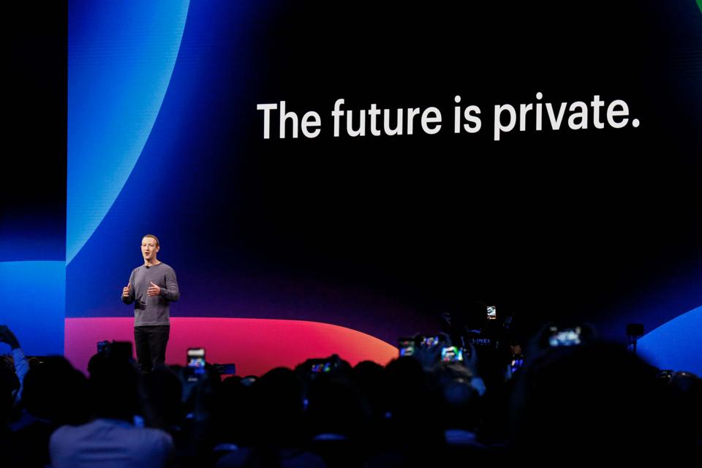
A Utilitarian Framework highlights the flaws in the system:
Payton Dean
It is not the intent of the action but the actual impact that decides the morality of the action.
It would create a significantly less secure access point for dangerous players.
The creation of these backdoors will not only be used by the United States.
Belarus, Hong Kong, Thailand, and Russia.
It could cause a rise in WikiLeaks type situations.
<Graphic as big as will fit>
[3]
Notes:
I want to focus on the Utilitarian Frame work to look at the moral implications of the law because we cannot be sure what the actual intent is because we continually see legislation popping up always with a different reason.

Slide 14
Scenario 1: Australia
Payton Dean
In 2018, Australia instated encryption regulations
Technical assistance request: A notice to provide “Voluntary Assistance”
Technical assistance notice: Requiring decryption “if it is possible to decrypt” (E2EE is safe)
Technical capability notice: Requires companies to build new technology for decrypting
Differs:
The US would want to stop E2EE and assistance would be required not volunteered by the companies.
The implementation has not fully occurred and so we currently cannot see the outcome but the pushbacks from the Tech companies and beginning of conversations about encryption by other world powers (including the UK and US) prove that Australia will become the first case study on the regulation of encryption by the government in this way.
<Graphic as big as will fit>
[4]
Notes:
Technical assistance request: A notice to provide "voluntary assistance" to law enforcement for "safeguarding of national security and the enforcement of the law."
Technical assistance notice: A notice requiring tech companies to offer decryption "they are already capable of providing that is reasonable, proportionate, practicable and technically feasible" where the company already has the "existing means" to decrypt communications (e.g. where messages aren't end-to-end encrypted).
Technical capability notice: A notice issued by the attorney general, requiring tech companies to "build a new capability" to decrypt communications for law enforcement. The bill stipulates this can't include capabilities that "remove electronic protection, such as encryption."
The main difference in Australia would not demand an end to E2EE and only asks for decrypt ability for things that can be decrypted. While that does confuse the outcome for how affective the decrypting would be it means those social media

Slide 15
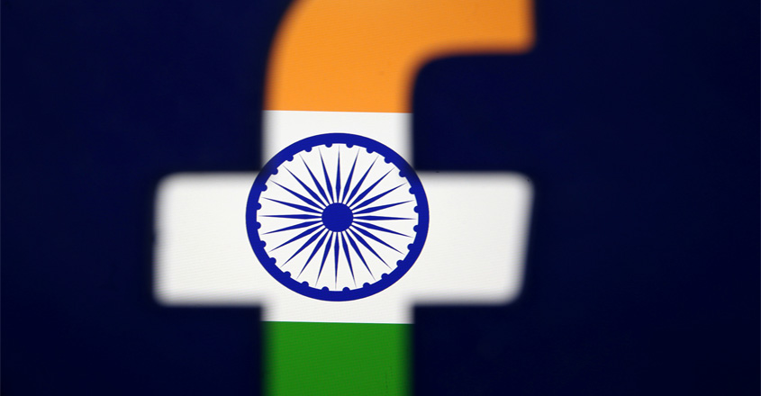
Scenario 2: India
Payton Dean
In 2019, India asked Facebook to decrypt private messages on Whatsapp, claiming that terrorists have no rights to privacy.
Facebook’s lawyer claimed Facebook was in no way obliged to share user data with the government. The case was brought to the Supreme Court in August (2019). The decision was tried in January.
In 2017, the Supreme Court ruled that privacy online was equal to the other privacy rights citizens have. This ruling followed suit.
[5]
Notes:
This is a more extreme example of the Law just how Australia was a less extreme example. However Facebook took India to ther supreme court and they were shot down.

Slide 16
These laws, especially the end of E2EE would really help law enforcement.
Payton Dean
But the truth is if people couldn’t safely do their illegal work or be in terrorist groups on Facebook they have all of TOR which is not in anyway regulated.
We have evidence of warrants either faked or given for fabricated evidence, what would stop law enforcement officers from doing that do the decryption system?
[6]
Notes:
You can argue that these style of laws will really help law enforcement and since, technically, they follow constitutional rights, they are not violating any rights. But the truth is if people aren’t protected by mainstream media they will just retreat to TOR. We also know that the current process for getting warrants can be fabricated, as in the evidence, or a judge may give a warrant based on badly informed information. It is that same system creating warrants for the decryption system.

Slide 17
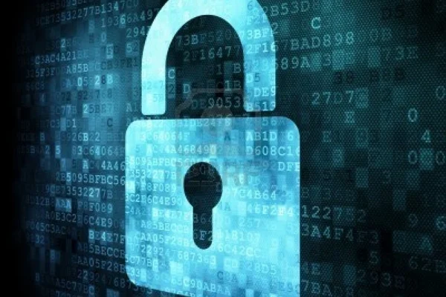
The Request of this Act would make everyone less secure.
Payton Dean
E2EE is becoming a norm for social medias
Snapchat, Facebook, Instagram, Zoom, WhatsApp, etc.
This act would mean none of these programs would be allowed to keep there E2EE in favor of something that can be decrypted.
[7]
Notes:
Overall, and most importantly, this law makes everyone less secure. E2EE is becoming a norm for social medias and making them dismantle it to be accessible for the government creates a less secure system whether or not the government is given access to the decrypted information.
While this law may give us the opportunity to prevent hate crimes and terrorist attacks it takes away the safety of users and can’t actual prove that it will work as a preventative measure as to get the warrant there would need to be probable cause which would be hard to get without an initial decryption. The Lawful Access to Encrypted Data Act creates a less secure environment for users and the ramifications out way the potential benefits being floated in the act.
Questions?

Slide 18
References
Payton Dean
[1] “Graham, Cotton, Blackburn Introduce Balanced Solution to Bolster National Security, End Use of Warrant-Proof Encryption That Shields Criminal Activity.” United States Senate Committee on the Judiciary, 23 June 2020, www.judiciary.senate.gov/press/rep/releases/graham-cotton-blackburn-introduce-balanced-solution-to-bolster-national-security-end-use-of-warrant-proof-encryption-that-shields-criminal-activity.
[2] “Protect Our Speech and Security Online: Reject the Graham-Blumenthal EARN IT Act.” EFF Action Center, act.eff.org/action/stop-the-earn-it-bill-before-it-breaks-encryption.
[3] Doffman, Zak. “New WhatsApp And Facebook Encryption 'Backdoors'-What's Really Going On.” Forbes, Forbes Magazine, 30 Sept. 2019, www.forbes.com/sites/zakdoffman/2019/09/29/whatsapp-backdoorwill-facebook-be-forced-to-break-message-encryption-as-reported/#17d123891b38.
[4] Reilly, Claire. “Google, Apple, Facebook Face World-First Encryption Laws in Australia.” CNET, CNET, 6 Dec. 2018, www.cnet.com/news/australia-passes-encryption-assistance-access-laws-facebook-google-twitter-apple-amazon/#.
[5] Reuters
..., et al. “Indian Govt, Facebook Spar Over Decryption Laws in Top Court.” The Irrawaddy, 23 Oct. 2019, www.irrawaddy.com/news/asia/indian-govt-facebook-spar-decryption-laws-top-court.html.
[6] By Ian, and Ian Paul. “A Beginner's Guide to BitLocker, Windows' Built-in Encryption Tool.” PCWorld, PCWorld, 1 Aug. 2016, www.pcworld.com/article/2308725/a-beginners-guide-to-bitlocker-windows-built-in-encryption-tool.html.
[7] Writer, Staff. “Beware Cellphone Cyber-Crime in South Africa: Norton.” MyBroadband, 4 Apr. 2013, mybroadband.co.za/news/security/74707-beware-cellphone-cyber-crime-in-south-africa-norton.html.

Slide 19
Class 7 The End
Keith A. Pray
Instructor
socialimps.keithpray.net
Notes:
This is the end. Any slides beyond this point are for answering questions that may arise but not needed in the main talk. Some slides may also be unfinished and are not needed but kept just in case.

