Slide 1
Class 10
Professional Ethics
Keith A. Pray
Instructor
socialimps.keithpray.net
Notes:
Here’s the title slide. Excited already, aren’t you? You may not be depending on how you enjoyed the last class.

Slide 2
Let’s keep track of what works well Online and Remote
Sign in with First and Last Name
Stay muted unless you are going to speak
To speak use the raise your hand feature
To answer yes/no questions use the “yes” ”no” buttons
Chat is fine for questions
Turn your camera on if possible
Wait until the end of student presentations to ask questions
  Write them down so you don’t forget
Others?

Slide 3
Papers
Use supporting data
Make sure argument is for conclusion
Quantify
  Do not use terms like: less, more, a lot, huge, great, big, tiny, etc.
Absolute statements are difficult to prove
  Avoid: all, always, any, every, everyone, never, none… unless you can show it
State assumptions and definitions
http://socialimps.keithpray.net/assignments/paper-guidelines/
Notes:
Save for next time:
Clearly state conclusion
First statement preferred
Absolute statements are difficult to prove
Avoid: all, always, any, every, everyone, never, none… unless you can show it
Be sure to put quotes around entire quote
Hyperbole is the best thing ever!
but not in these papers
Print 2 sided and save a tree
Use template, saves time (and -1 point)
Include Counter Point and Response
Include Author, Title, Publish Date, Publisher for references
Read paper aloud to proof

Slide 4
Grades
To Date
43 Max Possible

Slide 5
Overview
Review
Debate
Assignment
Students Present
Notes:
ADD QUIZ AS BACKUP IF CLASS DISCUSSION NOT LONG ENOUGH

Slide 6
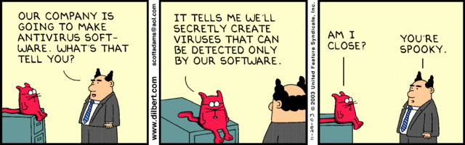
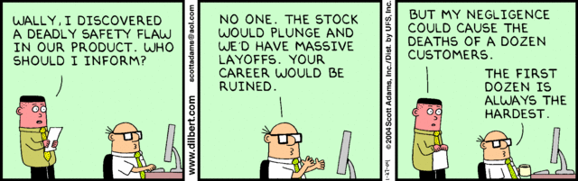
Notes:
Ask how many people in ACM or IEEE

Slide 7
Debate Ground Rules
Before Debate
  10 minutes to converse with your team
  Share argument points, counter points, and responses so everyone can represent
  Decide who will respond to what points from the opposing side
During Debate
  1 minute opening statements (what you hope your answer will accomplish)
  Stand up when speaking
  1 turn per person until everyone on your team has spoken
  30 second limit
  Switch sides at any time if you change your mind
Notes:
Release Game or Not Debate
Chapter 9 In-class Exercises # 24.
Should the company produce the game?
Use the SWE Code Of Ethics as the basis for your argument.

Slide 8
My Reading Notes
pp. 409 Can one perform services for one’s self?
pp. 412 1993-1999 Does this seem like a long time?
pp. 413 “errors of omission or commission”?
UPDATE
pp. 422 3. Would people agree – social contract?
pp. 438 So the baby can be left outside and no one is responsible?
Notes:
An error of commission is one where the person responds where they should not. This is compared to an error of omission, where the person fails to respond when they should.

Slide 9
Assignment
1 Page Paper
  What should computerized automation be applied to next?
Finish all reading
Group Project
  Add analysis to website addressing all topics covered to date
  Group Presentation Draft
    Email presentation as Power Point attachment to course staff
    Post Power Point file on group website
Notes:
1 Page Paper Ideas:
For Good - How will you use your computing related education to do good in the world?
Dark Net - Is the Dark Net good or bad?
Does computerized automation help the economy or society?
What should computerized automated be applied to next?
If productivity has increased so much, why are we working so hard? Should we?
What job skills will survive computerized automation?

Slide 10
Overview
Review
Debate
Assignment
Students Present
Notes:
Show WPI and/or corporate code of ethics.

Slide 11
WikiLeaks
Katherine Cariglia
Notes:
<greet the audience>
My presentation is about the infamous website, WikiLeaks. As I assume you all know, WikiLeaks is primarily used to release classified material with the intention of “exposing certain truths to the public.” WikiLeaks’ contributors often attempt to maintain their anonymity for safety purposes, however, the validity of the claims made and documentation released often comes into question. So, the question I want to ask all of you is, “does the anonymity provided by certain communication technologies like WikiLeaks help to safely expose unethical practices or does it simply give way to an increased amount of false claims?”

Slide 12

Non-Anonymous whistleblowers: Chelsea manning
Katherine Cariglia
Responsible for leaking nearly 500,000 classified battle reports as well as helicopter attack footage [1][2]
Pros: Leaked documentation and footage exposed violations of human rights [2]
Cons: Risked information misuse by enemy nations [2]
[3]
[1] David Welna, “12 Years of Disruption: A WikiLeaks Timeline,” (NPR, April 11 2019)
[2] David Dishneau, Pauline Jelinek, “Witness: Manning Said Leak Would Lift ‘Fog of War,’” (Associated Press, December 19 2011)
[3] Mark Peckmezian, “Chelsea Wears Gabardine Blazer with Embroidered Lapels, Star Pocket Scarf Saint Laurent.” (Dazedigital.com, 8 Mar. 2019)
Notes:
We’ll begin with a discussion of non-anonymous whistleblowers. In 2010, a series of battlefield reports and attack footage was released to WikiLeaks by then-soldier Chelsea Manning. The reports, dubbed The Afghan War Logs and The Iraq War Logs, contained information about civilian casualties, the torturing of prisoners of war, the hunt for Osama Bin Laden, and other gruesome details. Though the release of this information potentially jeopardized national security and foreign relations, the exposure of the highly unethical practices by the U.S. army can be viewed in a positive light, in the hopes that these practices are disallowed.

Slide 13
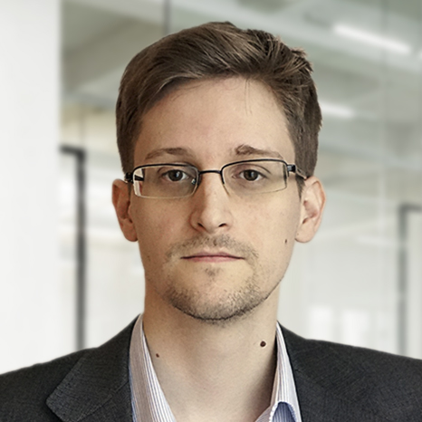
Non-Anonymous whistleblowers: Edward snowden
Katherine Cariglia
Responsible for leaking a massive amount of global surveillance data collected by the National Security Agency [1][4]
Pros: exposure of in-depth surveillance of charities, large companies, world leaders, and innocent people [4]
Cons: caused widespread panic/concern, compromised foreign relations and national security [4]
[5]
[1] David Welna, “12 Years of Disruption: A WikiLeaks Timeline,” (NPR, April 11 2019)
[4] The Editorial Board, “Edward Snowden: Whistle-Blower,” (The New York Times, January 2 2014)
[5] “Edward Snowden,” (Unleash, 2019)
Notes:
In 2013, an enormous amount of information was leaked by Edward Snowden to various news sources, including WikiLeaks. This information detailed how the NSA accessed hundreds of millions of accounts from Google, Yahoo, Verizon, Xbox Live, and others in order to spy on the owners of these accounts. Snowden stated he felt morally compelled to share the extent of government surveillance with innocent people whose privacy rights were violated. This revelation caused widespread concern and risked compromising foreign relations and national security. However, many people believe that his actions have greatly benefited society and spurred new laws protecting privacy rights.
In both examples of whistleblowers I have presented thus far, the significant amount of detail provided by their exploits and lack of anonymity have been proven to be accurate and have had positive effects. But what happens when anonymity is maintained? Can you still prove leaks to be true or false? Will the benefits of information exposure outweigh the harms?

Slide 14
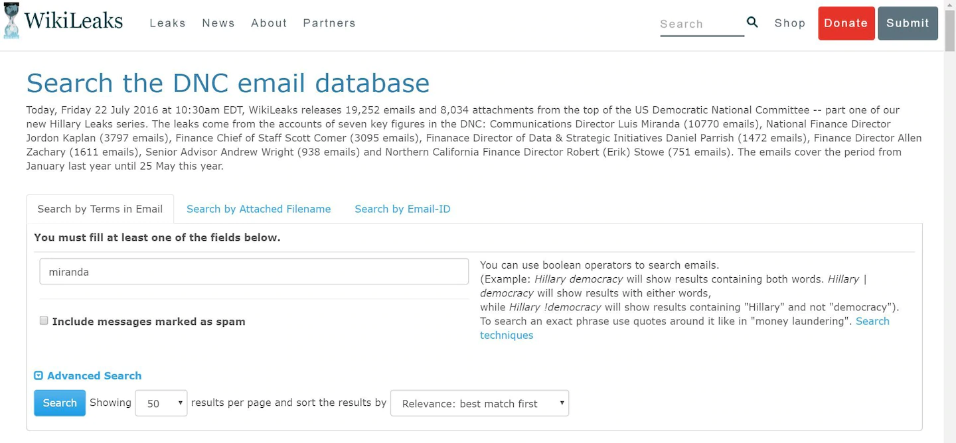
Anonymous whistleblower(s) and dnc emails
Katherine Cariglia
A group of Russian hackers infiltrated the email servers of the Democratic National Committee [1] [6] [7]
Pros: exposed bias and irresponsible conduct within the DNC [1] [6]
Cons: leaked donors’ personal information and caused serious disruption in the 2016 presidential election [1] [6]
[8]
[1] David Welna, “12 Years of Disruption: A WikiLeaks Timeline,” (NPR, April 11 2019)
[6] Andrea Peterson, “WikiLeaks Posts Nearly 20,000 Hacked DNC Emails Online,” (The Washington Post, July 22 2016)
[7] Nancy LeTourneau, “The WikiLeaks-Russia Connection,” (Washington Monthly, January 25 2019)
[8] Andrea Peterson, “A Screenshot of the WikiLeaks DNC Email Database,” (The Washington Post, July 22 2016)
Notes:
In 2016, thousands of emails collected from various members of the Democratic National Committee were released on WikiLeaks. The conversations and information contained in the emails ranged from innocent discussions to private information about donors, and most notably, discontent about Bernie Sanders’ campaign. The source of the hack was found to be from Russia, though WikiLeaks creator Julian Assange has repeatedly denied this. These emails sparked controversy during the 2016 election, because within the supposedly neutral DNC, many people were disparaging Bernie Sanders in favor of Hilary Clinton. Altogether, the negative effects of these leaks included possible identity theft using donor information, reduced trust in the DNC and democratic candidates, and highlighted the possibility of Russia significantly influencing the result of the 2016 presidential election. However, the emails did help to expose unjust behavior and bias within the DNC.

Slide 15

Anonymous whistleblower(s) and vault 7
Katherine Cariglia
Anonymous whistleblower(s) released documents and hundreds of millions of lines of code from the Central Intelligence Agency’s Vault 7 project [1] [9] [10]
Pros: exposed government hacking capabilities and significant security issues in various software programs [1] [2]
Cons: showed that the government intentionally accessed loopholes without disclosing or attempting to fix them to innocent civilians worldwide [1] [9] [10]
[11]
[1] David Welna, “12 Years of Disruption: A WikiLeaks Timeline,” (NPR, April 11 2019)
[9] Scott Shane, Matthew Rosenberg, Andrew W. Lehren, “WikiLeaks Releases Trove of Alleged C.I.A. Hacking Documents,” (The New York Times, March 7 2017)
[10] Bruce Schneier, “How Long Until Hackers Start Faking Leaked Documents?” (The Atlantic, September 13 2016)
[11] Bernard Lowe, “The Official Logo of Vault 7,” (Wikipedia.org, April 8 2017)
Notes:
In 2017, a large amount of documentation and code detailing the CIA’s Vault 7 project was released anonymously to WikiLeaks. The capabilities of this project included vulnerabilities and hacking tools for a variety of things including web browsers, smart home technology, certain aspects of technology in modern cars, as well as operating systems including Apple iOS, Android, Windows, macOS, and Linux. The released documentation publicized the fact that the government had secretly gained this type of access without disclosing this to innocent users or providing the creators of the software opportunities to fix these vulnerabilities, causing a great amount of concern. However, the authenticity of the documentation released was never ascertained. Though certain experts claim the documentation to be legitimate, it is now becoming easier and easier for hackers and cybersecurity experts to forge similar documents that appear just as realistic. Because of this, it is difficult to know the effects of the leaks with certainty.

Slide 16
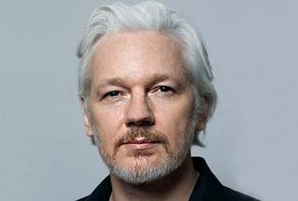
Conclusion: bias, uncertainty, and unreliability
Katherine Cariglia
Documentation forgery: a real and dangerous possibility [10] [12]
Significant ties to Russia [13] [14] [15]
Control over reporters and their word choice/covered stories [16]
[17]
[10] Bruce Schneier, “How Long Until Hackers Start Faking Leaked Documents?” (The Atlantic, September 13 2016)
[12] Eric Zorn, “The Inherent Peril in Trusting Whatever WikiLeaks Dumps on Us,” (The Chicago Tribune, October 13 2016)
[13] Nancy LeTourneau, “The WikiLeaks-Russia Connection,” (Washington Monthly, January 25 2019)
[14] Jo Becker, Steven Erlanger, Eric Schmitt, “How Russia Often Benefits When Julian Assange Releases the West’s Secrets,” (The New York Times, August 31 2016) [15] Jason Lemon, “Russia Reacts to WikiLeaks Founder Julian Assange’s Arrest: ‘We Hope All His Rights Will Be Respected,’” (Newsweek, April 11 2019)
[16] Guy Faulconbridge, “WikiLeaks Tells Reporters 140 Things Not to Say About Julian Assange,” (Reuters, January 6 2019)
[17] “Julian Assange,” (Jamaica Observer, April 11 2020)
Notes:
With examples of both anonymous and named WikiLeaks contributors and the positive/negative effects of their leaks, we can now examine the role of anonymity in WikiLeaks as a whole. Many, if not most, of the leaks are in the form of documentation. Today, online documents are increasingly easy to forge and manipulate. Many cybersecurity experts and hackers can manipulate a document by altering dates, signatures, images, wording, etc. Because the authenticity of most classified documentation cannot be commented on by its possible creators, it is extremely difficult to determine if an anonymously posted document is legitimate. Additionally, WikiLeaks creator Julian Assange has a firm grip on what can be said and released. Though he claims the goal of WikiLeaks is to expose truth, only negative truths about the United States (and some other nations) have been posted. In fact, Assange has significant ties to Russia. He refuses to make criticisms of its obviously authoritarian government and has even received endorsements and praise from various Russian officials. He is friendly with Russian president Vladimir Putin and the Russian Kremlin and refuses to post negative exposures of the Russian government. Many WikiLeaks contributors are speculated to be Russian, and act in the interest of anti-Americans. This allows for many biased reports and leaks. Assange even has control over what WikiLeaks contributors cannot say, including “false and defamatory claims” about himself. The support of Russia and the censoring of his own reporters both clearly undermine the purpose of WikiLeaks and propagate misinformation and do little good for the public other than stirring controversy and anger. In conclusion, the bias, uncertainty, and unreliability of WikiLeaks and its anonymous contributors make the entire website no more legitimate than a biased newspaper, and therefore all the information presented must be taken with a grain of salt.

Slide 17
References
Katherine Cariglia
[1] David Welna, “12 Years of Disruption: A WikiLeaks Timeline,” (NPR, April 11 2019), https://www.npr.org/2019/04/11/712306713/12-years-of-disruption-a-wikileaks-timeline (Accessed April 9 2020)
[2] David Dishneau, Pauline Jelinek, “Witness: Manning Said Leak Would Lift ‘Fog of War,’” (Associated Press, December 19 2011), http://archive.boston.com/news/nation/washington/articles/2011/12/19/letter_suggests_manning_wanted_to_make_history/ (Accessed April 14 2020)
[3] Mark Peckmezian, “Chelsea Wears Gabardine Blazer with Embroidered Lapels, Star Pocket Scarf Saint Laurent.” (Dazedigital.com, 8 Mar. 2019), dazedimg-dazedgroup.netdna-ssl.com/537/azure/dazed-prod/1260/4/1264257.jpg (Accessed April 14 2020)
[4] The Editorial Board, “Edward Snowden: Whistle-Blower,” (The New York Times, January 2 2014), https://www.nytimes.com/2014/01/02/opinion/edward-snowden-whistle-blower.html (Accessed April 15 2020)
[5] “Edward Snowden,” (Unleash, 2019), https://unleashgroup.io/las-vegas-2019/speakers/edward-snowden (Accessed April 15 2020)
[6] Andrea Peterson, “WikiLeaks Posts Nearly 20,000 Hacked DNC Emails Online,” (The Washington Post, July 22 2016), https://www.washingtonpost.com/news/the-switch/wp/2016/07/22/wikileaks-posts-nearly-20000-hacked-dnc-emails-online/ (Accessed April 16 2020)
[7] Nancy LeTourneau, “The WikiLeaks-Russia Connection,” (Washington Monthly, January 25 2019), https://washingtonmonthly.com/2019/01/25/the-wikileaks-russia-connection/ (Accessed April 16 2020)
[8] Andrea Peterson, “A Screenshot of the WikiLeaks DNC Email Database,” (The Washington Post, July 22 2016), https://www.washingtonpost.com/news/the-switch/wp/2016/07/22/wikileaks-posts-nearly-20000-hacked-dnc-emails-online/ (Accessed April 16 2020)
[9] Scott Shane, Matthew Rosenberg, Andrew W. Lehren, “WikiLeaks Releases Trove of Alleged C.I.A. Hacking Documents,” (The New York Times, March 7 2017), https://www.nytimes.com/2017/03/07/world/europe/wikileaks-cia-hacking.html (Accessed April 9 2020)

Slide 18
References
Katherine Cariglia
[10] Bruce Schneier, “How Long Until Hackers Start Faking Leaked Documents?” (The Atlantic, September 13 2016), https://www.theatlantic.com/technology/archive/2016/09/hacking-forgeries/499775/ (Accessed April 9 2020)
[11] Bernard Lowe, “The Official Logo of Vault 7,” (Wikipedia.org, April 8 2017), https://en.wikipedia.org/wiki/File:VAult_7.jpg (Accessed April 17 2020)
[12] Eric Zorn, “The Inherent Peril in Trusting Whatever WikiLeaks Dumps on Us,” (The Chicago Tribune, October 13 2016), https://www.chicagotribune.com/columns/eric-zorn/ct-wikileaks-potential-hoax-zorn-perspec-1014-jm-20161013-column.html (Accessed April 9 2020)
[13] Nancy LeTourneau, “The WikiLeaks-Russia Connection,” (Washington Monthly, January 25 2019), https://washingtonmonthly.com/2019/01/25/the-wikileaks-russia-connection/ (Accessed April 16 2020)
[14] Jo Becker, Steven Erlanger, Eric Schmitt, “How Russia Often Benefits When Julian Assange Releases the West’s Secrets,” (The New York Times, August 31 2016), https://www.nytimes.com/2016/09/01/world/europe/wikileaks-julian-assange-russia.html?_r=2 (Accessed April 19 2020)
[15] Jason Lemon, “Russia Reacts to WikiLeaks Founder Julian Assange’s Arrest: ‘We Hope All His Rights Will Be Respected,’” (Newsweek, April 11 2019), https://www.newsweek.com/russia-wikileaks-julian-assange-arrest-1393122 (Accessed April 19 2020)
[16] Guy Faulconbridge, “WikiLeaks Tells Reporters 140 Things Not to Say About Julian Assange,” (Reuters, January 6 2019), https://www.reuters.com/article/us-britain-ecuador-assange/wikileaks-tells-reporters-140-things-not-to-say-about-julian-assange-idUSKCN1P00NN (Accessed April 9 2020)
[17] “Julian Assange,” (Jamaica Observer, April 11 2020), http://www.jamaicaobserver.com/apps/pbcsi.dll/storyimage/JO/20200411/ARTICLE/200419942/AR/0/AR-200419942.jpg?MaxW=319&MaxH=215&ImageVersion=SectionMain (Accessed April 19 2020)

Slide 19
Building a personal AI
Conrad Tulig

Slide 20
History / Background
Conrad Tulig
Many different applications
Solving Algorithms
  The Turing Machine
  IBM’s Deep Blue chess computer
Computer Vision
  Self Driving Cars (Tesla, Waymo)
Automation
<Graphic as big as will fit>
[1][2][3]
Notes:
Briefly go over the history/background of AI -> transition into Personal AI

Slide 21
What is a personal ai?
Conrad Tulig
The term ‘AI’ is thrown around to mean many different things
Singularity: Machine is conscious of it’s own existence
Turing Test (Was Predicted to happen by 2000)
  However No one has won the Loebner Prize yet
[4]
Notes:
AI – Anything from basic software automation/algorithms to advanced machine/deep learning
When used in the context of Personal AI, refers to the idea that the machine is conscious of it’s own existence

Slide 22
Technology
Conrad Tulig
We aren’t there yet
Can a neuron be simplified down to just a silicon chip?
3 Levels of Consciousness
  C0: Unconscious operations
  C1: Make decision from multiple possibilities based on information
  C2: Metacognition
[5][6]
Notes:
The functionality of a neuron can be replicated with a silicon chip, so does it just take enough silicon chips to replicate the human brain?
C0: For example facial recognition, state of most AIs
C1: Present in human infants and animals, neural networks
C2: Ability to monitor your own thoughts: correct yourself when you make mistakes, peruse things you are curious in

Slide 23
Objective
Conrad Tulig
Will a Personal AI benefit society overall?
Benefits:
  Major steps towards Superintelligence
  Better understand our own consciousness
  Technological innovation/advancement
  Risks:
  Unknown Volatility
  Already cases of discrimination (Florida police AI)
[7][8]
Notes:
The big question when looking into the need for developing a Personal AI is will it benefit society as a whole?
There are only a few concrete beneifts behind its development, including steps towards superintelligence and gaining a better understanding of our own consciousness.
The more we understand ourselves the better we can be as a human race.
Besides that much of the motivation for creating Personal AI comes from simply the desire to move technological advancements forward in order to see what we can discover
The societal risks of a Personal AI are under the umbrella of volatility. And it’s a big one.
AI algorithm used by judges in Florida misrepresented how prone different races were to commit a crime a second time after leaving jail

Slide 24
Ethics
Conrad Tulig
If we consider an AI truly conscious, then is it considered to be human?
Does it deserve rights?
If so, are we using a conscious being as a means to an end?
[9][10]
Notes:
We need to also consider the ethical question behind making a Personal AI
So you may be wondering why Frankenstein’s monster is on the right hand side here.
Besides the biological aspect, the creation of the sentient monster as a means to an end for Frankenstein’s goals draws very close parallels to the eithical guidelines we should consider in the creation of a personal AI
When do we consider something human in order to provide it rights? – As mentioned before at a neuron level silicon chips can perform the same behavior, meaning the physical requirement for being considered conscious is irrelevant.
So if an AI truly becomes sentient, then are we not using a conscious being as a means to an end? At which point there the exploitation of the Personal AI would be no different than slavery
file:///Users/Robobot/Downloads/540-Article%20Text-540-1-10-20080128.pdf
https://www.independent.co.uk/news/science/ai-robots-human-rights-tech-science-ethics-a8965441.html

Slide 25
conclusion
Conrad Tulig
AI technology is rapidly growing, however still far off from a truly sentient AI
Its time to start considering the guidelines to follow now
Ethically immoral
And if we do give AI equal rights, the volatility risks are immense
<Citation>

Slide 26
References
Conrad Tulig
[1] “Application of AI - Javatpoint.” Www.javatpoint.com, 2018, www.javatpoint.com/application-of-ai.
[2] Greenemeier, Larry. “20 Years after Deep Blue: How AI Has Advanced Since Conquering Chess.” Scientific American, 2 June 2017, www.scientificamerican.com/article/20-years-after-deep-blue-how-ai-has-advanced-since-conquering-chess/.
[3] Smith Chris. “The History of Artificial Intelligence.” University of Washington, 2006, courses.cs.washington.edu/courses/csep590/06au/projects/history-ai.pdf.
[4] “Mitsuku Wins 2019 Loebner Prize and Best Overall Chatbot at AISB X - AISB - The Society for the Study of Artificial Intelligence and Simulation of Behaviour.” AISB, 4 Dec. 2019, aisb.org.uk/mitsuku-wins-2019-loebner-prize-and-best-overall-chatbot-at-aisb-x/.
[5] Ramirez, Vanessa Bates. “What Would It Mean for AI to Become Conscious?” Singularity Hub, 26 Mar. 2019, singularityhub.com/2019/03/26/what-would-it-mean-for-ai-to-become-conscious/.
[6] Ramsay, Kain. “The Three Levels of Human Consciousness.” Medium, Achology, 11 Mar. 2019, medium.com/achology/the-three-levels-of-human-consciousness-6d9a59fed577.
[7] B, Nalini. “The Hitchhiker's Guide to AI Ethics.” Medium, 21 June 2019, towardsdatascience.com/ethics-of-ai-a-comprehensive-primer-1bfd039124b0.
[8] “The Code Affirms an Obligation of Computing Professionals to Use Their Skills for the Benefit of Society.” Code of Ethics, www.acm.org/code-of-ethics.
[9] McLachlan, Hugh. “Should Sentient Robots Have the Same Rights as Humans?” The Independent, 26 June 2019, www.independent.co.uk/news/science/ai-robots-human-rights-tech-science-ethics-a8965441.html.
[10] Michael R. LaChat. “Artificial Intelligence and Ethics: An Exercise in the Moral Imagination.” AI Magazine, pp. 70–79, Summer 1986.

Slide 27
Emergent computing
Andrew Morrison
Notes:
Who has heard of emergence?

Slide 28
Defining emergence
Andrew Morrison
https://www.youtube.com/watch?v=16W7c0mb-rE&t=354s
  Kurzgesagt explanation for those interested!
General definition
  Ants, cells, wetness
Weak emergentism
Strong emergentism
  Focus
[1] [4]
Notes:
The property of emergence was originally defined in epistemology (study of the theory of knowledge). It is defined as behavior of a whole that is more than its individual parts.
It is very obviously seen in nature and biology. For example, ants as individuals are not intelligent, but together form complex colonies that can do incredible things like waging war against other colonies and maintaining fungi farms.
(It is often the communication between these parts that create the emergent properties.)
There are two types of emergence. The first is weak emergentism, which is much broader. It covers any property of a system that none of the components have. In the picture on the right, this would be the human being made up on organs, tissues, cells, etc.
Strongly emergent properties are irreducible, unpredictable, or both. Irreducible means that it cannot be explained by analyzing its parts. Unpredictable means that it was not intended and could not be predicted in the systems creation. This would be something less tangible like the consciousness of the human in the picture. This is the type of emergence I will focus on in this presentation.

Slide 29
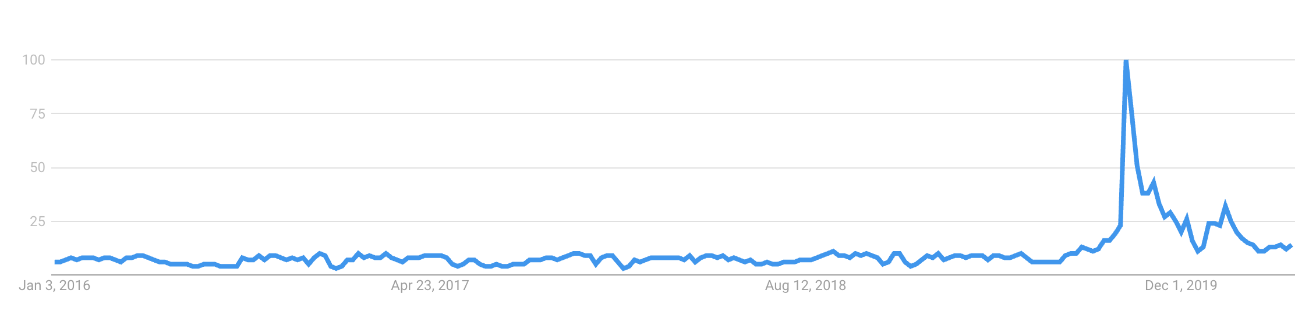
Emergence in Computer science
Becoming more popular
Software Engineering
  Subsystems and their organization
  Emergent Properties
    Reliability
    Security
    Usability
  Consequences
    Unintended results
Internet
  Power law
Artificial Intelligence
  Internal vs External
[2] [3] [4] [5] [8]
Notes:
In computer science emergence can be seen everywhere. Software is often made up of smaller parts that communicate with each other, so it makes sense that we see can see it here.
Reliability, security, and usability are examples of emergence in software.
Other than these innate properties however, emergence in software engineering is often undesirable because the software is designed to fulfill specific needs of the client who usually does not want unintended results.
The internet has been found to show quite surprising properties of emergence. The power law is one instance. It is the tendency of most internet traffic to go to a very small subset of sites, while most sites have very little of the total internet traffic.
Artificial intelligence is another place it can be seen. Researchers have made distinctions between the internal design of artificial intelligence agents and their externally observed behavior.

Slide 30
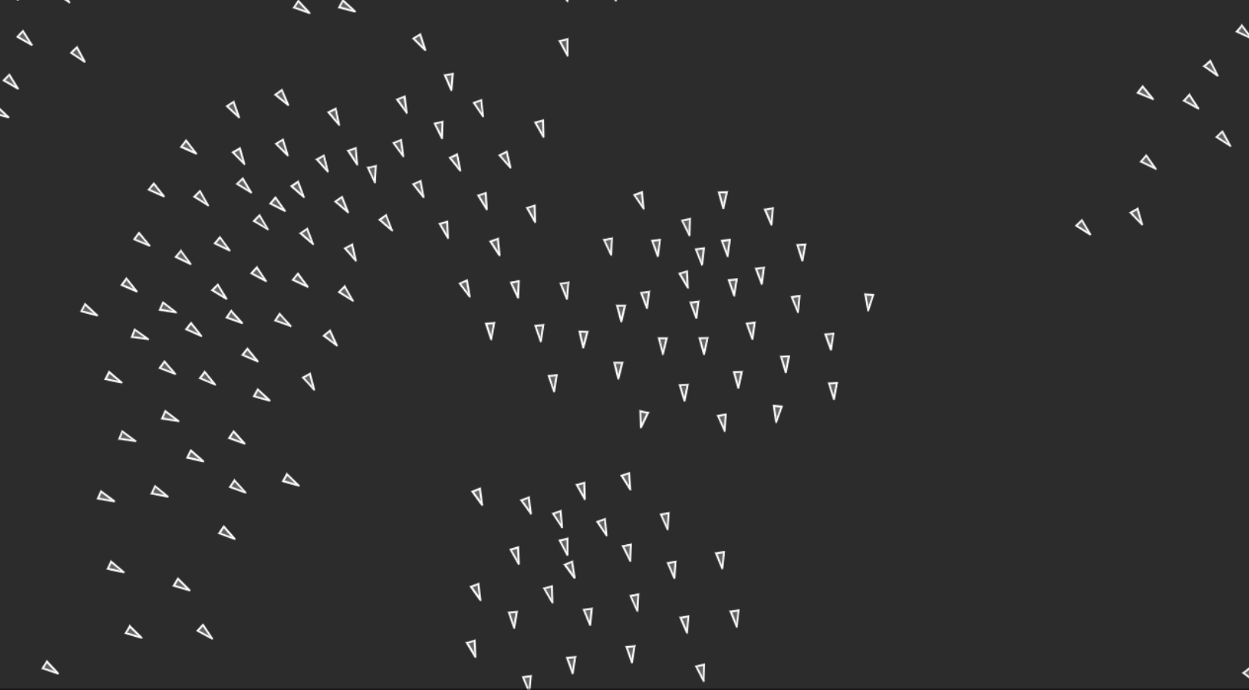
Uses of emergence
Complex systems
  The “Key”
Boids simulation
  Three simple rules
Agent Based Simulations (ABS)
  Uses
    Artificial Societies
    Real world simulations
  Real scenarios require unpredictability
[2] [4] [6] [7]
Notes:
So now that we know what emergence is, how can we use it?
In complex systems, emergence has sometimes been seen as what gives the system its complexity.
The boids simulation is a beautiful example. It accurately simulates a flock of birds. Each bird follows only three simple rules. (Play video)
Agent Based Simulations (ABS) greatly makes use of emergence. It is the simulation of agents interacting with one another. An agent is defined as an autonomous, proactive, and interacting entity within the simulation
The interactions between these agents in the simulations are often used to explore qualitative concepts ranging from simulation of artificial societies to simulations of the real world.
Real world scenarios are obviously unpredictable. In order to model it the simulation must be free from client and developer bias.
To do this, the conceptual model is built to be purposefully unpredictable. It cannot be validated until the output is observed, which means that the results are also irreducible.

Slide 31
Designing for emergence
ABS design process
  Cannot predict behavior statically
  Behavior is exhibited and observed at runtime
Emergent Based Engineering
  Purposefully designing software for emergent properties
  Still being researched
[2] [6]
Notes:
Agent Based Simulations uses the same design process as other fields like Software Engineering. The design process does not work well for ABS though, because it is verified differently and wants unpredictability and irreducibility.
Emergent Based Engineering is the idea that we can design the products with the intent of creating emergent properties. This type of engineering that is emergence-driven is still being researched and the process for which this would work is debated.

Slide 32
Conclusion
Emergence is everywhere
It can be planned for and utilized to do incredible things like create complex systems or build realistic unbiased simulations of real-world scenarios.
Notes:
Emergence can be seen everywhere!
We can use it in computer science to create complex systems and realistic unbiased simulations that can create amazing things like simulate the real world. By using an Emergent Based approach we can design for emergent properties in products.

Slide 33
References
<Your Name>
[1] Klaus A. Brunner, (N.D.), https://klaus.e175.net/emcsr2002.pdf
[2] Software Engineering System Dependability, https://cs.ccsu.edu/~stan/classes/CS410/Notes16/10-SystemDependability.html
[3] Nuno David, Jaime Sim o Sichman, Helder Coehlo, Towards an Emergence-Driven Software Process for Agent-Based Simulation, (N.D.)
[4] Gerhard Chroust, Emergent Properties in Software Systems, (2002)
[5] John Naughton, Why Power Has Two Meanings on the Internet, (Jan, 2013), https://www.theguardian.com/technology/2013/jan/06/power-laws-internet-john-naughton
[6] John Deguet, Laurent Magnin, Yves Demezau, (2007), https://www.sg.ethz.ch/media/publication_files/Deguet2007_Chapter_EmergenceAndSoftwareDevelopmen.pdf
[7] Daniel Shiffman, Flocking, (N.D.), https://www.processing.org/examples/flocking.html
[8] https://www.youtube.com/watch?v=16W7c0mb-rE&t=354s
[9] https://trends.google.com/trends/explore?date=2016-01-01%202020-04-26&geo=US&q=Emergence

Slide 34
Class 10
The End
Keith A. Pray
Instructor
socialimps.keithpray.net
Notes:
This is the end. Any slides beyond this point are for answering questions that may arise but not needed in the main talk. Some slides may also be unfinished and are not needed but kept just in case.

