Slide 1
Class 5
Intellectual Property
Keith A. Pray
Instructor
socialimps.keithpray.net
Notes:
Here’s the title slide. Excited already, aren’t you?
Weird Al Yankovic “Don’t Download This Song” (3:53)
https://www.youtube.com/watch?v=zGM8PT1eAvY

Slide 2
Papers
http://socialimps.keithpray.net/assignments/paper-guidelines/
Quantify
  Not terms like: less, more, a lot, huge, great, big, tiny, etc.
Avoid absolutes
  Terms like: all, none, always, never
  Difficult to prove, easy to show false
Define terms
No strawman fallacy in counter point
Read paper aloud to proof
Read directions, many time lines missing
Notes:
Save for next time:
Be sure to put quotes around entire quote
State a strong, clear conclusion
First statement preferred
Provide Counter Point and Response
Print 2 sided and save a tree
Hyperbole is the best thing ever!
but not in these papers
No strawman fallacy in counter point
Text book is not a primary source
Use template, saves time (and -1 point)
Cite as suggested [1]

Slide 3
Overview
Review
Assignment
Students Present
Guest Speaker –

Slide 4
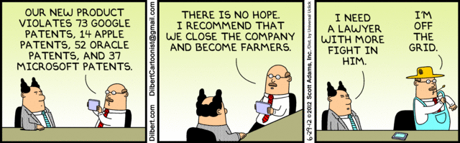
Notes:
Comments, observations, questions on IP Chapter?

Slide 5
My Reading Notes
pp. 165 “...ownership of ideas...” not quite right
pp. 168 public domain year 1997/1999 from source published in 1996?
pp. 170 SaaS, Google Search example? “…before he gave them the plot.”? “…cannot erase the memories...” Paycheck (2003)
pp. 180 4.4 #2 preferred?
pp. 186/196 revenue != profit
pp. 190 blocking 100% seems impossible
pp. 194 Any legitimate BitTorrent use examples since 2005?
pp. 197 “licensing agreement … hardware”? Confidential source code very outdated.
pp. 198 4.7.3 references?
pp. 205 Perhaps friends should not ask you to break the law?
Any successful businesses operate as a support service?
pp. 207 Is Perl still most popular? Quality study from 2003, change?
pp. 209 who uses tape?
pp. 210 “human-readable, lawyer-readable…”
pp. 223 Interview has nothing to do with computing

Slide 6
Group Quiz
For each On the left answer a–d on Right
Trademark
Copyright
Patent
Trade Secret
What does it protect?
What qualifications have to be met?
How long does protection last?
Give a specific example currently protected?
Notes:
Trademark
Used to denote a product or service.
Apply in specific areas of commerce. Only applies in specified area of business
Indefinite term as long as in use and protected against becoming a common noun or verb.
You do not have to register a trademark unless you want to bring litigation before a federal court (there are other benefits too, but what are they?)
Copyright
Expression, not ideas: Fuzzy. E.g. derivative works, characters, merchandising, plots.
Mickey Mouse, Tarzan.
US Default : Original Author, Exception: work for hire, Transferred: yes
Rights: Publication, Performance / exhibition, Adaptation to other media, Excerpting, Attribution, Derivative works
US Term: Lifetime of author plus 70 years., 95 years for companies.
Governed by US law and international treaties (e.g. WIPO).
Fair Use: News reporting, reviews, etc., Scholarly / educational use, Private, non-commercial use, Lending libraries and archives
Fair Use restrictions: Admission charge, Re-transmission
In general, you can: Read, view, play, etc., Copy for personal use., Time-shift, Space-shift
In general, you cannot: Copy for others., Transfer to someone else but keep a copy., Show / perform it publicly.
What about video rentals?
Rationale: Encourage creativity. Encourage dissemination. Balance between private and public good. It’s a social contract.
Patent
A mechanism, process, or composition of matter.
Must be: Novel. Useful. Non-obvious. Described clearly. Must do what it says.
Usual term 20 years.
Utility and plant patents: 20 years.
Design patents last 14 years. (ornamental design of functional item)
Provisional patent gives 1 year, before full patent
Trade Secret
You must take steps.
Enforceable by: Contracts, Laws against industrial espionage.

Slide 7
Group Quiz
For each On the left answer a–d on Right
Trademark
Copyright
Patent
Trade Secret
What does it protect?
Qualifications required?
How long does protection last?
Specific example currently protected?
Notes:
Trademark
Used to denote a product or service.
Apply in specific areas of commerce. Only applies in specified area of business
Indefinite term as long as in use and protected against becoming a common noun or verb.
You do not have to register a trademark unless you want to bring litigation before a federal court (there are other benefits too, but what are they?)

Slide 8
Group Quiz
For each On the left answer a–d on Right
Trademark
Copyright
Patent
Trade Secret
What does it protect?
  Mark denoting product of service
Qualifications required?
  Unique in specific area of commerce
How long does protection last?
  While in use and protected against common noun or verb usage. Need to register to sue.
Specific example currently protected?
Notes:
Trademark
Used to denote a product or service.
Apply in specific areas of commerce. Only applies in specified area of business
Indefinite term as long as in use and protected against becoming a common noun or verb.
You do not have to register a trademark unless you want to bring litigation before a federal court (there are other benefits too, but what are they?)

Slide 9
Group Quiz
For each On the left answer a–d on Right
Trademark
Copyright
Patent
Trade Secret
What does it protect?
Qualifications required?
How long does protection last?
Specific example currently protected?
Notes:
Copyright
Expression, not ideas: Fuzzy. E.g. derivative works, characters, merchandising, plots.
Mickey Mouse, Tarzan.
US Default : Original Author, Exception: work for hire, Transferred: yes
Rights: Publication, Performance / exhibition, Adaptation to other media, Excerpting, Attribution, Derivative works
US Term: Lifetime of author plus 70 years., 95 years for companies.
Governed by US law and international treaties (e.g. WIPO).
Fair Use: News reporting, reviews, etc., Scholarly / educational use, Private, non-commercial use, Lending libraries and archives
Fair Use restrictions: Admission charge, Re-transmission
In general, you can: Read, view, play, etc., Copy for personal use., Time-shift, Space-shift
In general, you cannot: Copy for others., Transfer to someone else but keep a copy., Show / perform it publicly.
What about video rentals?
Rationale: Encourage creativity. Encourage dissemination. Balance between private and public good. It’s a social contract.

Slide 10
Group Quiz
For each On the left answer a–d on Right
Trademark
Copyright
Patent
Trade Secret
What does it protect?
  Expression, not ideas. Derivative work, publication, performance
Qualifications required?
  Original
How long does protection last?
  Author lifetime + 70 years, 95 years for companies
Specific example currently protected?
Notes:
Copyright
Expression, not ideas: Fuzzy. E.g. derivative works, characters, merchandising, plots.
Mickey Mouse, Tarzan.
US Default : Original Author, Exception: work for hire, Transferred: yes
Rights: Publication, Performance / exhibition, Adaptation to other media, Excerpting, Attribution, Derivative works
US Term: Lifetime of author plus 70 years., 95 years for companies.
Governed by US law and international treaties (e.g. WIPO).
Fair Use: News reporting, reviews, etc., Scholarly / educational use, Private, non-commercial use, Lending libraries and archives
Fair Use restrictions: Admission charge, Re-transmission
In general, you can: Read, view, play, etc., Copy for personal use., Time-shift, Space-shift
In general, you cannot: Copy for others., Transfer to someone else but keep a copy., Show / perform it publicly.
What about video rentals?
Rationale: Encourage creativity. Encourage dissemination. Balance between private and public good. It’s a social contract.

Slide 11
Group Quiz
For each On the left answer a–d on Right
Trademark
Copyright
Patent
Trade Secret
What does it protect?
Qualifications required?
How long does protection last?
Specific example currently protected?
Notes:
Patent
A mechanism, process, or composition of matter.
Must be: Novel. Useful. Non-obvious. Described clearly. Must do what it says.
Usual term 20 years.
Utility and plant patents: 20 years.
Design patents last 14 years. (ornamental design of functional item)
Provisional patent gives 1 year, before full patent

Slide 12
Group Quiz
For each On the left answer a–d on Right
Trademark
Copyright
Patent
Trade Secret
What does it protect?
  Mechanism, process, composition of matter
Qualifications required?
  Novel, useful, non-obvious, described clearly, must function
How long does protection last?
  Utility and plant: 20 years
  Design: 14 years
  Provisional adds 1 year
Specific example currently protected?
Notes:
Patent
A mechanism, process, or composition of matter.
Must be: Novel. Useful. Non-obvious. Described clearly. Must do what it says.
Usual term 20 years.
Utility and plant patents: 20 years.
Design patents last 14 years. (ornamental design of functional item)
Provisional patent gives 1 year, before full patent

Slide 13
Group Quiz
For each On the left answer a–d on Right
Trademark
Copyright
Patent
Trade Secret
What does it protect?
Qualifications required?
How long does protection last?
Specific example currently protected?
Notes:
Trade Secret
You must take steps.
Enforceable by: Contracts, Laws against industrial espionage.

Slide 14
Group Quiz
For each On the left answer a–d on Right
Trademark
Copyright
Patent
Trade Secret
What does it protect?
  Anything
Qualifications required?
  Must take steps to keep secret, e.g. Non-Disclosure Agreements, contracts
How long does protection last?
  As long as kept secret
Specific example currently protected?
Notes:
Trade Secret
You must take steps.
Enforceable by: Contracts, Laws against industrial espionage.

Slide 15
Overview
Review
Assignment - Average Group Happiness 1.25
Students Present
Guest Speaker
Notes:
But first take a look at:
CGP Grey
Copyright: Forever Less One Day (6:27)
https://www.youtube.com/watch?v=tk862BbjWx4
Tom Scott
http://tomscott.com
Welcome To Life (2:44)
https://www.youtube.com/watch?v=IFe9wiDfb0E&feature=youtu.be

Slide 16
Assignment - Self Search 1/3
Profile 2
Is You
1 Page
Paper
Filter
Inspiration
Search Methods
…
…
…
…
Filter
Profile 1
Could Be You

Slide 17
Assignment - Self Search 2/3
Discussion Board
Post search techniques
  Do not repeat entries.
Use techniques listed to produce a profile that could be you.
  Not responsible for techniques posted less than 24 hours before class
Filter first profile so that the information is for you.
Provide as appendix
  Provide a brief description if you’d rather not list the details
For search result consider:
  Exactly how did the data get there?
  How can this data be used?
  Is this a secondary use?
  Did you authorized use of the data? If not and you want to, request its use be discontinued and share the experience.
Be creative, anyone can type a name into Google
Do not pay for search services

Slide 18
Assignment - Self Search 3/3
1 Page Paper
Refer to search results to support your conclusion
Subscribe to the Discussion Board
Conclusion idea examples (not comprehensive):
  What impression would the profile make on a potential employer?
  What would your elder family members (or equivalent) think?
  Are you comfortable with what you found or did not find?
  Do you believe protecting your privacy is important or needed?
5 High quality sources still required

Slide 19
Overview
Review
Assignment
Students Present
Guest Speaker

Slide 20
Video Game Consumer Rights
Matt Ferreira

Slide 21
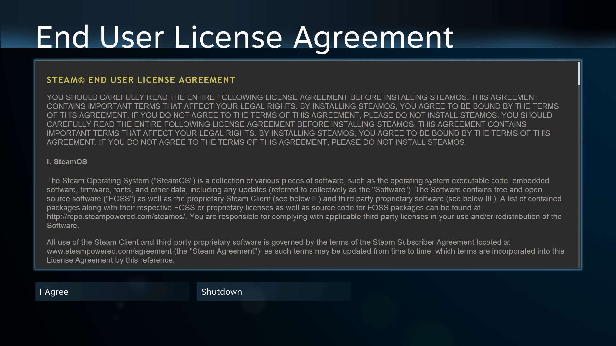
Product Vs service
Matt Ferreira
Games Traditionally a Product
  Disk
  Cartridges
Now there is Ambiguity
  Digital Distribution
  Streaming Services
  Vernor v. Autodesk
[1]
[2]
Notes:
The video game industry is an exploded over the past two decades, becoming larger than the music and movie industries combined
Along with that change is a shift in how video game developers treat their intellectual property.
When video games where physical media they were treated as a product but as things become more digital companies want to claim that these games are in fact a service
The upcoming micorsoft xlcoud streaming is clearly a service, where a customer pays a monthly fee to play a list of games, the same model as Netflix
Interestingly google has a somewhat similar service called google stadia. The key difference is that in addition to paying a monthly fee customer must also purchase indiudal games just as if they were buying a physical copy. That means if this service where to shut down the customers would have no legal way to play what they had bought
Even straight up buying a game for download can be rendered a service due to 2008 case Vernor v. Autodesk

Slide 22
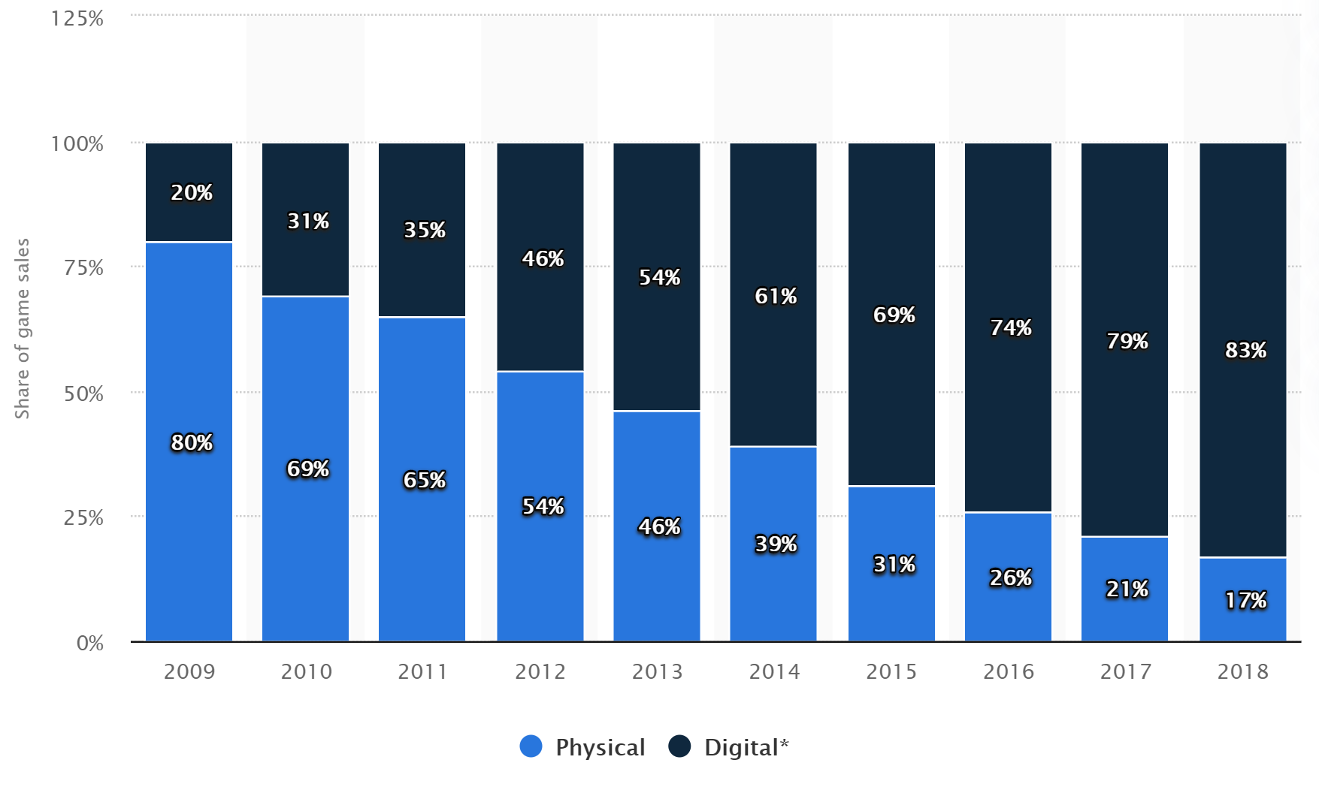
Resale
Matt Ferreira
First Sale Doctrine
Digital Products don’t “Degrade” in the same way physical Products do
Games sold digitally are treated differently form those sold physically
[4]
[3][5][6][7]
Notes:
Why would a company prefer to offer a service rather than a product? It provides greater control.- can ignore first sale doctrine
First sale doctrine aka copyright exhaustion allows consumers to give or sell their specific copy to whomever they wish
For example if you bought a music albulm you are not allowed to copy it and sell it but you are allowed to give that original album away
This does not mean game publishers have no legitimate reason to prevent the resale of there Ips. Unlike with physical products digital products don’t degrade with time as would a car for example. This means customers could play a game a sell it when they are done for half price. The individual who buys this used copy is essentially getting a new product for half the price and so has no reason to buy it from the copyright owner.
This however does not justify the total prevention of resale. Players can spend thousands of dollars on single game buy virtual products with little to no opportunity to sell them at a later date or even will it away to family. When a person “owns” these games and virtual products dies all rights to them vanish on the simple grounds that they are digital. If however they bought the game in a physical medium they would have those rights
In 2009 French courts ruled that companies cannot prevent the resale of games based on how the game was delivered to the end user. It remains to be seen if the US will enforce similar laws in the coming years.

Slide 23
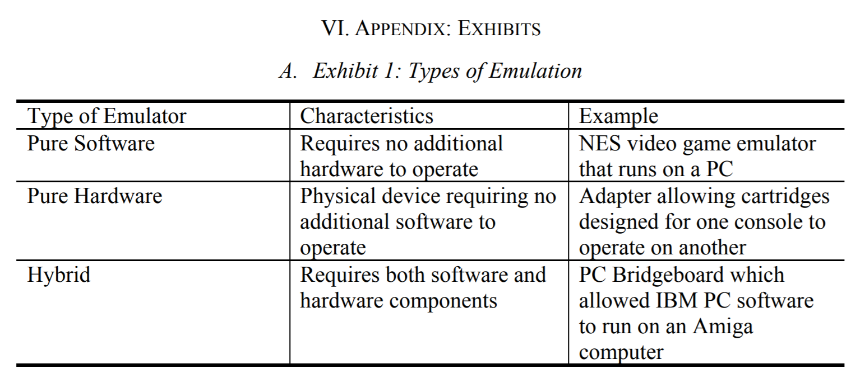
Emulation and modding
Matt Ferreira
Can play on different platforms
Preserves access to games that may no longer be accessible
Fix bugs and improve performance
[10]
[8][9][10]
Notes:
When consumers purchase the rights to play a game companies often put restriction on where or how they play.
For example companies design their games to be playable only on products that they sell. This mean that when a customer purchases the right to play a game they are not guranteed to be able to use it. To get buy this consumer can emulate the game by using hardware or software to be able to enjoy the game on a platform that the publisher hadn’t intended.
This can be very important for games that may be no longer accessible for those who purchasesd them. For example if someone legally owns a old Nintendo cartridge but their Nintendo is broken, they will be able via software or an adapter play the game on a modern computer. Additionally if a game they own requires a server that the company shutdown emulation allows the game to live on. Companies of course sees this as copyright infringement and often file law suits
Modding or the modification of games is another important ability of game owners. While the ability to mod a game can certainly be misused, it can also be critical to fix gamebreaking bugs or improve the performance of an old game for modern hardware. Modding a game is analogous to taking a vehicle to a mechanic for repairs and tune-ups.

Slide 24
Possible solution
Matt Ferreira
Cloud-based digital rights locker
  Timed resale permission
Notes:
Due to the interactive and often social nature of video game ownership is significantly more complex than other entertainment media. However new technology can help ellivate some of the problems I have brought up. Cloud-based digital rights lockers have been used to combat piracy in movies. An example of such a service is movies anywhere. This service allows a customer to receive a digital code when ever they buy a movie from a participating company. This code allows them to access the movie from any vendor. If they bought the movie on amazon they will be able to access it on hulu. This could be applied to video games to ensure that the publishers and developers can profit off their IP while giving consumers real ownership over what they buy. To ensure that the resale of games doesn’t cripple the companies economically there could be a minimum time required before the digital code could be passed from one use to another. So when the game is new all the money goes to the IP owners and gradualy over time customers will be allowed to resell their products.

Slide 25
References
Matt Ferreira
[1] Falcon, Jonathon A, FRENCH CONSUMER ADVOCATE SUING VALVE OVER VIOLATING CONSUMER RIGHTS, (Gamewatcher, 12/18/2015), https://www.gamewatcher.com/news/2015-18-12-french-consumer-advocate-suing-valve-over-violating-consumer-rights (4/8/2020)
[2] Golden, Mathew, DEATH OF THE SECONDARY VIDEO-GAME MARKET: NATURAL CAUSES, OR EUTHANASIA? (U. OF PENNSYLVANIA JOURNAL OF BUSINESS LAW, 8/28/2014) PP. 1189-1210
[3] Fawbush, Joseph, Digital Rights Over Video Games Under International Scrutiny, (FindLaw, 7/27/2019), https://blogs.findlaw.com/technologist/2019/09/digital-rights-over-video-games-under-international-scrutiny.html (4/8/2020)
[4] Gough, Chistina, Breakdown of U.S. computer and video game sales from 2009 to 2017, by delivery forma, (statista, 8/9/2019), https://www.statista.com/statistics/190225/digital-and-physical-game-sales-in-the-us-since-2009/ (4/8/2020)
[5] Elks, Sonia, Virtual goldmine: In-game goods fuel debate over digital ownership, (Reuters, 11/25/2019), https://www.reuters.com/article/us-global-videogames-property-analysis-t/virtual-goldmine-in-game-goods-fuel-debate-over-digital-ownership-idUSKBN1Y0032 (4/8/2020)
[6] 1854. COPYRIGHT INFRINGEMENT -- FIRST SALE DOCTRINE, (The United States Department of Justice Archives, 1854), https://www.justice.gov/archives/jm/criminal-resource-manual-1854-copyright-infringement-first-sale-doctrine (4/9/2020)
[7] Gallacher, Emma, Exhaustion of Copyright, https://www.lexology.com/library/detail.aspx?g=29f0d605-aae8-4163-966b-3d2acb0ba3a3 (4/8/2020)
[8] Kuehl, John, Video Games and Intellectual Property: Similarities, Differences, and a New Approach to Protection (Mitchell Hamline School of Law, 2016), PP.11
[9] (RIAA) https://www.riaa.com/resources-learning/about-piracy/ (4/8/2020)
[10] Conley, James, Use of a Game Over: Emulation and the Video Game Industry, A White Paper (Northwestern Journal of Technology and Intellectual Property, Spring 2004), Vol 2

Slide 26
AI and Intellectual property
Shuxing Li

Slide 27
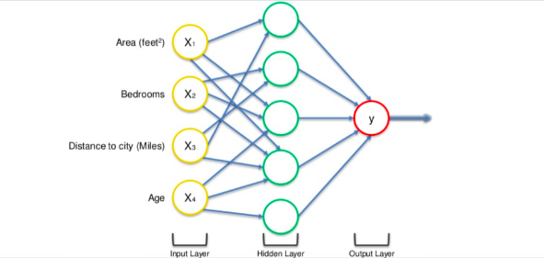
Artificial Neural network
Shuxing Li
Examples:
  Image/Text recognition
  Style Transfer
Problematic Examples
  Deepfake/Voice Synthesis
  Image/Music Generation
What is an ANN:[1]
Problematic Examples: [2]
Notes:
Although there’s quite a lot of topic under artificial intelligence, we will mainly be focusing on topics relating to artificial neural network.
What is an artificial neural network? An ANN is composed of many neurons that have different weights. The network takes inputs and associate them with certain outputs. Using this method,
It is possible to create Ais that does image or text recognition, or style transfer.
There are, however, more problematic neural networks that stepped into the realm of intellectual property,
Such as the deepfake or voice synthesis, music or image generation
As for today, we are mainly covering the problem with computer generated art assets and related copyright problems.

Slide 28
Current State of ART
Shuxing Li
A common sense has yet to be achieved.
The World Intellectual Property Organization is working actively on cases regarding such topic.
  Should AI created content be copyright protected?
  Should the copyright belong to an AI, or does it belong to a human creator?
    Favoring either one can have significant impacts on the creators’ future.
  Is it a violation of IP if an AI uses copyrighted work as training sets?
WIPO Proposal: [2]
Notes:
As for currently, a common knowledge has yet to be achieved by the countries. The World Intellectual Property Organization held a conference on February 2020 regarding this issue, and will
Hold another conference very recently regarding the issues of intellectual properties, such as creating works, using copyright data as training sets, or the belonging of intellectual properties with Deepfake videos.

Slide 29
Should generated content be protected?
Shuxing Li
Different countries treat the topic differently:
Tencent won a case against company who copied stock market article from their AI writer Dreamwriter.
  Court find Dreamwriter’s article “uniquely enough to be considered copyrighted”
United States: Human must be involved in the process of creation to have the material protected.
Tencent Dreamwriter: [5]
US Copyright Office [8][9]
Notes:
Should AI created content have copyrights? Countries like China and Japan already have laws regarding AI created contents, and state that AI created contents have copyright. This, however, does not stand true for countries like the United States. The united states claim that a human must be involved in the process to have a piece of work be copyright protected.
In January 2020, Tencent won a lawsuit against another company who copied the financial article created by Tencent’s AI Dreamwriter. The court believe that the Dreamwriter has created article uniquely enough
That the articles should be considered copyright materials.
But that brings to further question – If an AI created work has copyright, who should be the holder of the copyright material, the AI, or is it human?

Slide 30
WHO SHOULD OWN THE COPYRIGHT?
Shuxing Li
Current “Weak AI” cannot be considered a valid author
Current AI is only a tool for improving creation workflow
  Unless the current AI is “Strong AI” which can think and create spontaneously.
Allowing AI owning copyright can lead to more complications regarding copyright contents.
Dreamwriter case favor human as copyright holder, but ownership is highly dependent on the copyright law of different country.
  What is the copyright law trying to award? Humans, or any form of creator?
Human Creators: [3]
Dreamwriter Case Analysis: [4]
Strong, Weak AI [6]
Copyright Law [8]
Notes:
The German Patent and Trade Mark Office has a clear specification on such topic, to which many organizations in the WIPO agreed.
The current AI is considered a “Weak AI”. These AI cannot think independently, nor can they perform tasks other than creating content. Therefore, these AIs should be considered tools that assist in creativity works.
Unless the AI is considered “Strong AI”, they should not be able to own copyright in any sort. In fact, if a weak AI owns a copyright to its work, further complications regarding copyright may be brought up, leading to more difficult situations. The dreamwriter case also favored this way of thinking.
Still, the case can be completely different based on what each countries’ copyright law value: does it value humans, or just any kind of creator

Slide 31
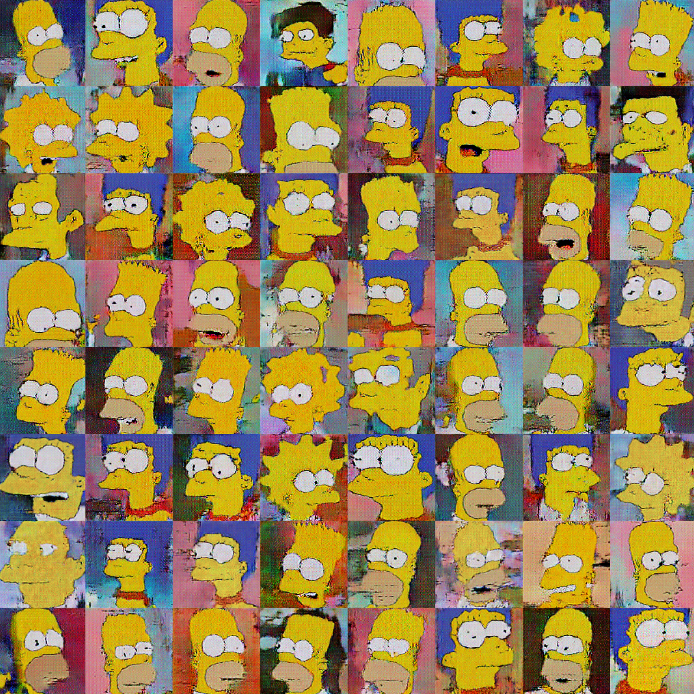
Using Copyrighted training sets
<Your Name>
Create a training set from copyright materials.
Use the training set to train an AI and use the AI to create content.
Appropriate use?
WIPO Proposal: [2]
Notes:
Another complication happens with using copyrighted training sets.
If someone created a training set using copyright materials, and used the training set to train his neural network, is it a form of appropriate use?

Slide 32
Using Copyrighted training sets
Shuxing Li
Proof of infringement is difficult to find.
Does not necessarily impact the original creator of the data
Bears similarity to datamining
  Datamining has exceptions in the European Unions
  Similar laws can be enforced under such matter
Judgement also varies from country to country.
  Somewhat fair use in the U.S.
  Infringement in Australia.
Proof of Infringement [7]
Impact on Original Creator, Similarity to Datamining [3]
Data Mining Exceptions [8]
Notes:
Huawei and Wikimedia both consider using copyright training sets a valid move, because the proof of infringement is difficult to find, and the work generated does not necessarily negatively impact on the original creator of the data.
Also, using these sets to train neural network bears a similarity to datamining, which has some special exceptions on extracting information from copyrighted materials, both in the U.S. and in the EU. Similar laws can be applied under neural network situations.
However, the judgement of this kind of behavior may vary from country to country. Australia claims that artworks with a tiny sign of other creator’s work is considered infringement, and using copyrighted training sets is probably a bad idea.

Slide 33
Conclusion
Shuxing Li
Laws have yet to be drafted for conflicts in this area
  Current framework has some level of support for such conflicts, but many details are missing.
  Issues are highly dependent on the countries’ laws.
For the U.S.
  AI generated works are not protected by copyright.
  Using copyrighted data is a gray zone, but the law seems to be in favor.
Notes:
Overall, there is simply not enough information to determine whether Ais should have copyright, and using copyrighted training sets are fair use.
But there’s something we can conclude – for the united states, computer generated works are not currently protected by the copy right.
As for using copyrighted data as training set? Laws are missing in such matter, and we can expect to see some changes very soon.

Slide 34
References
Shuxing Li
[1] Nagesh Singh Chauhan, Introduction to Artificial Neural Networks(ANN) (October 3, 2019) https://towardsdatascience.com/introduction-to-artificial-neural-networks-ann-1aea15775ef9
[2] WIPO, Draft Issues Paper on Intellectual Property Policy and Artificial Intelligence (December 13, 2019) https://www.wipo.int/meetings/en/doc_details.jsp?doc_id=470053
[3] WikiMedia Foundation, Re: Draft Issues Paper on Intellectual Property Policy and Artificial Intelligence(February 14, 2020) https://www.wipo.int/export/sites/www/about-ip/en/artificial_intelligence/call_for_comments/pdf/org_wikimedia_foundation.pdf
[4] Xiaomi, Re: Draft Issues Paper on Intellectual Property Policy and Artificial Intelligence (n.d.) https://www.wipo.int/export/sites/www/about-ip/en/artificial_intelligence/call_for_comments/pdf/org_xiaomi_zh.pdf
[5] Yangfei Zhang, Court rules AI-written article has copyright (January 09, 2020) https://www.chinadaily.com.cn/a/202001/09/WS5e16621fa310cf3e3558351f.html
[6] German Patent and Trademark Office, Artificial intelligence and intellectual property rights (n.d.) https://www.sciencedirect.com/science/article/pii/S0267364911001518#fn10
[7] Huawei, Re: Draft Issues Paper on Intellectual Property Policy and Artificial Intelligence (n.d.) https://www.wipo.int/export/sites/www/about-ip/en/artificial_intelligence/call_for_comments/pdf/org_huawei_zh.pdf
[8] Macquarie Law School, Re: Consultation on Impact of Artificial Intelligence on IP Policy (February 14, 2020) https://www.wipo.int/export/sites/www/about-ip/en/artificial_intelligence/call_for_comments/pdf/ind_matulionyte.pdf
[9] U.S. Copyright Office, Compendium: Chapter 300 (Revised September 29, 2017), https://www.copyright.gov/comp3/chap300/ch300-copyrightable-authorship.pdf, (pp. 4)

Slide 35
Class 5
The End
Keith A. Pray
Instructor
socialimps.keithpray.net
Notes:
This is the end. Any slides beyond this point are for answering questions that may arise but not needed in the main talk. Some slides may also be unfinished and are not needed but kept just in case.

