Slide 1
Class 9
Errors Failures Risks
Keith A. Pray
Instructor
socialimps.keithpray.net
Notes:
Here’s the title slide. Excited already, aren’t you?
What is the point of this assignment? (Did SW Teams from the reading pick good test strategies? Will you be able to support your choices if something goes wrong?)
What errors? – Have student record list on board
Who looked for existing test strategies?
Who looked for directions on how to test currency?

Slide 2
Survey Results (1/2 Participation)
Notes:
I’m going to switch back to in class paper mid-term surveys, response rate just too low.
Common items for next time:
I am in FL 140 about an hour before and after each class
Estimated breakdown of course time per week:
4 hours class time
4 hours reading (2 chapters ~90 pages @ 2 minutes per page)
8 hours practicing mastery of material (papers, group project, class activity prep)
If you are spending much more than this let me know and we can figure out a more efficient way to spend your time

Slide 3
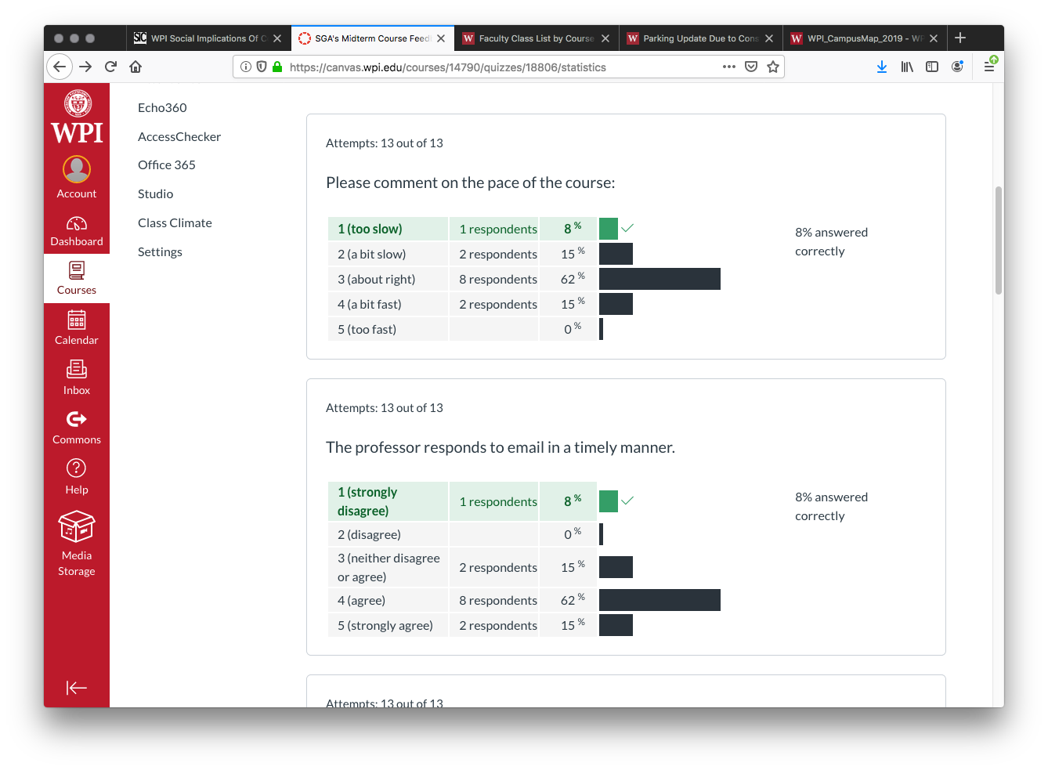
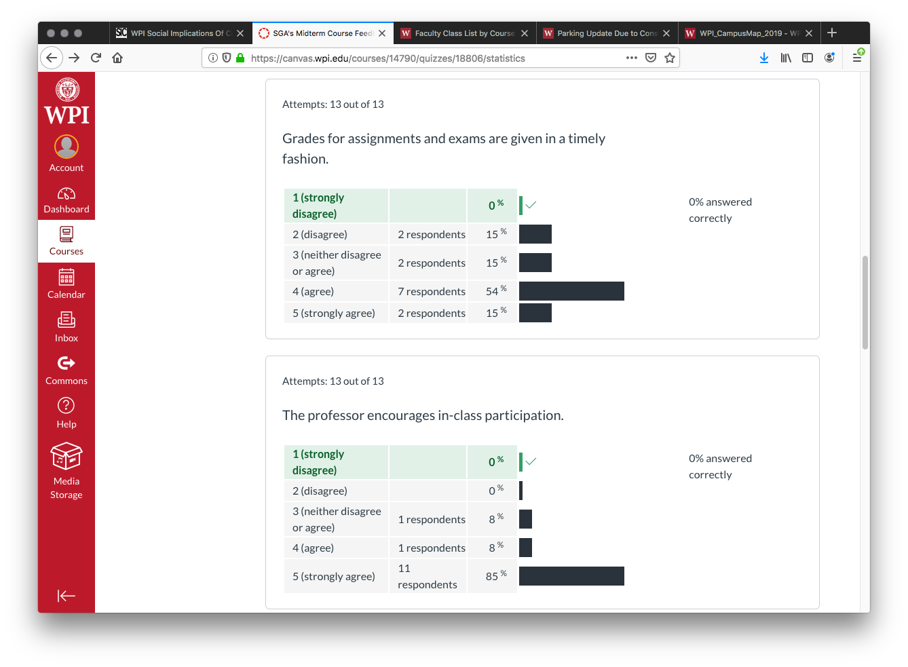

Slide 4
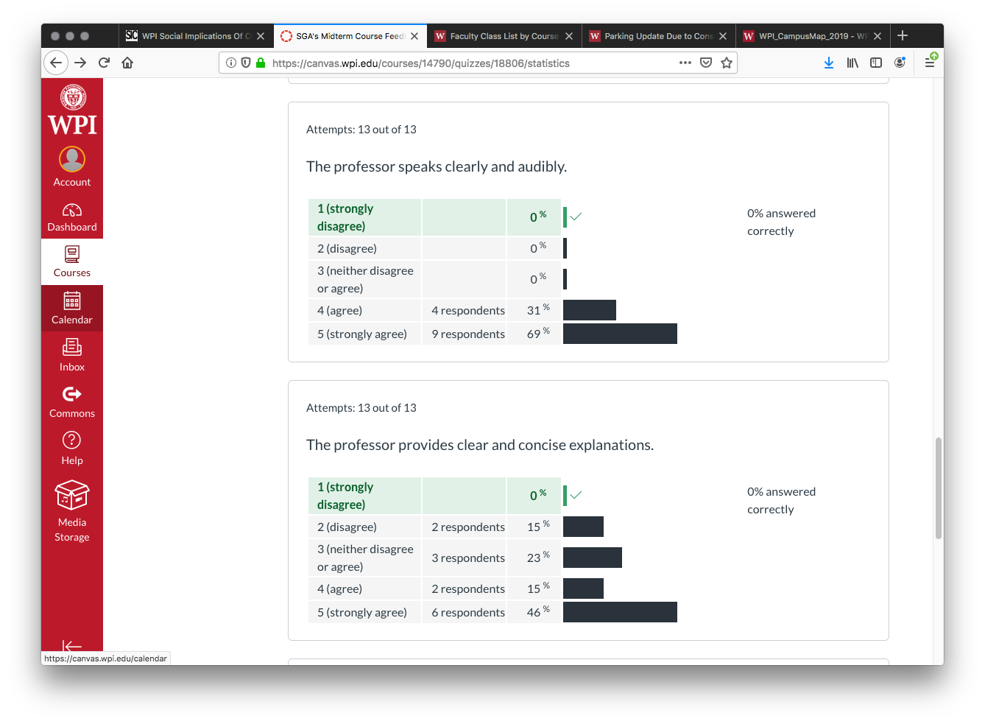
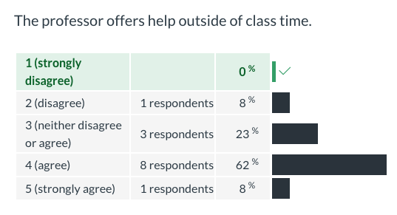

Slide 5
Grades
To Date
34 Max Possible

Slide 6
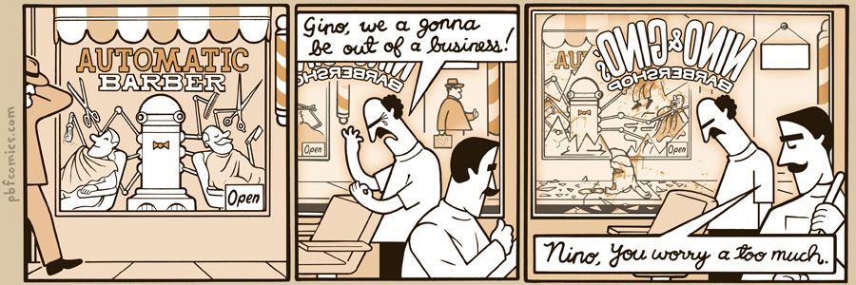
http://pbfcomics.com/197 (2014-09-26)
Notes:
10 – Errors, Failures, Risks

Slide 7
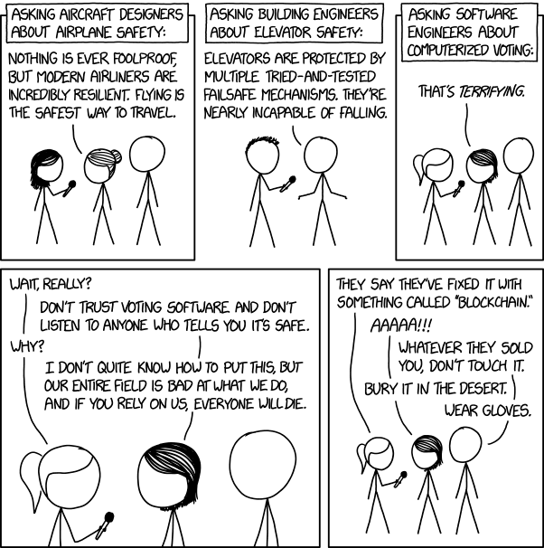
Overview
Guest Speaker
Review
Assignment
Students Present
https://xkcd.com/2030/ (2018-09-21)
Notes:
Good alternative if guest speaker not coming or late
Why Electronic Voting is a BAD Idea - Computerphile
https://www.youtube.com/watch?v=w3_0x6oaDmI
We can also discuss articles listed on Security Discussions under documents of course web site.
TODO: add quiz as backup if class discussion or guest speaker fail

Slide 8
My Reading Notes
pp. 366 Any false arrests since 1989?
pp. 368 Argument assumes DB cannot exist without existing inaccuracies.
pp. 373 This is not to keep the PATRIOT system from responding to false alarms.
pp. 375 Always encapsulate units! Not clear if SW involved.
pp. 376 Any SW diffs between Mars Missions?
pp. 378 Why did the Tokyo Stock Exchange refuse?
pp. 380 Republicans and Florida?
pp. 381. Do the second thoughts on DRE machines make the interview at end Chapter’s end less relevant?
pp. 389 No simulation examples since 2002?
pp. 390 Did The Limits to Growth predictions motivate people to change?
pp. 392 What happened to Verification?
pp. 394 “satisfies the specification” = verification. “needs of the user” = validation.
pp. 395 SW quality since 2009?
pp. 396 Gender bias nice addition!
pp. 406 21, source from 2004, is it implemented yet? 23 like game release question in next chapter.
Questions I liked: 10, 12, 16, 17, 18, 20, 21
Notes:
MSNBC on Denver's Automated Baggage System 2010-08-23 (2:27)
https://www.youtube.com/watch?v=xx8f4x6C_KY
Accessed 2019-04-09

Slide 9
Overview
Guest Speaker
Review
Assignment
Students Present
Notes:
We can also discuss articles listed on Security Discussions under documents of course web site.
ADD QUIZ AS BACKUP IF CLASS DISCUSSION OR GUEST SPEAKER FAIL

Slide 10
Assignment
Prepare for Debate
  From Chapter 9 In-class Exercises # 24.
  Should the company produce the game?
  Use the SWE Code Of Ethics as the basis for your argument.
  Use other sources for supporting data
Optional 1 paper on topic, lowest paper grade will be dropped

Slide 11
“Works Performs on my machine”
Kyle Ehrlich

Slide 12
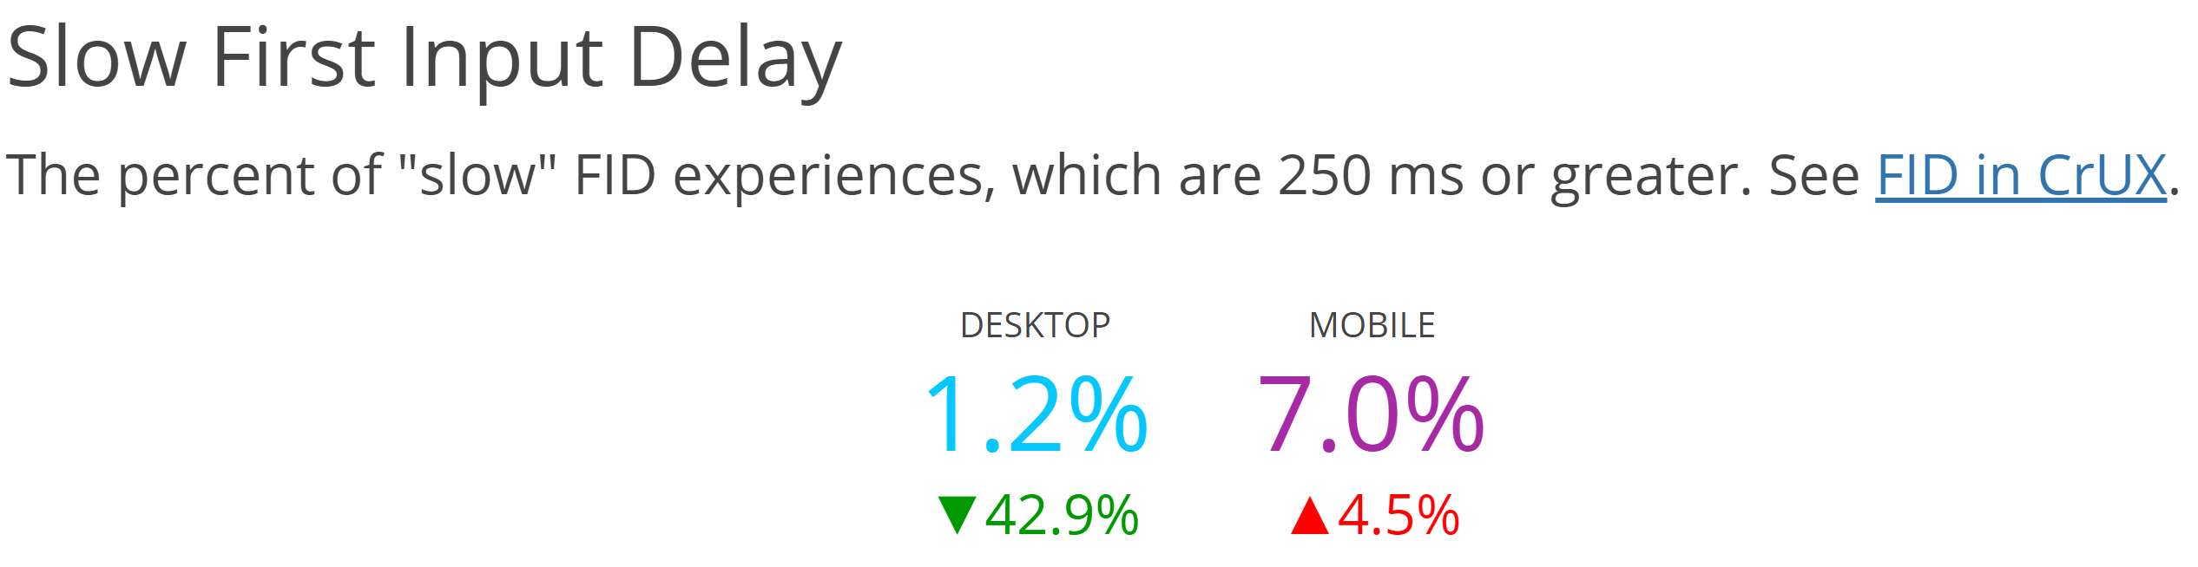
Problem: Processor performance
Kyle Ehrlich
Computing is going mobile.
  Aug 2019, 51.65% of computing devices are mobile.
Development lives on desktop where the users increasingly are not.
Mobile devises expose inefficiency.
https://httparchive.org/reports/chrome-ux-report
Notes:
Computing is going mobile. As of Aug 2019 51.65% of computing devices where mobile. How many of you develop and test actively on your phones? While it is possible, it is tedious and often comes at the expense of the debugging experience.
Why this matters is largely that generally speaking mobile devices are going to perform significantly slower than desktop. The statistic you see here on the left is from the Chrome User Experience Report analysis from http archive. It shows the % of time that the main thread on a webpage stays blocked for more than a quarter of a second. Additionaly you are going to be working in
SRC: https://gs.statcounter.com/platform-market-share/desktop-mobile-tablet/worldwide
SRC’: https://httparchive.org/reports/chrome-ux-report

Slide 13
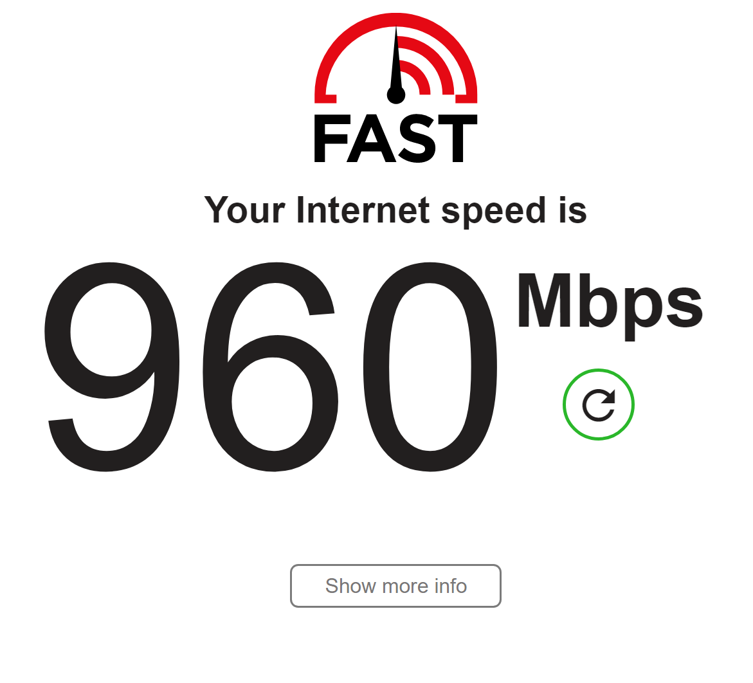
Problem: Network performance
Kyle Ehrlich
My development environment →
  Wired
  Desktop
Real users
  Global average connection speed: 7.2mbps [3]
  Mobile
<Fast.com>
Notes:
Performance has multiple components so first we are going to focus on network speed. On the right here you can see the results of a speed test I took while working on this presentation. This is the context I develop under, wired into the wall on a high quality network. This is more than one hundred and thirty times above the global average. Additionally as established earlier most users are on phones where connections may be unreliable or metered.

Slide 14
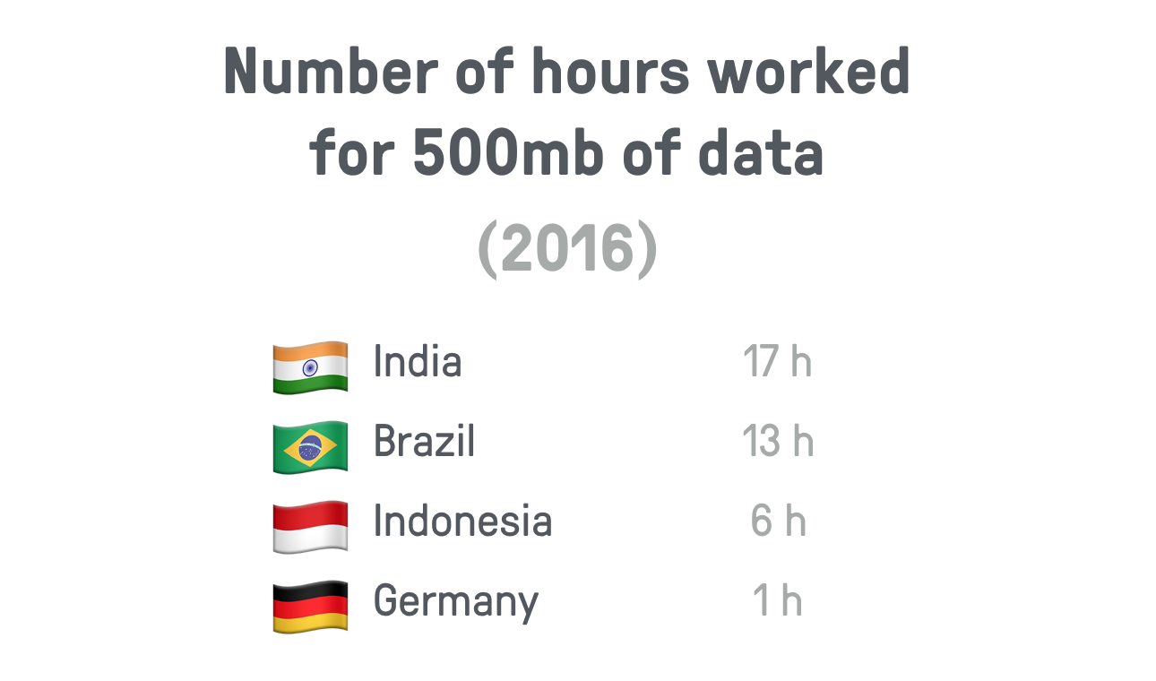
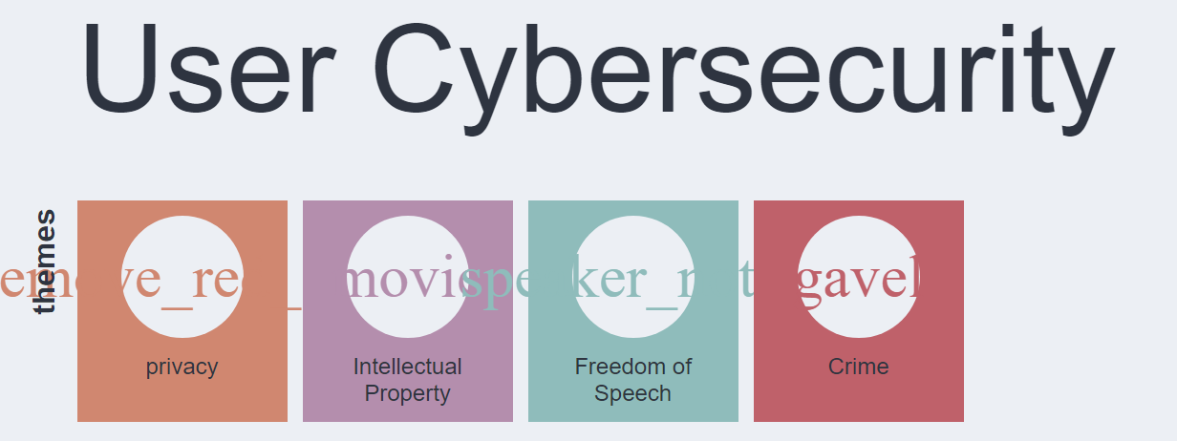
Why it matters
Kyle Ehrlich
Impact is not universal
Performance is reliability
[4]
[4] https://building.calibreapp.com/beyond-the-bubble-real-world-performance-9c991dcd5342
Notes:
This is not just about making the fastest applications possible, there are many ways that performance translates into reliability. If I had only tested on my unthrottled WPI connection, I probably would have never known that a user on a slow 3g connection visiting my groups project site would spend a while looking at this screen. Additionally the cost of these limited resources can vary wildly, such as data plans being more expensive internationally or on phones where unneeded work costs battery, which may be more costly to refill. So awareness of your application’s weight becomes critical. Just because a downloaded large font doesn’t matter for you data plan does not mean that this is universally true.
Notes for if it comes up in questions:
An interesting topic around the battery concern has to do with data collection. At least in the web context many browsers actually limit apis that allow pages to view battery state to combat fingerprinting.

Slide 15
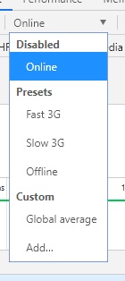
Solutions
Kyle Ehrlich
Collect real data
Test in accurately constrained environments
Set high goals
Notes:
So here are some solutions.
First: know your actual users and how your application performs on their machines, there are plenty of tools to help you do this
Second: test in real environments or accurately emulated environments, Most devtools will have a way to limit networks speeds, and you do own a phone.
Third: Set high goals. If you are going to develop on high-end hardware, your app should preform like it. For example the general guideline for web applications is that you should be seeing 60fps scrolling. Not because 30fps would make your users sick, but because if you get 30 on your computer, you might see 15 on a phone.

Slide 16
References
Kyle Ehrlich
[1] https://gs.statcounter.com/platform-market-share/desktop-mobile-tablet/worldwide (accessed 9/19/9)
[2] https://httparchive.org/reports/chrome-ux-report (accessed 9/19/9)
[3] State of the internet report (Q1 2017, akamai)
[4] https://building.calibreapp.com/beyond-the-bubble-real-world-performance-9c991dcd5342 (accessed 9/19/9)

Slide 17
Self Crashing Cars
Scott Gubrud

Slide 18
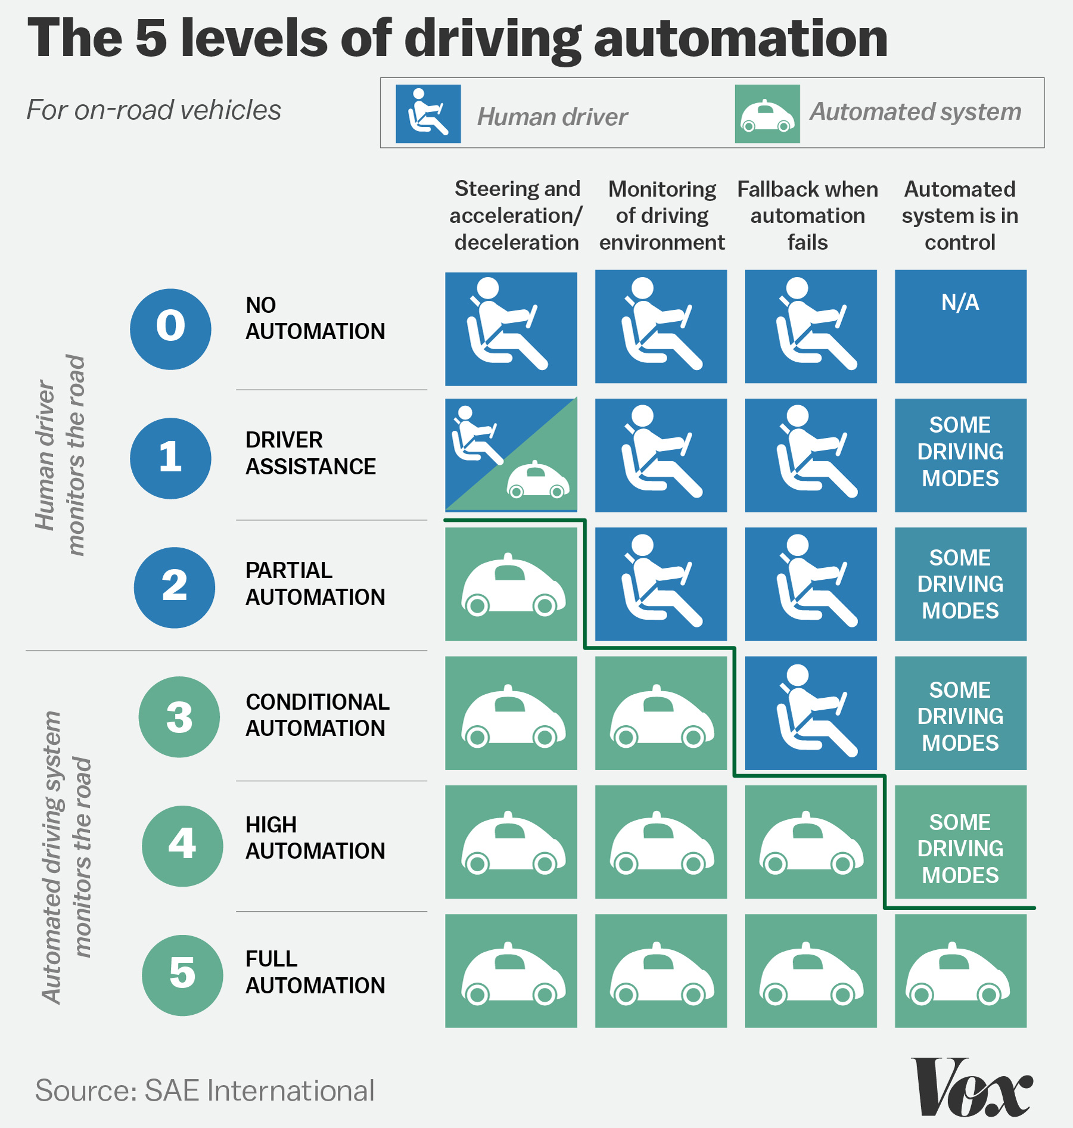
Computer vs human driving
Scott Gubrud
In 2017 there were approximately 6.4 million motor vehicle traffic crashes[1]
  That is roughly 2 crashes per million miles driven
  Around 90% of car crashes are caused by human error[2]
Autonomous vehicles have the potential to significantly reduce that
  Around 67% of Americans think that self-driving vehicles are somewhat or very likely to result in fewer crashes[3]
https://cdn.vox-cdn.com/uploads/chorus_asset/file/7129959/Driveless-car-scale.jpg
Notes:
In 2017 there were 6.4 million car crashes that’s 2 per million miles driven. At a human error rate of around 90% that means 5.76 million car crashes due to human error. One way to reduce this human error is to reduce human involvement in driving the car. The Society of Automotive engineers defines 5 levels of driving automation based on how much control is given to the computerized system and under what conditions. The traditional image of a fully self driving car that can operate almost entirely without human input would be a level 4 or level 5 car. 67% of Americans believe that self driving cars are likely to result in fewer crashes than human operated counterparts.

Slide 19
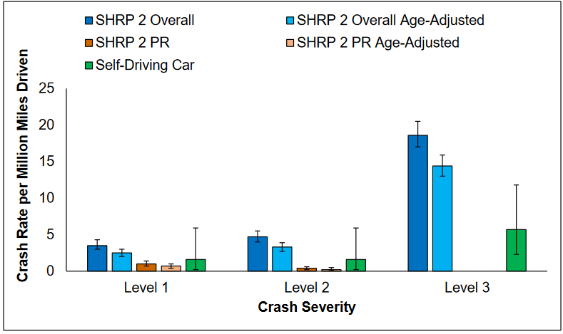
Are self-driving cars safer?
Scott Gubrud
While they are not susceptible to traditional human errors self-driving cars have their own problems
  Hardware failures
  Software failures
  Potential Cyber threats[4]
How do you test something like a self-driving car
  Hard to get statistically significant results in low error systems[5]
  How to test against the variety of variables you will see in the real world
https://www.vtti.vt.edu/PDFs/Automated%20Vehicle%20Crash%20Rate%20Comparison%20Using%20Naturalistic%20Data_Final%20Report_20160107.pdf
Notes:
But are self driving cars actually safer than human driven cars. While they avoid traditional human failures they have problems of their own. Autonomous vehicles in order to operate rely on a multitude of cameras and sensors as well as an interface for actually controlling the car. Each of these pieces introduces a new point of failure. All of the automation also requires a sophisticated software system in order to process inputs and make decisions. Any piece of software inevitably is going to have some bugs. There is also the problem of more malicious attacks. In 2016 two cyber security experts demonstrated that they could take control of some systems within certain Chrysler cars wirelessly. These were low level automation cars but breaking and some turning could be controlled. As the user gets further removed from control of the vehicle this kind of problem becomes potentially more dangerous as they make it harder for the user to respond in the event of an attack. Self driving cars also present a huge challenge for testing. Human driven cars see crashes around once ever 500 thousand miles on average so in order to test such a system you may have to drive more millions of miles. Also how in testing do you expose the vehicle to a wide enough range of conditions to be comparable to the real world. This image shows an attempt to compare crash rates across human and self driving cars. Initially self driving cars look like their doing good until you look at the error bars and see that potential error on these the entire bar.

Slide 20
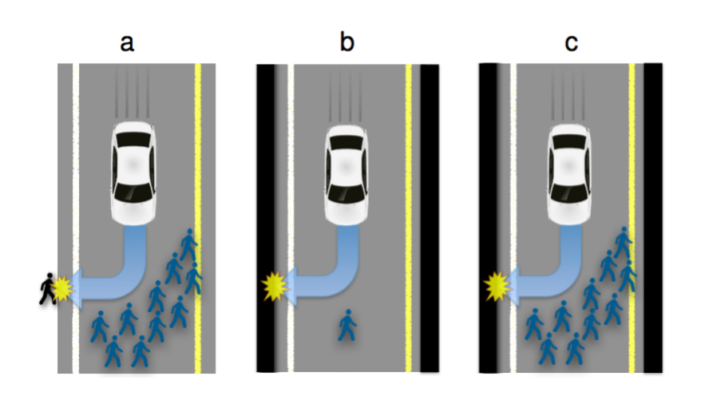
The ethics of self-driving cars
Scott Gubrud
Passenger safety vs the safety of pedestrians and other drivers
  A study found that Americans tend to agree with the utilitarian point of view that car should protect the greatest number of people[6]
  However people report that they would prefer buying a car that protected themselves[6]
Who should get to decide?
  The individual, the car maker, or the government
  The same study found people were far more likely to purchase if the decision was not regulated by the government
https://www.technologyreview.com/s/542626/why-self-driving-cars-must-be-programmed-to-kill/
Notes:
No matter how good self driving cars get they will still inevitably be put in situations were an accident is unavoidable. The image shows three such situations. In each the either a single individual or a group of individuals have stepped out in front of a car that does not have time to break to prevent hitting them. The car has two options swerve into a wall or hit them. How should the car decide in any of these situations. Should the car protect its passenger or should it protect the greatest number of people. When asked about what is the most moral decision in situation c where the choice is between the passenger and 10 people most people respond that sacrificing the passenger is most moral decision. However more of those same people reported that they would buy a car that protects themselves and their family members over one that simply tries to minimize damage.

Slide 21
References
Scott Gubrud
[1] Traffic Safety Facts Annual Report Tables. NHTSA. https://cdan.nhtsa.gov/tsftables/tsfar.htm retrieved 9/19/2019
[2] Human Errors Drive Growing Death Toll In Auto Crashes. David Schaper NRP. https://www.npr.org/2016/10/20/498406570/tech-human-errors-drive-growing-death-toll-in-auto-crashes retrieved 9/19/2019
[3] ASURVEY OF PUBLIC OPINION ABOUT AUTONOMOUS AND SELF-DRIVING VEHICLESIN THE U.S., THE U.K., AND AUSTRALIA. Brandon Schoettle and Michael Sivak UMTRI. https://deepblue.lib.umich.edu/bitstream/handle/2027.42/108384/103024.pdf retrieved 9/19/2019
[4]The Jeep Hackers Are Back to Prove Car Hacking Can Get Much Worse. Andy Greenberg. Wired. https://www.wired.com/2016/08/jeep-hackers-return-high-speed-steering-acceleration-hacks/ retrieved 9/19/2019
[5]Safer Roads with Automated Vehicles? OECD. https://www.itf-oecd.org/sites/default/files/docs/safer-roads-automated-vehicles.pdf retrieved 9/19/2019
[6]The social dilemma of autonomous vehicles. Jean-François Bonnefon, Azim Shariff, and Iyad Rahwan. https://arxiv.org/ftp/arxiv/papers/1510/1510.03346.pdf retrieved 9/19/2019

Slide 22
Class 9
The End
Keith A. Pray
Instructor
socialimps.keithpray.net
Notes:
This is the end. Any slides beyond this point are for answering questions that may arise but not needed in the main talk. Some slides may also be unfinished and are not needed but kept just in case.

Slide 23
Reliability Of Statistics
Are other factors controlled?
Is enough time covered?
Is all data reported?
Use Intuition
  Are results reasonable?
Notes:
Power line dangers. Electromagnetic fields? PCBs in transformers?

Slide 24
Cost-Benefit Analysis
How much does it cost?
What do I get for this cost?
Notes:
Like a social contract.

Slide 25
Risk-Benefit Analysis
What could go wrong?
How likely is it?
How costly are the consequences?

Slide 26
Limitations to
Risk-Benefit Analysis
Hard to quantify probabilities
Hard to quantify costs
Who bears the costs?
Are the potential benefits worth it?
Notes:
What is the value of a human life?
What is the value of a species?
E.g. future generations, poor people.
Omelas

Slide 27
Some Measures
Mean Time To Failure (MTTF)
Mean Time Between Failures (MTBF)
Mean Time To Repair (MTTR)
Notes:
Is it repairable?
What does it mean to repair? Running again? Data fixed? Caught up?
Restoring the GBC Web site.

Slide 28
Relying Too Much
Limits of modeling reality
Limits of precision
Limits of algorithms
Limits of interpretation
Notes:
Battle of the X-Planes
Trusting the statistics. Are differences significant?
Colin Chapman’s Lotus 7 chassis.

Slide 29
Producing Good Software
Good specifications
Good usability
Good design
Robustness
Good implementation
Testing
Notes:
Specs: Know what you are going to do. Often difficult. What does the customer want? What does the customer need?
Usability: Logical and intuitive, Consistent, Helpful, Complete, Accessible, Disability. Complete—not have to write things down.
Design: Logical, Modular, Consistent, Well-specified, Flexible, Extensible, Adaptable, New features, new platforms.
Robustness: Tolerant of data errors, Tolerant of human errors, Tolerant of network errors, Enough detail / not too much. Stack trace vs. “?” “A script error has occurred. Do you want to debug?”
Implementation: Adequate hardware (E.g. memory, storage, speed), Adequate software (Languages, OS, libraries), Internal and external documentation
Testing: Should be at all phases of the development cycle. Plan ahead for it. Consistent, repeatable, documented. Regression testing.

Slide 30
Plan For The Long Term
Version control
Future development
New platforms
Patches
Security
Training
Customer support

Slide 31
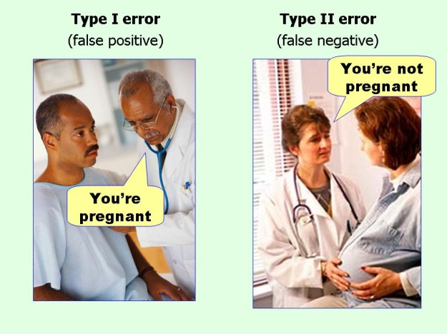
marginalrevolution.com/marginalrevolution/2014/05/type-i-and-type-ii-errors-simplified.html (2016-04-11)

