Slide 1
Class 3 Ethics
Keith A. Pray
Instructor
socialimps.keithpray.net
Notes:
Here’s the title slide. Excited again, aren’t you? You should be.
How did the first paper go?
What were your topics?
What conclusions did you draw?

Slide 2
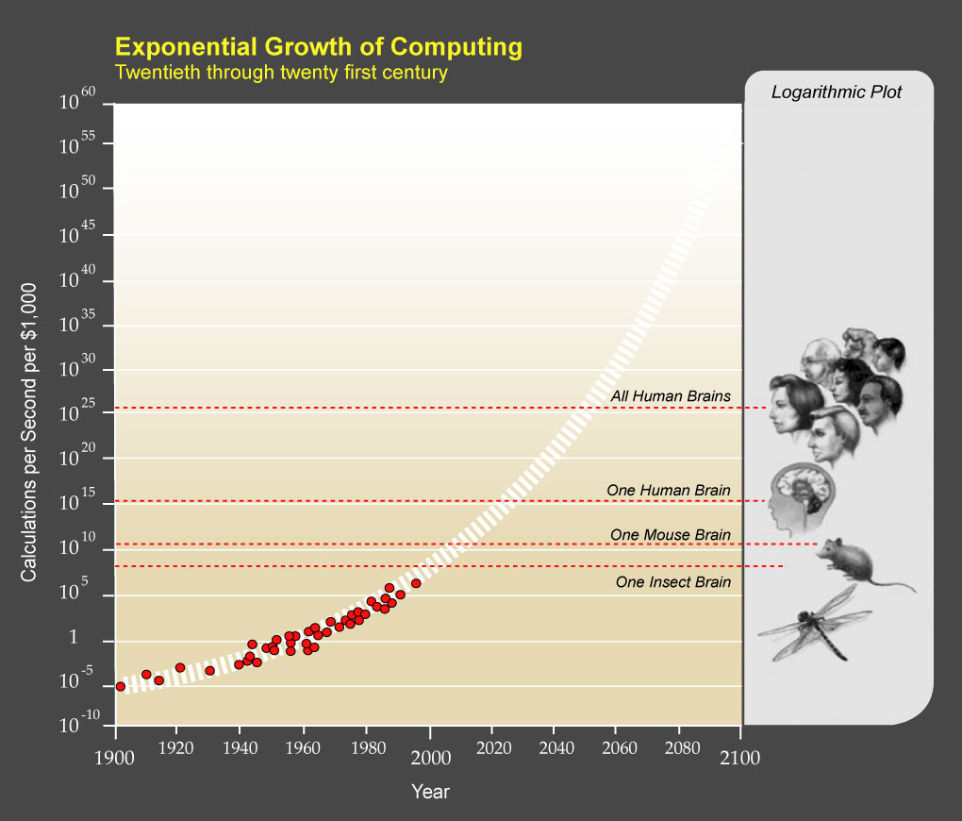
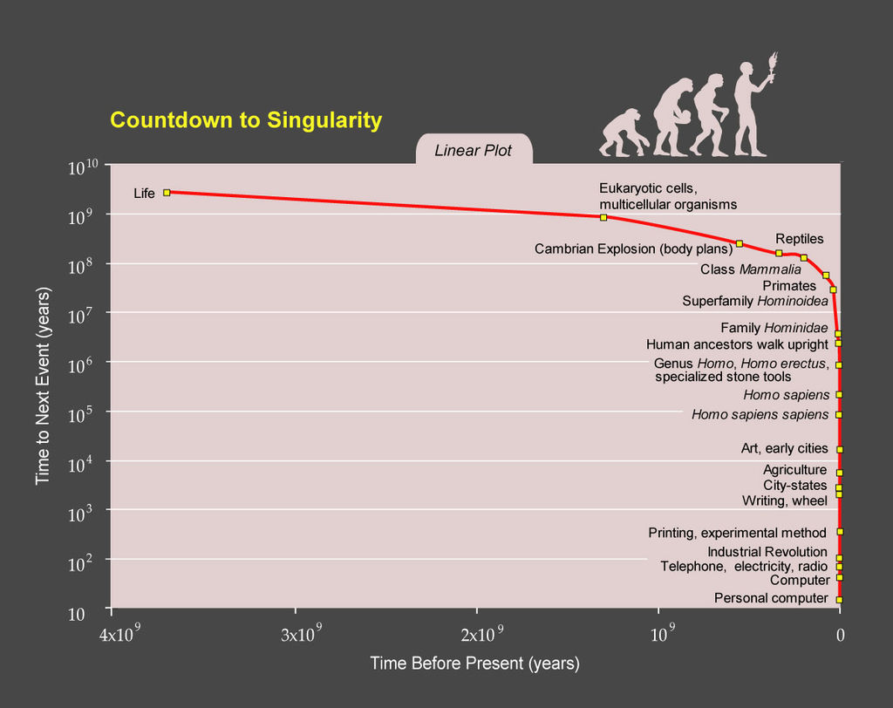
Ray Kurzweil
Notes:
[1] "PPTExponentialGrowthof Computing" by Coutesy of Ray Kurzweil and Kurzweil Technologies, Inc. - en:PPTExponentialGrowthof_Computing.jpg. Licensed under CC BY 1.0 via Wikimedia Commons - http://commons.wikimedia.org/wiki/File:PPTExponentialGrowthof_Computing.jpg#/media/File:PPTExponentialGrowthof_Computing.jpg
[2] "PPTCountdowntoSingularityLinear" by Coutesy of Ray Kurzweil and Kurzweil Technologies, Inc. - en:PPTCountdowntoSingularityLinear.jpg. Licensed under CC BY 1.0 via Wikimedia Commons - http://commons.wikimedia.org/wiki/File:PPTCountdowntoSingularityLinear.jpg#/media/File:PPTCountdowntoSingularityLinear.jpg
This puts it a different way:
Show Epic Rap Battles of History: Steve Jobs vs. Bill Gates (If class ok with obscene lyrics) (2:47)
https://www.youtube.com/watch?v=njos57IJf-0

Slide 3
Logistics Reminder
Sign up for individual presentations
Great ideas so far!
13 out of 24 students are scheduled for individual presentations
A slot disappears next week leaving 10 available slots
Notes:
Email Etiquette – thoughts?
Extra credit for identifying extra credit opportunities requires you complete the extra credit assignment
Email all the course staff, you’ll get a quicker response

Slide 4
Overview
Group Project
Review
Ethics
Assignment

Slide 5
Group Project Overview
Project Web Site
Analyze subject from the prospective of each topic covered in class
Critical Thinking, Ethics, and Professional Ethics are analysis tools, not topics
Movie: Explore each computing technology portrayed
Computing Technology: How is technology portrayed in mass media?
Presentation
Give arguments for most salient conclusions drawn
Movie or Emerging Computing Technology?

Slide 6
Overview
Group Project
Review
Ethics
Assignment

Slide 7
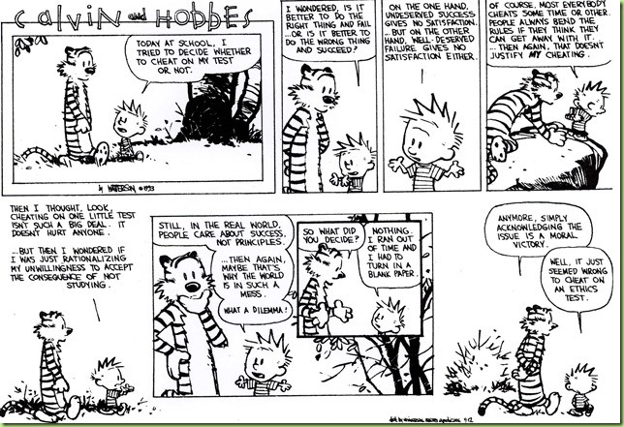

Slide 8
My Reading Notes
pp. 57 Does mention of Hitler invalidate the argument? - Mike Godwin
pp. 58 “Instincts were learned…”?
pp. 66 There’s no expectation the doctor’s practice would suffer?
pp. 80 Insurance companies do it, should they?
pp. 87 “mother’s right to privacy”?
pp. 94-95 Do most states (#?) have anti-texting while driving laws now?
pp. 99 Good to see using theories and seeing how many produce the same outcome
pp. 106 “…everyone…become…programmer” – Why is this an ethical issue?
End of Chapter questions I liked: 9, 10, 14, 15

Slide 9
Overview
Group Project
Review
Ethics
Assignment

Slide 10
Ethical Actions
Based on belief that people are
Rational
Free to choose
Mandatory
Prohibited
Acceptable
Why does society care?
Why do individuals care?
Notes:
Harming someone else may be unavoidable.
Examples?

Slide 11
Rights
Where do they come from?
What are they?
“Life, liberty, and property” – Locke.
“Life, liberty, and the pursuit of happiness” – Jefferson.
Others?
How does one acquire a specific right?
E.g. ownership?
Types of rights
Negative (liberties)
Positive (claim-rights)
Notes:
God? Society? Government?
Privacy? Due process?
Turning natural resources into personal property.
Actions can be ethically mandatory, prohibited or acceptable.
Positive: someone else has to do something.
Examples?

Slide 12
Ethics Vocabulary
Deontological Theories
A.K.A. nonconsequentialist
Theory/study of moral obligation
Consequentialist Theories
Social Contract Theory
Virtue Ethics
A.K.A. Character Based Theory
Greek deon = duty
Emphasizes duty and absolute rules to be followed whether they lead to good or bad consequences.
Kant often primary example.
Rules should apply to everyone.
Good rules intrinsically follow logic. Follow reason not emotion to make decisions.
Treat people as an ends, not solely as a means. Respect for persons.
Notes:
Which formulation of the categorical imperative do you prefer?
Kant’s Axe (1:33)
Published on Nov 18, 2014 – BBC Radio 4
Accessed 2016-09-02
www.youtube.com/watch?v=x_uUEaeqFog

Slide 13
Ethics Vocabulary
Deontological Theories
A.K.A. nonconsequentialist
Theory/study of moral obligation
Consequentialist Theories
Social Contract Theory
Virtue Ethics
A.K.A. Character Based Theory
Main example is Utilitarianism.
Increase aggregate utility or happiness. How to measure?
Watch out for theories going to far; violating rights of a few for the “good” of the many.

Slide 14
Ethics Vocabulary
Deontological Theories
A.K.A. nonconsequentialist
Theory/study of moral obligation
Consequentialist Theories
Social Contract Theory
Virtue Ethics
A.K.A. Character Based Theory
Uses rights as basis
Explains people’s selfishness in absence of common agreement
Analysis of moral issues regarding people and government.
Characterization of actions can change outcome of analysis, does not solve conflicting rights.
Are laws based on ethics?
Are all laws ethical?
Notes:
From Wikipedia (get primary source):
“Consent of the governed" is a political theory stating that a government's legitimacy and moral right to use state power is, or ought to be, derived from the people or society over which that power is exercised.
This theory of "consent" is historically contrasted to the divine right of kings and has often been invoked against the legitimacy of colonialism.
Following John Locke's notion of a nation of "free and equal" citizens, the Founders of the United States believed that consent of the governed was the only legitimate basis upon which one "free and equal" citizen could exercise legal authority over another -- otherwise neither equal could overcome the other.

Slide 15
Ethics Vocabulary
Deontological Theories
A.K.A. nonconsequentialist
Theory/study of moral obligation
Consequentialist Theories
Social Contract Theory
Virtue Ethics
A.K.A. Character Based Theory
Stresses character development and moral education, not formalized rules.
What kind of person should I be?
Depends on homogeneous community standards for morality.
Plato and Aristotle, more recently by Alasdair MacIntyre.

Slide 16
Group Quiz Scenario 4 in Section 2.1.2
Split into teams of 4
Pick one of:
Kantian
Act Utilitarian
Rule Utilitarian
Social Contract Theory
Virtue Ethics
Does your team recommend release next week ?
Provide justification (argument)

Slide 17
Overview
Group Project
Review
Ethics
Assignment

Slide 18
Assignment
Complete all assigned reading
Work on your individual presentations
Start Group Project work (if possible)

Slide 19
Class 3 The End
Keith A. Pray
Instructor
socialimps.keithpray.net
Notes:
This is the end. Any slides beyond this point are for answering questions that may arise but not needed in the main talk. Some slides may also be unfinished and are not needed but kept just in case.

