Slide 1
Class 1 Introduction
Keith A. Pray
Instructor
socialimps.keithpray.net
Notes:
Here’s the title slide to the first class. Excited already, aren’t you?
Who knows what Emacs or vi is?

Slide 2
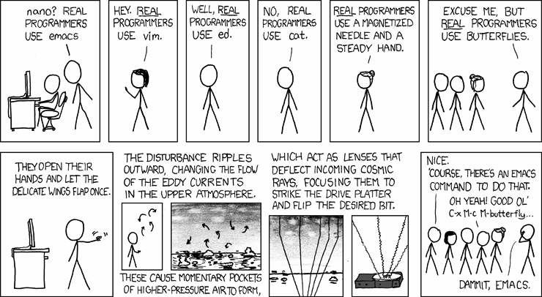
http://xkcd.com/378/
Notes:
How many people in the world get this joke?
According to wolframalpha.com (2012-08-23):
2.34% (of 6.79 billion people) attend secondary school
50 million secondary school grads in United States (of 309 million people) 16.18%
3.3 million computer specialists in United States (of 309 million people) 1.06% (or 6.6% of college grads)

Slide 3
/(BB|[^B]{2})/
Notes:
How many people in the world get this joke?
According to wolframalpha.com (2012-08-23):
2.34% (of 6.79 billion people) attend secondary school
50 million secondary school grads in United States (of 309 million people) 16.18%
3.3 million computer specialists in United States (of 309 million people) 1.06% (or 6.6% of college grads)

Slide 4
Overview
Introduction
Course Staff
Logistics
Purpose
Assignment

Slide 5
Course Staff
Instructor
Keith A. Pray
kap@wpi.edu
FL 243 Adjunct Office
TA
Doug MacFarland
dcmacfarland@wpi.edu
FL A22, next to the Zoo Lab
Office Hours
Tuesday and Friday 12:30pm - 2:30pm
Wednesday 12:00pm - 2:00pm
By Appointment
Notes:
Here’s our contact info.
Introduce yourself.
Get to know class:
Youngest? Oldest? Country of origin?
Majors? Years?
Reasons for taking class

Slide 6
Logistics
Course Web Site
http://socialimps.keithpray.net/
Grading
Due Dates
Etc.
myWPI
Interactive assignments
Your grades
Notes:
Let’s go to the course website for this stuff.
Always check course web site for grading.
Individual presentations are due 24 hours before class so that they can be incorporated into those class slides.
Since most things due class to class are small in the number of points we will not be giving credit late work. You can still turn it in and we’ll tell you how well you would have done.

Slide 7
Purpose
Learn about how computing affects society, and vice versa.
Practice critical thinking skills.
Practice written and oral presentations.
Notes:
Remember to look at course outcomes on web site.

Slide 8
Self Quiz!
What is computing?
What is the oldest computing device you can think of?
What is the biggest impact computing has had on your life?
What good will you do with your degree?
Notes:
What is the difference between liberties (negative rights) and claim rights (positive rights)?
For example: manual calculating aids – clay or wax tablet, slate tablet, paper tablet, abacus, mathematical tables (logarithms is an important one). The counters in an abacus is where the term “counter” meaning place in a shop where transactions take place.

Slide 9
Manufacturer | Compaq Computer Corporation, United States
Type | Portable computer
Release date | January 1983
Introductory price | US$3,590
Operating system | MS-DOS
Storage capacity | Two 5.25" floppy disk drives or, optionally, one floppy drive and a 10 MB hard drive
Memory | 128 kilobytes (expandable to 640 KiB)
Display | Built-in 9" green screen monitor and a unique CGA-compatible video card
Weight | 28 lb (12.5 kg)
Processor | Intel 8088
Speed | 4.77 MHz
Notes:
Show old portable computer.
Info in slide from http://en.wikipedia.org/wiki/Compaq_portable
Links on web site.
http://socialimps.keithpray.net/documents/index.jsp?content=Show_and_Tell.html
We’ll show it another class…

Slide 10
Overview
Introduction
Course Staff
Logistics
Purpose
Assignment

Slide 11
Assignment
Create an information processing technology timeline
You can choose any scope (time periods, domains, etc.) and format you like
Example timeline - http://www.pbs.org/wgbh/amex/telephone/timeline/timeline_text.html
Write a 1 page paper that draws a conclusion using your timeline to illustrate your point.
Notes:
Be sure to read paper guidelines!

Slide 12
Class 1 The End
Keith A. Pray
Instructor
socialimps.keithpray.net
Notes:
This is the end. The slides beyond this point are for answering questions that may arise but not needed in the main talk. Some slides may also be unfinished and are not needed but kept just in case.

Slide 13
Practice Quiz!
What is Ethics?
How does cyberethics relate to the scope of this course?
What is the difference between normative and descriptive studies?
What information processing technology issue interests you most so far?
Notes:
Use this quiz next time if using same text.

Slide 14
Class Discussion
What is technology?
In your lifetime, what information processing technologies have been:
Introduced
Enhanced
Become more prevalent.
Pick one and discuss:
What did people fear would happen?
What actually did happen?
Notes:
Feel free to send me topics you came up with during class and I’ll add them to these speaker notes for the prosperity of all (wo)mankind.
Cell phones have become ubiquitous. Could you give up use of your cell phone for 48 hours?
High speed communications make large amounts of data accessible, libraries, books, publications, music, video. It also makes outsourcing overseas possible.

Slide 15
Class Discussion II
Pick a story (real or fictional) which you have heard, read, or seen.
What technologies were important in that story?
How did they affect society?
Notes:
This turned into more of a pick a few movies to relate to the class and turn it into group presentations.

Slide 16
Social Implications of Technology
Whole-Class Discussion
Consider the Industrial Revolution
Roughly the 19th Century
What technologies were introduced?
What consequences did people fear?
What actually happened?
Notes:
Steam engine, steamship, railroad, telephone, telegraph, photography, motion pictures, phonograph, new farm equipment.
Unemployment, crime, breakdown of traditional values.
What they feared, but people shifted jobs and produced more.

Slide 17
Notes:
How many people in the world get this joke?
A lot more than 10 years ago.

