Slide 1
Star Wars: Episode II - Attack of the Clones
Daniel Kwan, Stephanie Mabe, Gavin Smith

Slide 2

Plot summary
Republic crumbles as planets join Count Dooku's separatist movement
Senator Padmé survives 2 assassination attempts on Coruscant
Obi-Wan investigates and uncovers a secret clone army on Kamino
Anakin protects Padmé on Naboo; the two secretly fall in love
Obi-Wan tracks Dooku to Geonosis, finds a droid army being built
Jedi rescue mission triggers the Clone Wars between both armies
[1]
Notes:
Daniel: The Galactic Republic is falling apart as many planets try to leave and start their own group led by Count Dooku (bad guy). After someone tries to kill Senator padme, the Jedi Obi-Wan Kenobi investigates and finds a huge clone army that was secretly made for the Republic. His student Anakin Skywalker is sent to protect padme.
Obi Wan follows the trail to the planet Geonosis where he learns Dooku is building a robot army to fight the republic. The jedi go to stop him, and the new clone army shows up to help them, starting the clone wars.

Slide 3
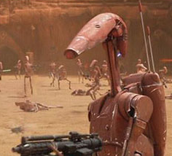
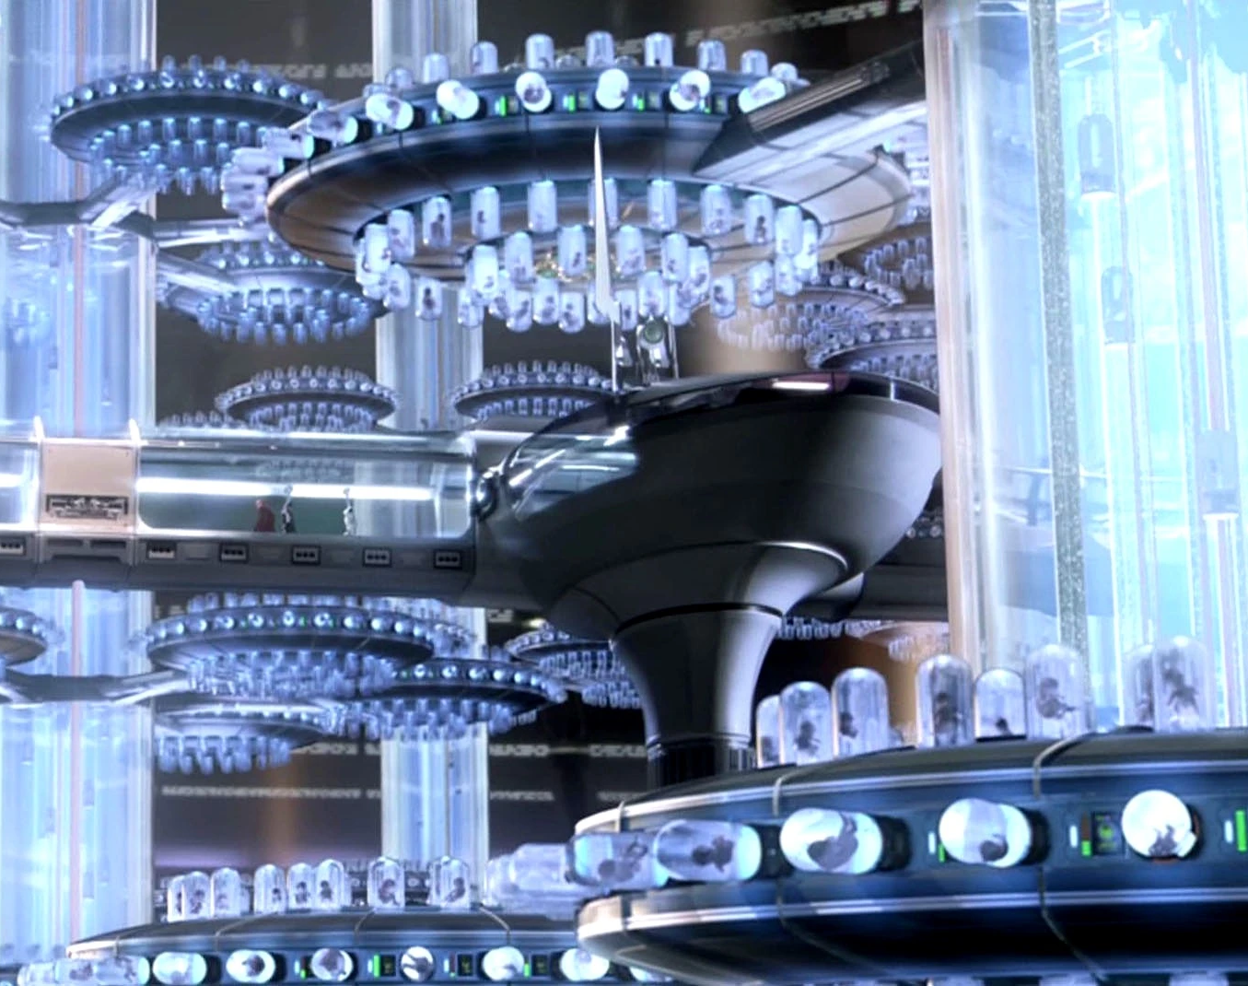
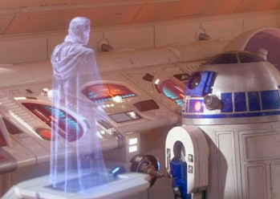
Computing Technology
Droids-
Robots that automate a diverse range of tasks
Cloning Technology-
Technology that makes it possible to create clones of an individual
Holograms-
Video communication that can be transmitted across systems
[1]
Notes:
-Gavin Smith:In Star Wars Attack of the Clones, computing technology is shown through a sci-fi lens. Droids are shown to have a range of sentience, with R2-D2 and C-3PO being very sentient, as R2-D2 knows when and how to help even if no one directly asks for it. C-3PO understands multiple languages and is self-aware, as his head is installed on a battle droid body. Droids are shown to automate several different tasks, such as a sporting event, serving food and drinks, pulling carts, building more droids, and an entire droid army (as shown here).
On planet Kamino, an entire facility (as shown here) creates clones whose purpose is to fight for the Jedi and the Republic. The clones are created from Jango Fett’s DNA and are modified to mature faster and be obedient soldiers.
In Star Wars, holograms are used to communicate across the galaxy, either allowing for recorded messages or live communications. Holograms are a sci-fi way to imagine video communication. Star Wars Attack of the Clones was released in 2002, and live video communication became popular soon after in the early 2000’s with Skype [4].

Slide 4
Conclusion
Over-reliance or trusting computing systems too much leads to vulnerability
Notes:
Gavin Smith:From our analysis of Star Wars Attack of the Clones, we identified concepts of over-reliance in computing systems that led to issues or conflict.

Slide 5
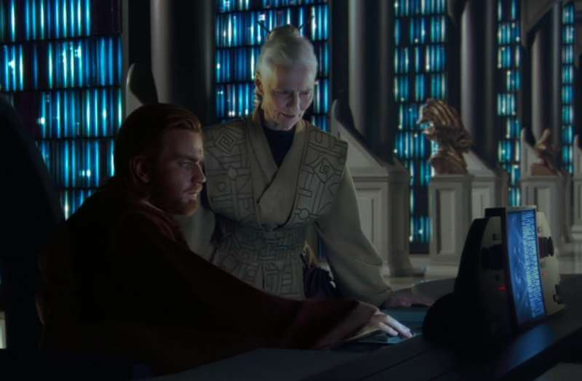
Internet and Censorship
0:38:00 Kamino was deleted from the Jedi Archives by someone with access
Yoda "only a Jedi could have erased those files," which means insider censorship
In 2024, 4.5 billion people lived under significant internet censorship [5]
[1]
Notes:
Gavin Smith: Obi-Wan goes looking for the planet Kamino in the Jedi Archives, which is basically the most trusted database in the galaxy. The planet isn't there. The librarian Jocasta Nu refuses to even consider that the records could be wrong, and tells him "if it does not appear in our records, it does not exist." Obi-Wan takes the problem to Yoda, who figures it out almost instantly and says only a Jedi could have erased those files. So this is insider censorship, someone with the highest level of access went in and deleted the truth, and the Jedi making decisions off that database have no idea what's missing.
The same thing happens today on a much bigger scale. According to Freedom House's 2024 report, about 4.5 billion people live under significant internet censorship and 73% of internet users live in countries where governments actively suppress online content.
The pattern shows up in the U.S. too, just in different forms. During the COVID-19 pandemic, federal agencies pressured Facebook, Twitter, and YouTube to remove posts about vaccine side effects and the lab leak theory, which the Supreme Court case Murthy v. Missouri ruled was likely a First Amendment violation. Major social media platforms also adjust their algorithms in ways the public doesn't see, deciding which posts get amplified and which get buried. The 2023 Twitter Files showed the company had maintained secret blacklists that suppressed certain accounts from search and trending pages without telling users. The effect is the same as deleting Kamino from the Archives, if people don't see information, they can't act on it.
The Jedi don't fail because they're untrained. They fail because the inputs they trusted were wrong. Trusting a system without asking what might be missing is the vulnerability.

Slide 6
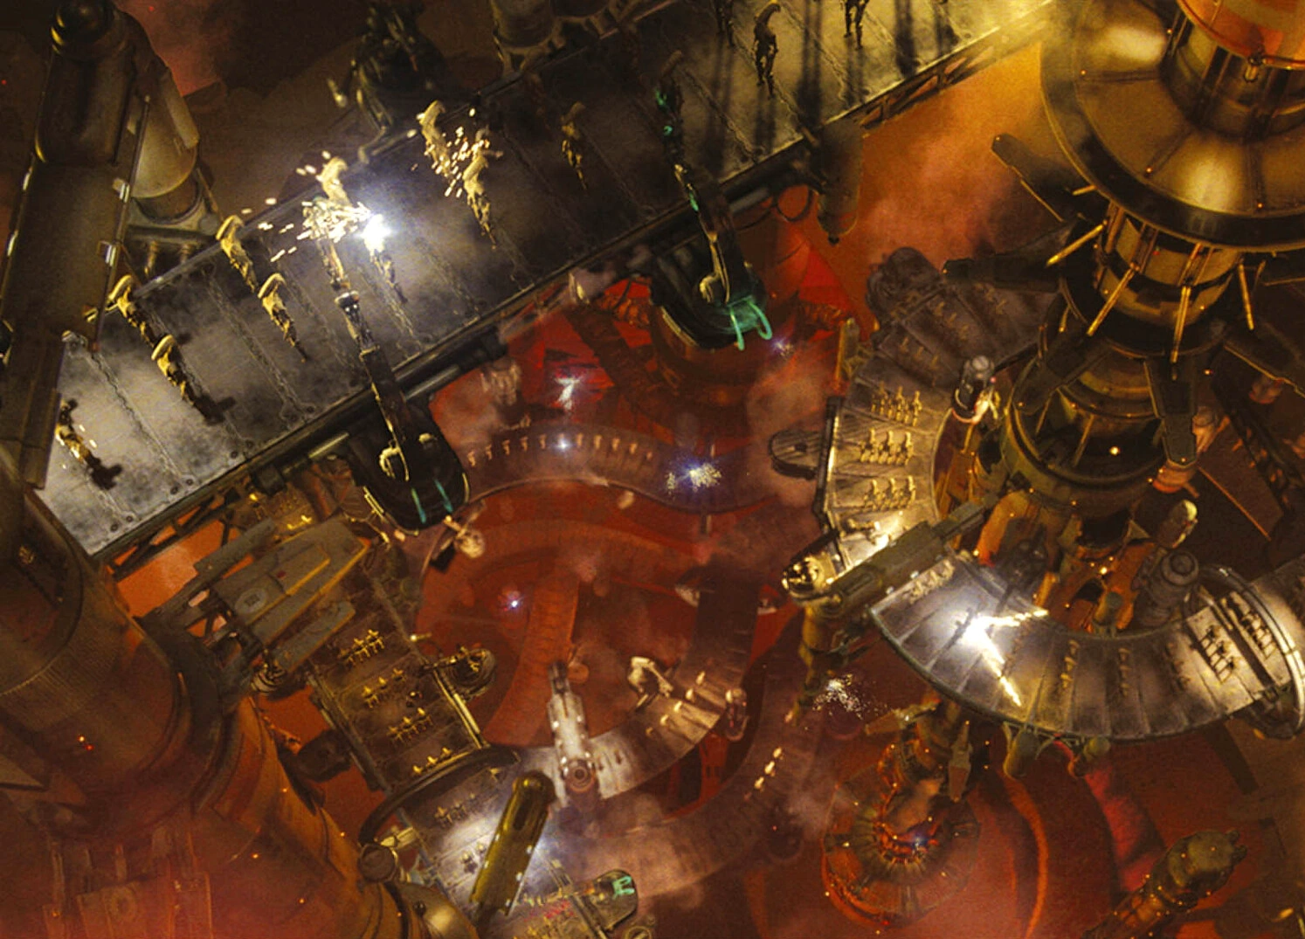
Machinery Hazards
The Therac-25 killed 6 patients due to software over-reliance [3]
Radiation Therapists feel error messages are still too vague [3]
In 2024, 213 workers were killed by actively powered equipment [2]
[1]
Notes:
(Stephanie Mabe) The Therac-25, as mentioned in our books, is a machine used for radiation therapy to treat cancer. However, this model reused old code and didn’t have the hardware safeguards found in older models; this led to six patients dying due to radiation overdose from the machine [3]. Dr. Fritz Hager, a medical physician who witnessed two of these accidents, mentioned that the Therac-25 displayed a Malfunction 54 error message, which he pointed out was vaguely described only as “Dose Error” in the manual. Dose error could be an underdose or overdose of radiation, and he was assured it was “impossible for the machine to generate too high radiation” [3]. Trusting the machine delayed the realization of the danger it posed.
A 2024 survey of radiation therapists found that up to 25% reported receiving error messages on their machines that they believed to be unclear [3]. Even with what was learned from the Therac-25, 40 years later, operators are still in a position where they trust machines without fully understanding the error messages.
According to the U.S. Bureau of Labor Statistics, 213 workers were killed due to incidents involving powered equipment in 2024. These occurred during maintenance, normal operation, or passing by equipment. [2] Safety features must be put in place to protect people from dangerous equipment. In Star Wars Attack of the Clones, there’s a large automated droid factory on Geonosis (as shown in the picture) where Anakin and Padme are nearly killed because the factory didn’t have any safety features to detect if there was any danger posed to living beings. Relying on and trusting the automation and software is dangerous, as without physical safeguards, people could get seriously injured or killed.

Slide 7
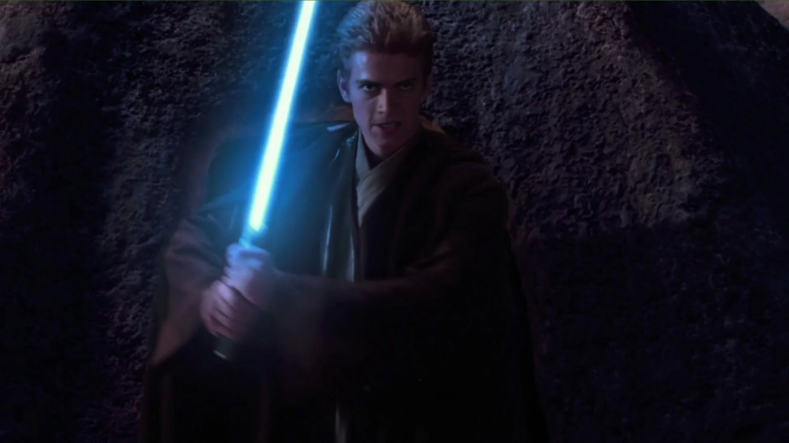
Anakin's overreliance on lightsaber
[1]
0:18:00 Drops his saber in the speeder; Obi-Wan: "this weapon is your life"
1:25:00 Uses his saber to slaughter the Tusken Village in rage
2:00:30 Charges Dooku alone, disarmed and loses his arm in seconds
The tool he over trusts makes him cocky and costs him his arm.
Notes:
Daniel: Anakin drops his lightsaber while jumping between vehicles and his Mentor Obi-Wan scolds him saying "this weapon is your life". Anakin doesn’t respect his weapon and this causes issues later on. On Tatooine, he finds his mother dying and he uses his weapon to kill an entire village including kids. He's using his weapon for emotional control while also killing others for a sense of superiority and revenge. In the final fight with Count Dooku, Anakin ignores Obi-wan's plans to attack together and Dooku literally disarms him in under 15 seconds. He was trusting his skill and the light saber way too much.

Slide 8

Ai overreliance
DELETE LATER SOURCES FOR CONNECTIONS TO SOCIETY
Gerlich, M. (2025). "AI Tools in Society: Impacts on Cognitive Offloading and the Future of Critical Thinking." Societies, 15(1), 6. Published by MDPI (peer-reviewed). MDPI
Baldeo, S. (2026). "Generative AI Reliance and Executive Function Attenuation: Behavioral Evidence of Cognitive Offload in High-Use Adults." Technology, Mind, and Behavior (APA peer-reviewed journal). Participants reported reduced confidence in their own independent reasoning, lesser perceived ownership of ideas, and trade-offs between task speed and depth of thought. The researcher noted the issue was not AI use itself but the degree of passive acceptance. APA
On AI overreliance creating real-world vulnerability (the Order 66 parallel):
Bellahsen-Harrar et al. (2025). "Exploring the risks of over-reliance on AI in diagnostic pathology." PLOS One. DOI: 10.1371/journal.pone.0323270.. nih
[1]
0:25:00 Analysis droids fail to identify the saberdart; While Dex solves it instantly
Frequent AI use correlates-0.75 with critical thinking skills [6]
72% of U.S teens have used AI companions: 52% use them regularly [7]
Anakin processes grief through the use of killing a village using his lightsaber a tool of emotional control like how teens use AI companions as emotional outlets
92% of university students now use AI in their studies, up from 66% one year earlier [8]
Notes:
Gavin Smith: Obi-Wan brings the assassin's saberdart (toxic small dart that was used to try and assassinate Padme) to the Jedi analysis droids, and they tell him it doesn’t exist in their database. He almosts gives up. He then goes to Dex's Diner, and Dex (the alien who runs the diner) takes one look at the dart and identifies it instantly. Obi-Wan used the droid AI to identify the dart but it had no actual answer which almost caused him to give up showing that AI doesn’t always have the knowledge and that experience and judgement can fill the gap.
The same tension is showing today. As a 2025 study by Gerlich surveyed 666 people and found a strong negative correlation (minus 0.75) between AI use and critical thinking. Meaning people are offloading reasoning and thinking to the AI which makes people think less critically.
AI is also showing emotionally. A recent study from Common Sense Media found that 72% of U.S teenagers have used AI companions, and 52% use them regularly, for friendship advice, and therapy.
Compared to Anakin using his lightsaber to vent his frustration into the village of Tuskan, teenagers vent to ai. When they should be making real relationships and seeking therapy from real people.

Slide 9
References
[1] George Lucas (Director, Writer), Jonathan Hales (Writer), (2002) Star Wars: Episode II - Attack of the Clones [Film] Lucasfilm
[2] Census of Fatal Occupational Injuries (CFOI) ‐ Current and Revised Data: U.S. Bureau of Labor Statistics. (2024). www.bls.gov . https://www.bls.gov/iif/fatal-injuries-tables.htm (accessed 4/30/2026)
[3] Silvis-Cividjian, N. (2024). Therac-25 Accidents: We Keep on Learning From Them. Computer, 57(12), 69–78. https://doi.org/10.1109/mc.2024.3450197 (accessed 5/2/2026)
[4] Uenuma, F. (2020, May 11). Video Chat Is Helping Us Stay Connected in Lockdown. But the Tech Was Once a “Spectacular Flop.” Time. https://time.com/5834516/video-chat-zoom-history/ (accessed 4/2/2026)
[5] Freedom House. (2024). Freedom on the Net 2024: The Struggle for Trust Online. Freedom House. https://freedomhouse.org/report/freedom-net/2024
[6] Gerlich, M. (2025). AI Tools in Society: Impacts on Cognitive Offloading and the Future of Critical Thinking. Societies, 15(1), 6. https://doi.org/10.3390/soc15010006
[7] Robb, M. B., & Mann, S. (2025). Talk, Trust, and Trade-Offs: How and Why Teens Use AI Companions. Common Sense Media. https://www.commonsensemedia.org/research/talk-trust-and-trade-offs-how-and-why-teens-use-ai-companions
[8] Higher Education Policy Institute. (2025). Student Generative AI Survey 2025. HEPI / Kortext. https://www.hepi.ac.uk/

