Slide 1

Spider-Man (2002)
Aditya Manoj Krishna, Raj Goode, Cole Miller, Luigi Cardaropoli, Antonio Neto
1

Slide 2
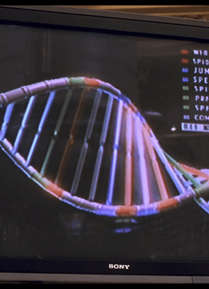
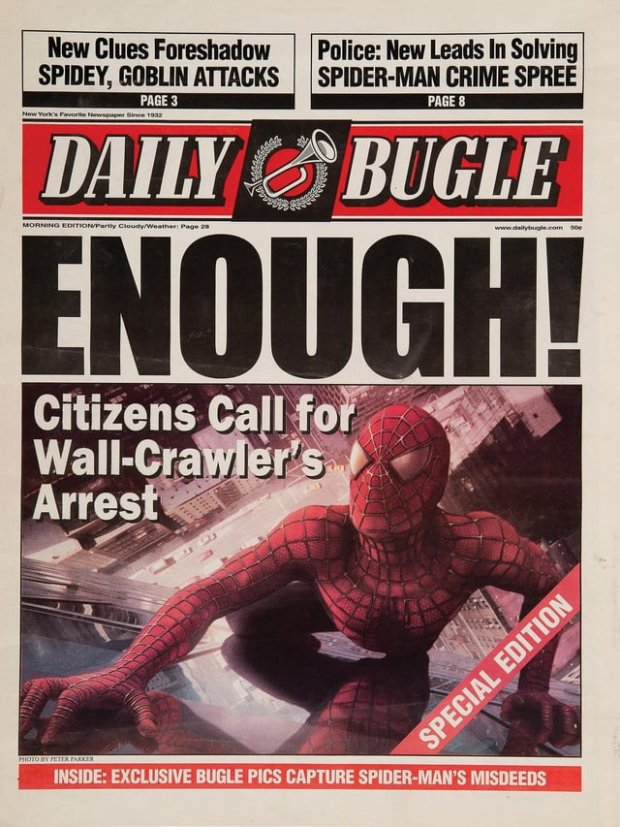
Notable Technology
Genetic Technology
The Bugle
2
Notes:
To argue for our first conclusion we would like to provide context on some notable tech in the movie
Early on in the movie Columbia University researchers experiment with spider genetics.
The Daily Bugle is a prominent newspaper in NYC and is a precursor to modern online news.
Mention early on Columbia spider genetics as a main point that created spider man
Just say there is a big change between how news was consumed in 2002 vs now don’t expand until next slide
Image Sources
Image of genes from [17]
Image of Daily Bugle from [18]

Slide 3
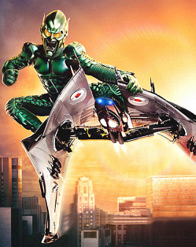
Notable Technology
Green Goblin Technology
Goblin Glider
Goblin Serum
Goblin Exoskeleton
3
Notes:
Green Goblin has a large arsenal of stolen inventions and technology originally developed by Oscorp. This includes the Goblin serum, glider, and exoskeleton.
The goblin serum was a steroid developed to enhance United states soldiers and allow them to handle the other goblin technology.
The goblin glider is a semi-autonomous glider with advanced weaponry. The goblin exoskeleton connects to the glider and allows for remote use of its control and weapons systems.
Image Sources
Green Goblin Image from [16]

Slide 4
Conclusions
Technology isn’t inherently dangerous but the misuse of it is.
Improvement in communications technology has not changed the spread of misinformation.
4
Notes:
Speaker notes:
We have two main conclusions those being : list conclusion 1 and 2
- Transition to next slide by saying something along the lines of lets delve into why we believe that technology isn’t inherently dangerous but the misuse of it is.
Arg notes
Arg 1
The goblin technology is blamed for Norman's actions, however he chose to misuse the tech, it was not inherently dangerous/wasn't acting autonomously
Similar modern military technology falls in the same category where it isn't inherently dangerous, its how its used that can determine that
Sources related to military tech that was made with good intention but taken by bad people
Main example: Wright brothers didn't intend for planes to be military, but they were
https://www.aviationquotations.com/results.php?search=Orville+Wright - First quote important, also one most of the way down pg 1 about it being an invention of peace
Arg 2
Strong minded people, like JJJ, who could see evidence against what they believe will still stick to their claims and make evidence to back them up.
In the movie this is on paper newspaper, but even with online news and social media, people still blindly follow opinions spread through the web
The Bugle spreading misinformation on paper would still spread it to the same people once online news exists
Source on rate of misinformation online, source on rate of people believing said misinformation/opinions. Could also find some for rate of indifference outside of your 'news bubble’
Define news bubble

Slide 5
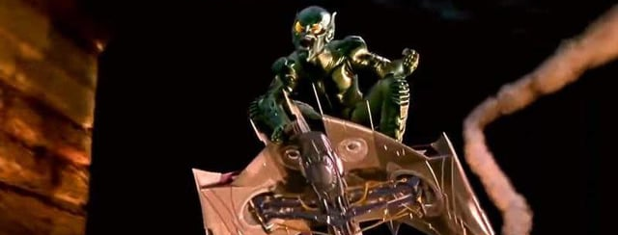
Misuse of Technology in the Movie
The Goblin Serum is blamed for Norman's insanity.
  Norman chose to take an experimental serum.
The Goblin Tech was designed for the military.
  Norman stole this tech and used it for his personal agendas.
5
Notes:
The goblin technology is blamed for Norman's actions, however he chose to misuse the tech, it was not inherently dangerous/wasn't acting autonomously
Even though the scientist working with Norman warned him about the dangers of the experimental serum, he decided to take it anyways which can be construed as a misuse of this tech because this wasn’t the intended use
The use for the serum was to help the person operating the glider become strong enough to do operate it.
The glider and the serum were both unstable, experimental tech.
He abuses the glider and other tech for his personal agendas after he is fired from the company and going around terrorizing the board members who fired him, even killing them.
In the movie, we're made to believe that technology is dangerous because of the harm that can be done with it, but we believe technology is dangerous when the user misuses it.
Green Goblin Image from [14]

Slide 6
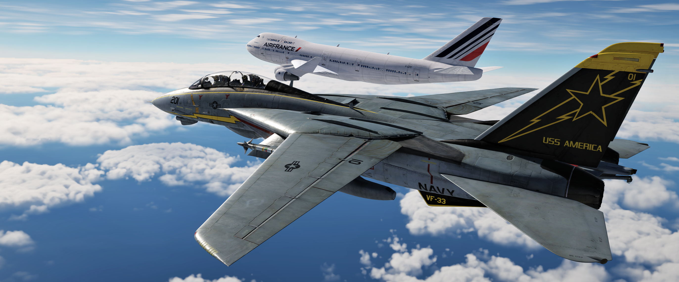
Misuse of Technology: Airplanes
In 1903, Wright brothers proved airplanes as a method of transportation was possible.
In 1908, military airplanes were created for the use of reconnaissance, combat, and bombings in WW1 [9].
On June 13, 1917, German bombings on London caused 162 civilian deaths and 426 injuries, the deadliest air raid on Britain [10].
The first commercial passenger carrying airline was in 1914 [11].
6
Notes:
In 1903, the Wright Brothers invented the airplane, proving transportation by the air was possible. But commercial flying like we know today was not actually the first application of the airplane. In 1908, the first military airplanes were created for the use of reconnaissance, combat, and bombings during world war 1, and commercial flights would not be seen until 6 years later in 1914. Countries quickly advanced their aircraft technology during WW1, and on June 13, 1917, Germany ran an air raid on London using their new airplane-like aircraft bombers, which caused 162 civilian deaths and injured 426 more. Which was the deadliest raid on britain
The wright brothers themselves state that they think of the invention of the airplane like the finding of fire, that they regret all the damage done by fire, but that they're glad humans can find 1000 ways to use fire, even if some of it is destructive.
References so far:
https://pubmed.ncbi.nlm.nih.gov/24961713/
https://encyclopedia.1914-1918-online.net/article/london-bombing-of/#toc_the_switch_to_bomber_aircraft
https://airandspace.si.edu/explore/stories/air-mail (ask professor for quality of source)
Image source : https://www.reddit.com/r/dcsworld/comments/1n61p7d/anyone_ever_been_on_a_commercial_flight_looked/#lightbox
Speaker Notes :
1903 wright brothers proved humans could fly with the goal to just take humans into the air and source 1 says they believed this to be a technology that would bring about peace.
Figher planes kill a lot of people vs commercial planes has improve global economy (find source)
Point out the analogy that guns don’t kill people, people kill people.
Segway to next slide based on this point
"I feel about the airplane much as I do in regard to fire. That is, I regret all the terrible damage caused by fire. But I think it is good for the human race that someone discovered how to start fires, and that it is possible to put fire to thousands of important uses. "
Air raids changed war because civilians could now be attacked from the air.
First commercial plane

Slide 7
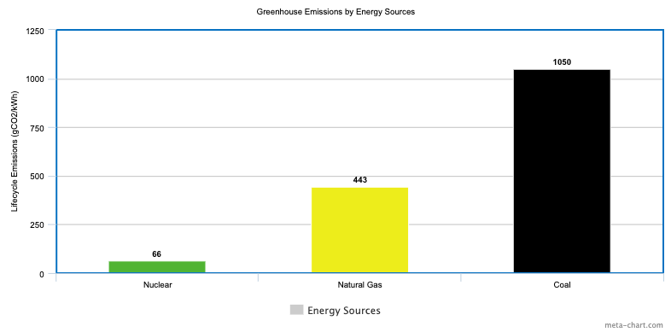
Misuse of Technology: Nuclear Tech
Nuclear technology can be used peacefully for low carbon electricity [6].
Nuclear technology can be used for medical diagnoses [7].
When weaponized, nuclear technology becomes extremely dangerous, as shown in both nuclear bombings of Hiroshima and Nagasaki. 214,000 civilian deaths [8].
7
Notes:
Nuclear technology is another example of technology that can be helpful or destructive depending on how humans use it. On the positive side, nuclear power can generate large amounts of steady electricity, while producing much lower greenhouse gas emissions than fossil fuels. Sovacool’s review of nuclear power emissions found that nuclear energy has much lower lifecycle emissions than coal and natural gas, showing that nuclear technology can be useful when used responsibly.
Nuclear technology is also important in medicine. The National Academies explain that nuclear medicine is used to diagnose, stage, and treat diseases, including cancers, cardiovascular disease, and certain neurological disorders. This shows that nuclear science can directly help save lives when it is used for medical purposes.
However, when nuclear technology is weaponized, it becomes catastrophic. Douple and his coauthors explain that researchers have studied the long-term radiation-related health effects of the atomic bombings of Hiroshima and Nagasaki for decades. By the end of 1945, the bombings caused roughly 140,000 deaths in Hiroshima and around 70,000 to 74,000 deaths in Nagasaki.
Conclusion:
Both of these examples help prove that while technology may seem dangerous because of its power, the danger actually comes from the misuse of technology.
Images sources
Greenhouse Emissions Chart from [6]

Slide 8
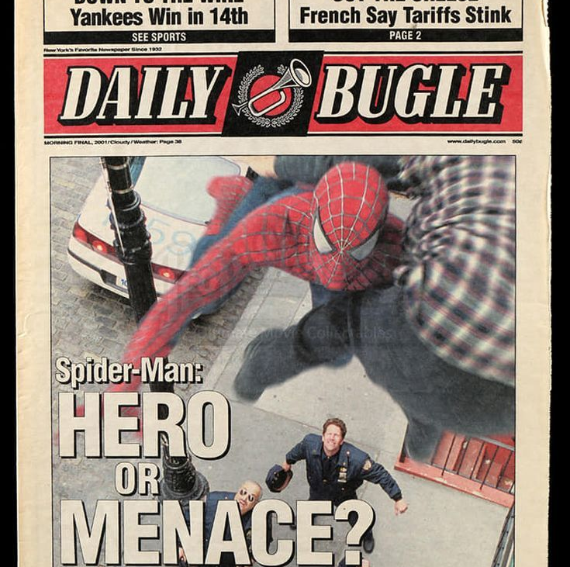
Misinformation in Spider-Man
The Daily Bugle publishes misinformation on Spider-Man
Jameson refuses to change his claims, even after Spider-Man saves him
8
Notes:
The editor of the Daily Bugle, J. Jonah Jameson, uses it to publish articles biased against Spider-Man to skew the views of the people of NYC.
Jameson uses misleading titles such as "Spider-Man: Hero or Menace?" (Point at image) to reach New Yorkers and convince them to read his articles. This allows him to spread mass misinformation brandishing Spider-Man as a criminal instead of a hero.
When faced with clear evidence countering his claims, Jameson refuses to back down
When protests the use of his photos in an article about Spider-Man attacking the city, Jameson refuses to change the paper.
Jameson refuses to redact his claims after being personally saved by Spider-Man when attacked by the Goblin.
The next day, Jameson publishes an article titled "SPIDER-MAN GREEN GOBLIN TERRORIZE BUGLE" claiming how he braved the attack
Image Citations
Daily Bugle Headline [13]

Slide 9
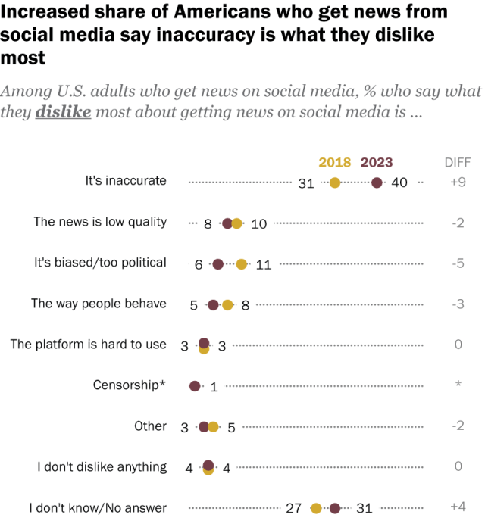
Misinformation in the Real World
Jameson knows Spider-Man is a good guy, he decides to hide this truth and spread misinformation.
  False news spreads faster than true news online [2].
  40% of social media users report false information as the biggest problem with social media [3].
Companies financially benefit from the spread of misinformation.
9
Notes:
Even though Jameson has seen evidence contradicting his claims, he still publishes articles claiming Spider-Man is a public menace
Social media companies ignore misinformation, as false news spreads faster than true news online [2]
40% of social media users see misinformation as the biggest problem with social media today [3]
The Daily Bugle, similarly, to social media companies financially benefits from the spread of this misinformation, as it draws more people to their platform.
Jameson continues to request Peter for photos of Spider-Man, and places him on the front cover, because it has been proven to sell
Similarly, social media companies are motivated by profit to intentionally design systems for engagement, even if it increases bias, polarization, and misinformation [4].
Image Sources
Graph from [3]

Slide 10
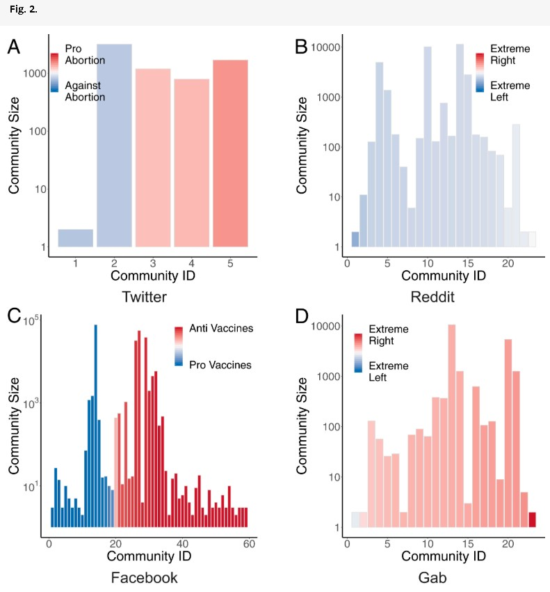
Echo Chambers
The Daily Bugle creates an echo chamber where Spider-Man is portrayed as a criminal
Social Media algorithms push users into consuming content that reinforces their world views.
  This creates echo chambers of people who share the same views [5].
10
Notes:
The Daily Bugle purposefully publishes stories exclusively framing Spider-Man as a menace. This creates an echo chamber among dedicated followers, who are constantly shown misinformation on Spider-Man, which could morph their views overtime and change public opinion.
Similarly, social media algorithms creates echo chambers by pushing affirmative posts towards users, isolating their ideologies and reaffirming dangerous world views. [5]
Image Sources:
Graph from [5]

Slide 11
References
[1] HDQwalls, Spiderman 2002 4k Wallpaper, (December 13, 2020), https://hdqwalls.com/spiderman-2002-4k-wallpaper (May 3, 2026)
[2] Soroush Vosoughi, Deb Roy, and Sinan Aral, The spread of true and false news online, (Science, March 9, 2018), https://www.science.org/doi/10.1126/science.aap9559 (May 3, 2026)
[3] Pew Research Center, What Americans like and dislike about getting news on social media, (Pew Research Center, February 7, 2024), https://www.pewresearch.org/short-reads/2024/02/07/many-americans-find-value-in-getting-news-on-social-media-but-concerns-about-inaccuracy-have-risen/ (May 3, 2026)
[4] University of Kansas School of Business, Profit motivation of social media companies may compel them to inject bias and create polarization, study finds, (University of Kansas, May 6, 2025), https://business.ku.edu/news/article/profit-motivation-of-social-media-companies-may-compel-them-to-inject-bias-and-create-polarization-study-finds (May 3, 2026)
[5] Matteo Cinelli et al., The echo chamber effect on social media, (Proceedings of the National Academy of Sciences, February 23, 2021), https://www.pnas.org/doi/10.1073/pnas.2023301118 (May 3, 2026)
[6] Benjamin K. Sovacool, Valuing the greenhouse gas emissions from nuclear power: A critical survey, (Elsevier, 2008), https://doi.org/10.1016/j.enpol.2008.04.017 (May 3, 2026)
[7] Institute of Medicine and National Research Council, Advancing Nuclear Medicine Through Innovation, (National Academies Press, 2007), https://www.nationalacademies.org/projects/NRSB-O-05-05-A/publication/11985 (May 3, 2026)
[8] Jonathan M Samet et al., Eighty years of cancer research after the atomic bombings of Hiroshima and Nagasaki, (Oxford Academic, October 27, 2025), https://academic.oup.com/carcin/article/46/3/bgaf071/8304051 (May 3, 2026)
[9] Richard P. Hallion, World War I: an air war of consequence, (PubMed, 2014), https://pubmed.ncbi.nlm.nih.gov/24961713/ (May 3, 2026)
[10] Ian Castle, London, Bombing of, (1914-1918-Online International Encyclopedia of the First World War, April 14, 2016), https://encyclopedia.1914-1918-online.net/article/london-bombing-of/#toc_the_switch_to_bomber_aircraft (May 3, 2026)
[11] National Air and Space Museum, Air Mail, (Smithsonian Institution, n.d.), https://airandspace.si.edu/explore/stories/air-mail (May 3, 2026) (Note: As requested, ask your professor about the quality of this source—though the Smithsonian is generally considered a highly reputable historical institution).
[12] Reddit Contributor, Anyone ever been on a commercial flight, looked out your window and seen a military aircraft on the wing?, (Reddit, n.d.), https://www.reddit.com/r/dcsworld/comments/1n61p7d/anyone_ever_been_on_a_commercial_flight_looked/#lightbox (May 3, 2026)
[13] Pinterest Contributor, Pinterest Pin 684969424612878014, (Pinterest, n.d.), https://kr.pinterest.com/pin/684969424612878014/ (May 3, 2026)
[14] Reddit Contributor, Best Goblin Glider design? Hear me out...I dig the..., (Reddit, n.d.), https://www.reddit.com/r/Spiderman/comments/1j8fxl4/best_goblin_glider_design_hear_me_outi_dig_the/ (May 3, 2026)
[15] Aviation Quotations, Orville Wright Quotes, (AviationQuotations.com, n.d.), https://www.aviationquotations.com/results.php?search=Orville+Wright (May 3, 2026)
[16] Wikipedia Contributors, Norman Osborn (2002 film series character), (Wikipedia, n.d.), https://en.wikipedia.org/wiki/Norman_Osborn_%282002_film_series_character%29 (May 3, 2026)
[17] Reddit Contributor, In Spider-Man (2002), shortly after Peter is bitten..., (Reddit, n.d.), https://www.reddit.com/r/MovieDetails/comments/852l2j/in_spiderman_2002_shortly_after_peter_is_bitten/ (May 3, 2026)
[18] Reddit Contributor, Did anyone find all those Daily Bugle newspapers..., (Reddit, n.d.), https://www.reddit.com/r/SpidermanPS4/comments/14pzxq2/did_anyone_find_all_those_daily_bugle_newspapers/ (May 3, 2026)
11

