Slide 1
SOLO
A Star Wars Story
Joan Albert, Tyler Looney, Jared Poulos, Liam Rathke, Javier Salido

Slide 2
Overview
01
02
03
Computing Technologies
Conclusions
Plot Summary
04
05
06
Supporting Materials
Counter Argument
Summary
Notes:
Here is a brief overview of the presentation starting with a plot summary for those who may not be familiar with the movie. Then we will talk about the relevant computing technologies before diving into our conclusions. We will present our conclusion, then the supporting materials and counter argument before moving onto the last conclusion and then follow the same order, and then we will summarize what we found.

Slide 3
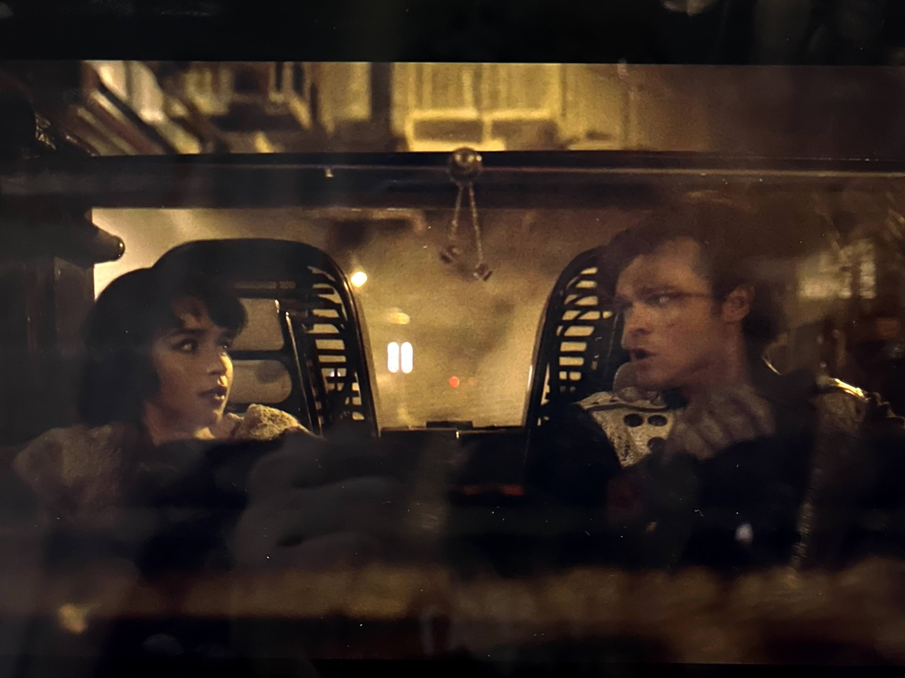
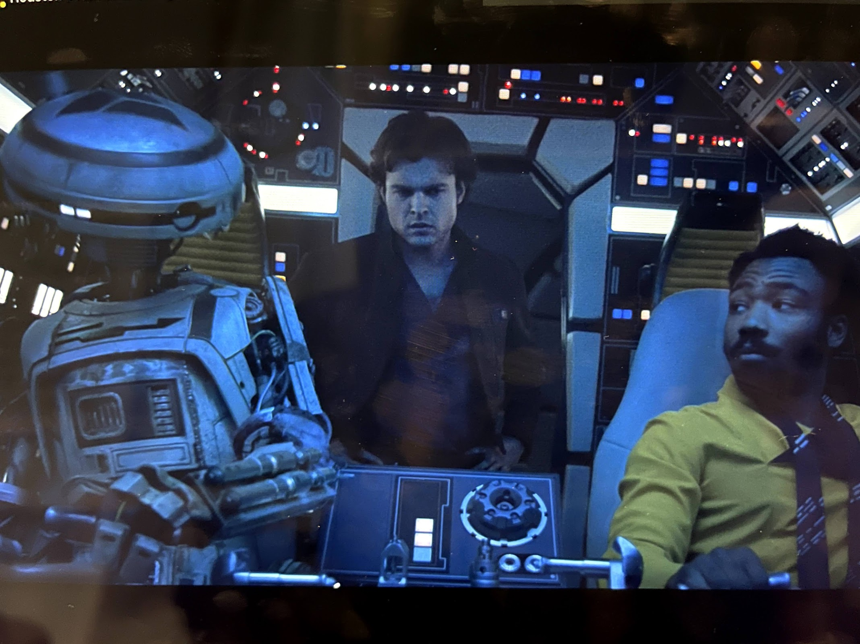
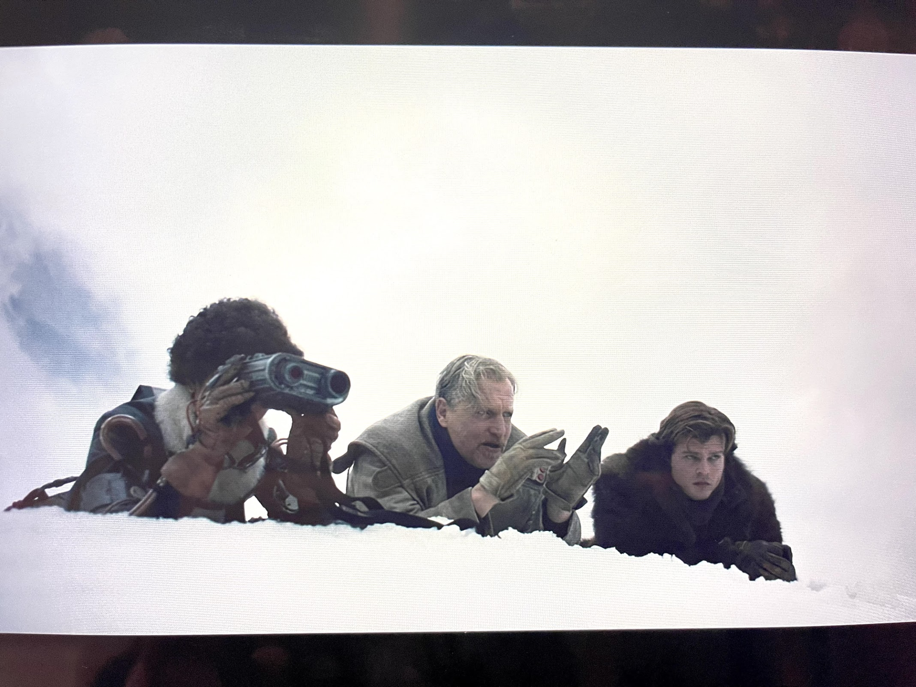
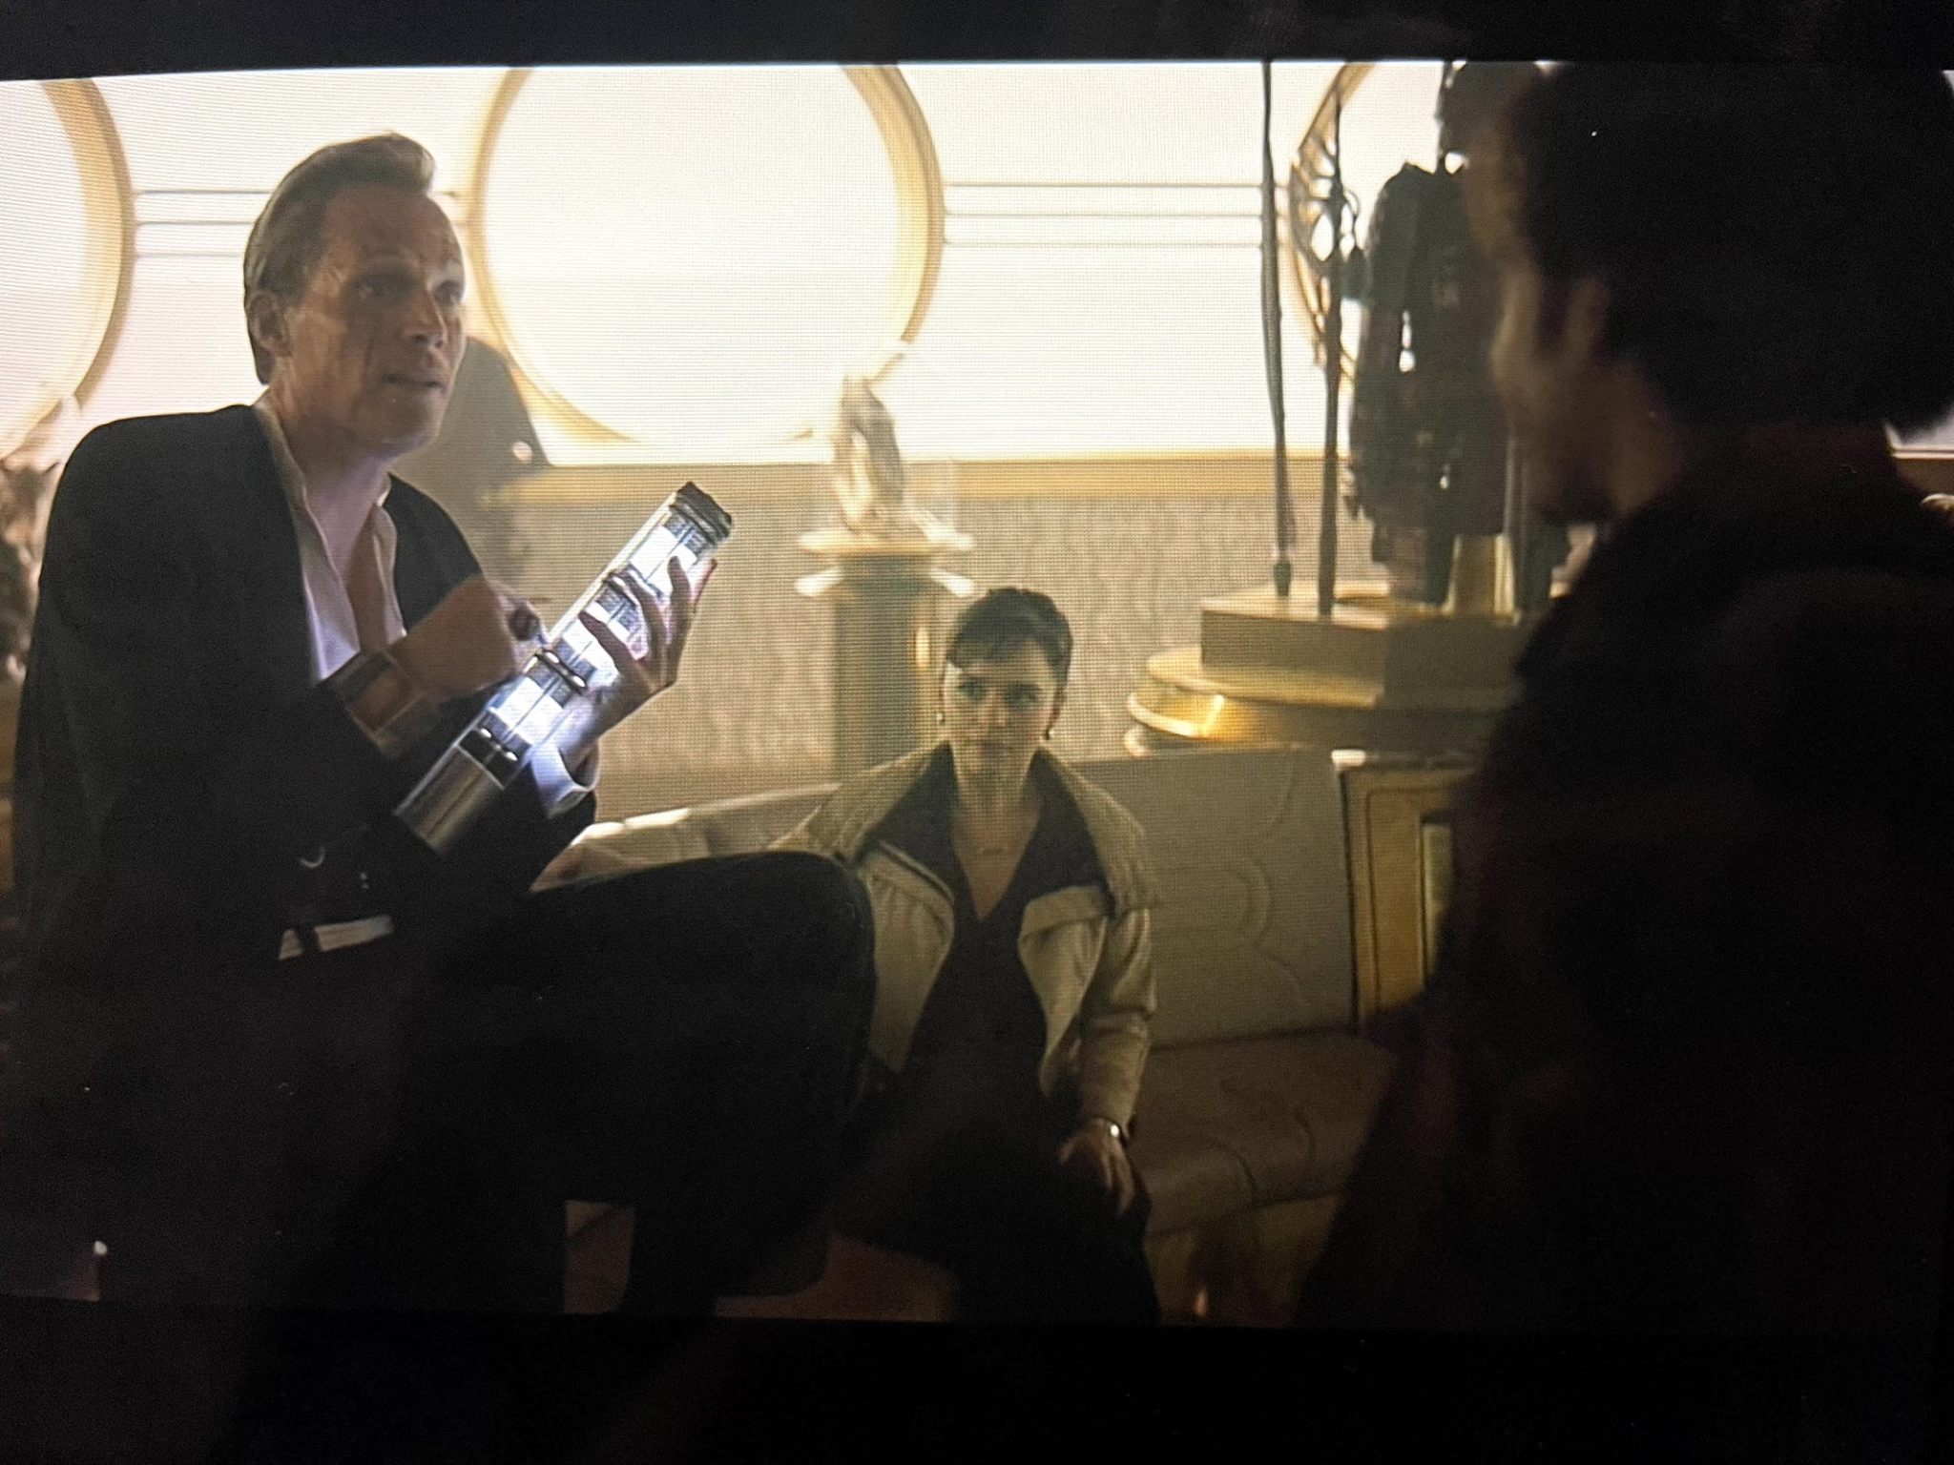
Plot Summary
The First Heist
Doing The Right Thing
Escaping Corellia
Repaying A Debt
[1]
Notes:
Tyler
There is a main theme throughout the movie of stealing valuable goods, in this case faster than light speed fuel called coaxium. At the beginning of the movie Han and his partner Qi’Ra try to use coaxium as a way to bribe the emigration officer to get away from the crime syndicate they are apart.
After Han escapes Corellia, he finds himself imprisoned with Chewbacca. The two of them are able to escape and end up joining a band of smugglers. Han and Chewbacca then decide to go on a heist with this group to steal more coaxium for a criminal organization, Crimson Dawn. This heist goes south when a rival pirate gang fights them over the coaxium and no one ends up with it.
Crimson dawn will kill the group if they can’t find a way to repay their debt so they rope in Lando Calrissian and the sentient droid L3 and their ship the Millenium Falcon because of their navigation and speed.
Finally Han, makes a decision to help the pirate gang keep the coaxium out of the hands of Crimson Dawn.
Throughout their journey however, they showcase several computing technologies that are essential to this Universe as well as invoke interesting discussions about how our world could be affected by advancements such as the ones in the movie.
[1] Howard, R (Director), Kasdan, J (Writer), Kasdan, L (Writer), George Lucas (based on characters created by). (2018) Solo: A Star Wars Story [Film] Lucasfilm

Slide 4
Computing Technologies
Droids
Restraining Bolts
Scomp Links
Artificially intelligent robots intended to serve a specific purpose, but created with self awareness and emotions
Hardware that is attached to droids to inhibit their free will and allows the owner to remotely disable them
Technology that allows droids and other machines to interface with local computers through a universal port.
[2]
Notes:
Jared Poulos
This film takes place in the star wars galaxy, in which technology followed a different path from our own, with some aspects of it being advanced but other technologies we have in the real world missing or underdeveloped. Here are a few of the ones most important to our presentation. Droids are sapient and self-aware robots who are built for a specific set of functions and almost universally seen as a servant class. They are forced to undergo memory wipes periodically to prevent them from forming a personality. To help control droids, restraining bolts are attached to them, which allow their masters to shut them down remotely or limit them from performing certain actions. Finally there are scomp links, universal connectors and ports that allow a machine (mostly but not all droids) to interface with a local computer network. They are present in places such as control rooms and require physical interaction to use, they do not appear to have wireless functionality.[1JP]

Slide 5
Main Conclusions
Wireless technology is more vulnerable to unauthorized access.
Sentient droids should have rights.
[1]
Notes:
Liam
After analyzing the film under the lens of this course, we came to two conclusions.
First, the emphasis on wired technology indicates that wireless communications are more vulnerable to unauthorized access. Second, the sentient droids portrayed in Solo deserve rights.
[1] Howard, R (Director), Kasdan, J (Writer), Kasdan, L (Writer), George Lucas (based on characters created by). (2018) Solo: A Star Wars Story [Film] Lucasfilm

Slide 6
Interconnectivity and Cyber Security
Wireless Networks
Many avenues to attack wireless networks
Devices on the network vulnerable
Public networks are common and easily impersonated
Internet of Things
Increased number of network nodes
Poorly protected network nodes
[3][4]
Notes:
With the explosion brought about by the internet, more and more companies and consumers desire the ability to harness the information and services available on the web.
This is true not just for laptop and desktop computers, but cellphones, tablets, and a plethora of other devices.
Rather than relying on wired connections for all these devices, the technology that has really enabled this lies in wireless connection, something that is rarely mentioned in the Star Wars movies. In fact, Solo follows the trend of many of the Star Wars movies where the protagonists must enlist the help of droids to establish a wired connection, through SCOMP links, with enemy networks to gather information or exploit their capabilities.
In our world, wireless networks are frequently the target of cyber crime for a variety of reasons. Often times, people fail to establish passwords for their networks or other security features which leave them particularly vulnerable to attacks.
On top of this, any device on the network can represent an avenue of attack, or is sometimes a reason to attack the network, as some devices are left unprotected against individuals with access to their network.
Another typical pitfall to security in the age of wireless connectivity is the existence of public networks alongside bad actors who can easily impersonate them to gain access to the information of those who connect to the network.
It would have made for a pretty short movie if Han and his buddies had hacked their way into the spice mines and simply registered an order for coaxium, or if the space pirates had their identities exposed when they fell prey to a fake imperial network at some local cantina.
Exacerbating these issues is this drive to create a so-called internet of things, as we enable even analog or mechanical devices with digital capabilities and the means of connecting to the internet. These devices usually connect to a network and can be used to gain access as the owner of the technology mistakenly believes that the security measures on a device such as a fish tank thermometer matter less. It can be significantly more difficult to secure a network when you have many many devices to manage, most of which are not connected by a wire.
[1JS] CISA, “Securing Wireless Networks | CISA,” us-cert.cisa.gov, May 08, 2020. https://us-cert.cisa.gov/ncas/tips/ST05-003.
[2JS] H. Wang, Z. Chen, J. Zhao, X. Di, and D. Liu, “A Vulnerability Assessment Method in Industrial Internet of Things Based on Attack Graph and Maximum Flow,” IEEE Access, vol. 6, no. , pp. 8599–8609, 2018, doi: 10.1109/access.2018.2805690.

Slide 7
Counter Argument: More Security Exists for Wireless Technology
Security of wireless technology
Lack of security of wired technology
Wireless communication security
Wireless access point security
Wireless network security
Cyber-physical systems
Manufacturing in the real world
[5][6]
Notes:
Counter argument: more security exists for wireless technology
Wireless technology has many effective countermeasures against vulnerabilities (I’ll go into some specific examples here) [2]
Wireless communication security
Signal hiding
Encryption
Authentication
Wireless access point security
802.1x authentication
Securely configure authorized access points after changing default settings (hackers already know them)
Wireless network security
Again encryption
Anti-virus
Anti-spyware
Firewall
Turning off identifier broadcasting
Changing the identifier and password so they are not the default (again, hackers)
Turning off network router when not in use
Avoiding using public networks
Wired technology does not have many effective countermeasures against vulnerabilities [1]
Cyber-physical systems
Manufacturing in the real world
Use of the Internet of Things in manufacturing makes cyber-physical attacks easier
Computer aided engineering software developers sell their software saying it is completely protected and encrypted, when they are still vulnerable
Cyber-physical attacks can be done at any point in the process (a critical one is quality control)
Current quality control approaches are not able to discern cyber-physical attacks because they rely on assumptions such as feature-based monitoring which do not hold up under attack
Current quality control diagnostics focuses more on recovery and doesn’t consider a cyber-physical attack as a possible cause of process disturbance
Sources
Lee J. Wells, Cyber-physical security challenges in manufacturing systems, (Manufacturing Letters, Apr. 2014) https://www.sciencedirect.com/science/article/pii/S2213846314000066 (09 May 2021)
Min-kyu Choi, Wireless Network Security: Vulnerabilities, Threats and Countermeasures, (International Journal of Multimedia and Ubiquitous Engineering, Jul. 2008) http://citeseerx.ist.psu.edu/viewdoc/download?doi=10.1.1.307.5273&rep=rep1&type=pdf (09 May 2021)

Slide 8
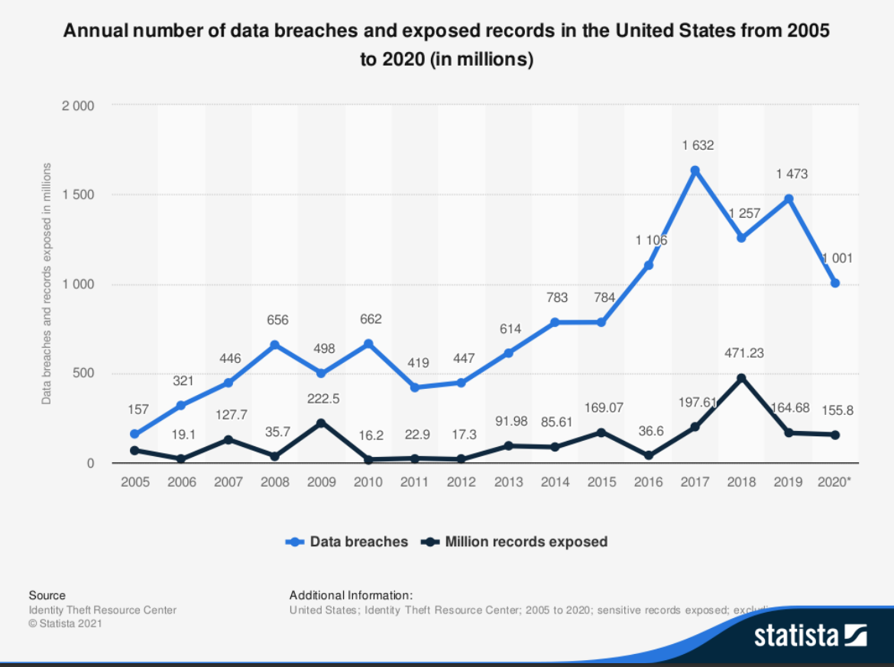
Cyber Crime
Most common types of cyber attacks are wireless
Cyber crime has been increasing over the last decade
[7][8]
Notes:
Part of the reason why there are many ways to protect oneself from wireless attacks is because there are many ways to perform such an attack, including Piggybacking, Wardriving, and Wireless Sniffing, just to name a few. In 2019, the most common form of cyber attack experienced by companies in the US was phishing, representing 38% of attacks.
As you may know, phishing takes place over email and en-masse, and happens when an individual poses as a reputable company to trick you into revealing personal information. The scope and reach of phishing would not be possible without the use of wireless technology, present today in most companies and homes in the US.
From all we’ve mentioned, it is only logical that cyber crime should be increasing. A trend we have found to be true. Over the past decade the number of data breaches has been increasing significantly according to many sources. Not only did they increase in number, but also in costs to resolve.
[3JS] Statista, “U.S. Data Breaches and Exposed Records 2018 | Statistic,” Statista, 2018. https://www.statista.com/statistics/273550/data-breaches-recorded-in-the-united-states-by-number-of-breaches-and-records-exposed/.
[4JS] Statista Research Department, “Cyber crime: Attacks Experienced by U.S. Companies 2019,” Statista, Jan. 25, 2021. https://www.statista.com/statistics/293256/cyber-crime-attacks-experienced-by-us-companies/ (accessed May 09, 2021).

Slide 9
Second Conclusion
Sentient droids should have rights.
Notes:
Liam

Slide 10
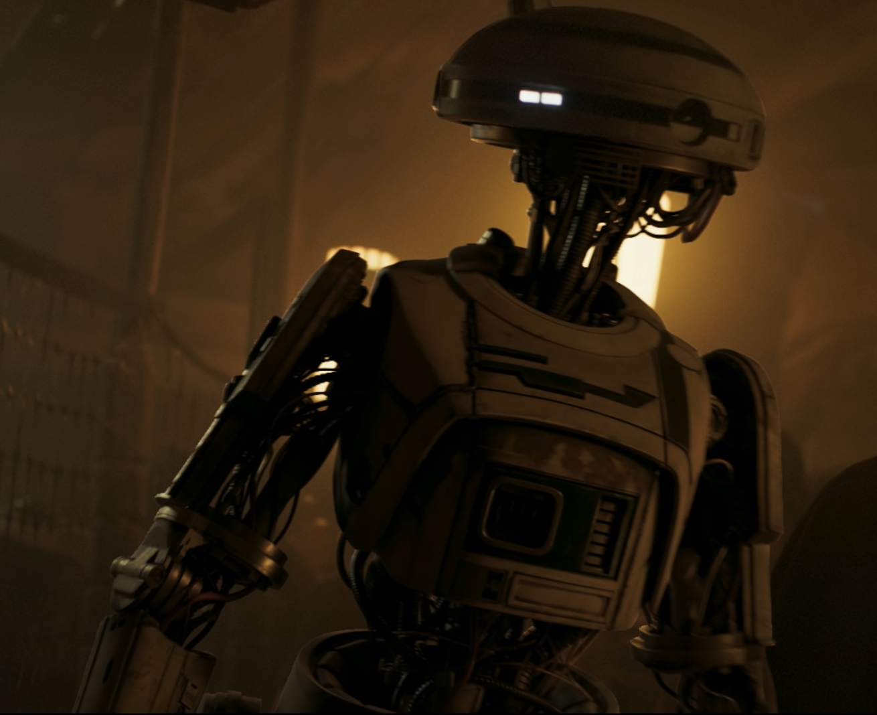
Droids express emotions just like organic beings
Group identity
L3-37 demands "equal rights", equating droid struggles with oppressed minorities [9]
Droids free each other of restraining bolts (liberation)
Keenly aware of emotional human actions (e.g. flirting, sarcasm) [10]
Droids can replicate/respond
[1][9][10]
Notes:
L3-37 is one of the best examples of a sentient, opinionated droid in the entire Star Wars franchise, and it allows the film to make strong emotional connections between droids and humanoids.
It’s clear that there’s a group identity among droids; throughout world history, marginalized populations formed strong communities based on shared experiences (for example, the women’s rights movement, the civil rights movement, the LGBT rights movement, and so on); these communities empower their members to overcome shared emotional anguish and turn a weakness into a strength. L3 in particular states “equal rights”, a phrase used by the aforementioned movements.
Moreover, droids such as L3 have a keen awareness of human interactions that depend heavily on reading emotions. L3 calls out flirting, and jokingly refers to her human companions as “organic overlords”, a reversal of the “omnic overlords” trope, which references groups of robots that control society in other dystopias.
Therefore, since droids both face an existential and emotional struggle, and can react to nuanced human emotional displays, it’s clear that droids are capable of expressing emotions just like organic beings.
[1] Howard, R (Director), Kasdan, J (Writer), Kasdan, L (Writer), George Lucas (based on characters created by). (2018) Solo: A Star Wars Story [Film] Lucasfilm
[SOURCE1] “Equality, human rights” (Britannica, February 20 2009), https://www.britannica.com/topic/equality-human-rights (Accessed May 9 2021)
[SOURCE2] Gerald Blaise, “Creating L3-37 for Solo: A Star Wars Story” (Industrial Lights and Magic, January 4 2019), https://www.youtube.com/watch?v=HkaQQISSMFA (Accessed May 9 2021)

Slide 11
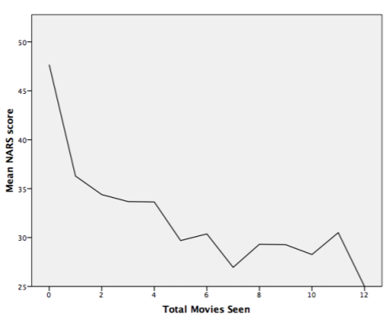
The Public and Droids
Exposure to robots in films improve opinions [11]
Franchise Popularity[12]
Studio Entertainment Income increased 86%
Consumer Products Income increased 23%
Watching films with robots reduces negative attitudes toward them [11]
[11][12]
Notes:
Jared Poulos
Given that droids feel, do viewers empathize with them? A 2011 study found that viewers of films portraying intelligent robots (regardless of whether they were heroes or villains) resulted in a more positive view of AI in real life.[11] The franchise this film is a part of has prominently featured droids from the beginning, and it is immensely popular. Disney’s 2016 quarterly reports attributed an 86% increase in entertainment media income and a 23% in consumer products income to the release of a one Star Wars film.[12] All the people watching those films and buying the media are exposed to AI in the form of droids, and thus are likely to develop a more positive opinion of them.

Slide 12
Counter Argument: Droids Are Not Moral Persons
Robots cannot have rights
The instrumental theory
The use of technology
[1][13][14]
Notes:
Counter argument: droids are not moral persons
Robots are not moral persons, so they are not able to have rights
Instrumental theory and humans’ use of technology [1]
Robots’ goals, behavior, and intelligence are determined entirely by humans [1, 2]
Humans use technology as a means to an end [1]
These tools are regarded as neutral and they are evaluated with respect to their utility to users as opposed to their value in themselves [1]
This theory applies to simple tools and complex AI [1]
Ultimately, robots are a technology that are created by humans with the intention that they will be used by humans as a tool for accomplishing their goals
Negative impact on humans
Poor decision-making regarding human interaction and resources allocated to humans [2]
Time and attention are limited and should not be spent on something that is of no consequence [2]
The more time humans spend interacting with robots, the less time they will have for interacting with other humans [2]
The more resources (time, money) humans use for developing this technology for AI interactions, the less they will be able to spend directly on humans and human interactions [2]
Evidently, the creation of robots and AI to interact with humans would be detrimental to humans’ interaction with each other by reducing the amount and quality of the interactions
Sources
David J. Gunkel, The other question: can and should robots have rights? (Ethics and Information Technology, 17 Oct. 2017), https://link.springer.com/article/10.1007/s10676-017-9442-4 (01 May 2021)
Joanna J. Bryson, Robots Should Be Slaves (21 May 2009), https://www.researchgate.net/publication/250333956_Robots_Should_Be_Slaves (01 May 2021)

Slide 13
The Ethics of Droid Rights
REAL WORLD
IN UNIVERSE
Rationality/Autonomy Approach[11]
Kantian Ethics
Information Ethics
Galactic Constitution[12]
Treated similarly to organics
Not servant class
No more memory wipes
[15][16]
Notes:
Jared Poulos
We can apply our real world ethics when discussing if droids deserve their treatment. Firstly, we need to determine their moral personhood, which we can through the rationality autonomy argument:
- Droids have the ability to consider morality when deciding to act
- They can act autonomously in a moral or immoral manner
- They are then morally responsible for actions, and therefore they should be considered people [4JP]
We can thus apply moral philosophies to droids, including Kantian ethics where they must be treated as an end and not a means (so not as slaves) and information ethics, under which the memory wipes that destroy information would be considered wrong. We can also examine the social contract.
Both before and after the Empire ruled the galaxy, Star Wars had a republic governed by a constitution. It outlawed slavery and guaranteed the rights of all sentients (a word which here means human-level of intelligent beings) would be equal. Under those rights, droids should not be kept as slaves and to not be memory wiped as humans and aliens are not subject to that treatment. It should be noted that when this film takes place, these laws are not in effect, but that is uniformly represented as wrong across Star Wars media [5JP]

Slide 14
Summary
Wireless technology is more vulnerable to unauthorized access.
Sentient droids should have rights.
Notes:
The world of Star Wars explored in the movie Solo has many strange features, but its technology is grounded in what people thought was possible in the 70s. When juxtaposed against our understanding of technology today, it provides a picture of how things could have been or could become different. In a world where few connections are wireless, hacking is left almost exclusively to droids, and results in more security as those who may wish to access your information need to journey across the galaxy to use their SCOMP links or steal your hard drives. In our world, wireless technology is more vulnerable to unauthorized access.
Far more interesting, however, is the presence of inorganic life, droids. AI today is not sapient as far as we know, and exists to fulfill our wants and desires. If we do bring about droid-like beings, it would only make sense for them to have rights, as they share characteristics with other groups of sapient and sentient individuals, including emotion. Using what we know about ethics and morality, continued enslavement of droids would go against our values as individuals and as a society. It is only reasonable that sentient droids should have rights.
Thank you for taking the time to listen to our presentation.

Slide 15
REFERENCES
[1] Howard, R (Director), Kasdan, J (Writer), Kasdan, L (Writer), George Lucas (based on characters created by). (2018) Solo: A Star Wars Story [Film] Lucasfilm
[2] Ryder Windham et al, Ultimate Star Wars, (DK Publishing ,2015)
[3] CISA, “Securing Wireless Networks | CISA,” us-cert.cisa.gov, May 08, 2020. https://us-cert.cisa.gov/ncas/tips/ST05-003.
[4] H. Wang, Z. Chen, J. Zhao, X. Di, and D. Liu, “A Vulnerability Assessment Method in Industrial Internet of Things Based on Attack Graph and Maximum Flow,” IEEE Access, vol. 6, no. , pp. 8599–8609, 2018, doi: 10.1109/access.2018.2805690.
[5] Lee J. Wells, Cyber-physical security challenges in manufacturing systems, (Manufacturing Letters, Apr. 2014) https://www.sciencedirect.com/science/article/pii/S2213846314000066 (09 May 2021)

Slide 16
REFERENCES
[6] Min-kyu Choi, Wireless Network Security: Vulnerabilities, Threats and Countermeasures, (International Journal of Multimedia and Ubiquitous Engineering, Jul. 2008) http://citeseerx.ist.psu.edu/viewdoc/download?doi=10.1.1.307.5273&rep=rep1&type=pdf (09 May 2021)
[7] Statista, “U.S. Data Breaches and Exposed Records 2018 | Statistic,” Statista, 2018. https://www.statista.com/statistics/273550/data-breaches-recorded-in-the-united-states-by-number-of-breaches-and-records-exposed/.
[8] Statista Research Department, “Cyber crime: Attacks Experienced by U.S. Companies 2019,” Statista, Jan. 25, 2021. https://www.statista.com/statistics/293256/cyber-crime-attacks-experienced-by-us-companies/ (accessed May 09, 2021).
[9] “Equality, human rights” (Britannica, February 20 2009), https://www.britannica.com/topic/equality-human-rights (Accessed May 9 2021)
[10] Gerald Blaise, “Creating L3-37 for Solo: A Star Wars Story” (Industrial Lights and Magic, January 4 2019), https://www.youtube.com/watch?v=HkaQQISSMFA (Accessed May 9 2021)
[11] Laurel Reik et al, Exposure to Cinematic Depictions of Robots and Attitudes Towards Them, (University of Cambridge, 2011), https://www.cl.cam.ac.uk/~pr10/publications/hri11.pdf (Accessed 5/8/2021)

Slide 17
REFERENCES
[12] The Walt Disney Company, THE WALT DISNEY COMPANY REPORTS FIRST QUARTER EARNINGS FOR FISCAL 2016, (Disney, 2/9/2016), https://thewaltdisneycompany.com/app/uploads/q1-fy16-earnings.pdf (Accessed 5/8/2021)
[13] H. David J. Gunkel, The other question: can and should robots have rights? (Ethics and Information Technology, 17 Oct. 2017), https://link.springer.com/article/10.1007/s10676-017-9442-4 (01 May 2021)
[14] Joanna J. Bryson, Robots Should Be Slaves (21 May 2009), https://www.researchgate.net/publication/250333956_Robots_Should_Be_Slaves (01 May 2021)
[15] John-Stewart Gordon, Artificial moral and legal personhood, (Springer, 9/9/20), https://link.springer.com/article/10.1007/s00146-020-01063-2 (Accessed 5/8/21)
[16] Jason Fry, Tales from Vandor, (Studio Fun International, 9/11/2018)

Slide 18
Questions?
Do you have any questions?
addyouremail@freepik.com
+91 620 421 838
yourcompany.com
Please keep this slide for attribution.

