Slide 1
Everything Everywhere All at Once
Max Clarke, Kaiden Zinck, Julian Guggino, Wen Chen

Slide 2

Plot synopsis
“A middle-aged Chinese immigrant is swept up into an insane adventure in which she alone can save existence by exploring other universes and connecting with the lives she could have led.” [1]

Slide 3

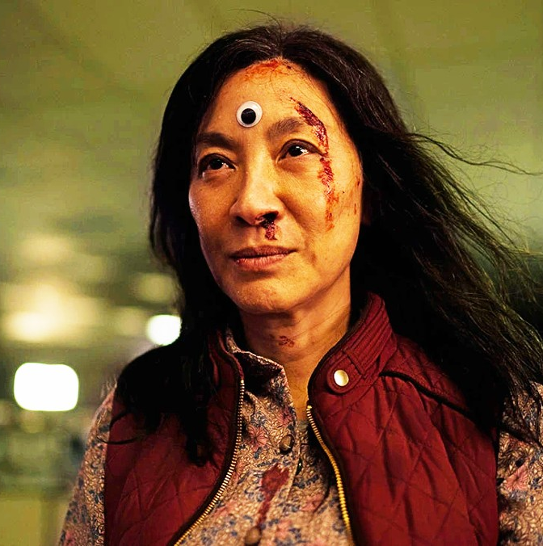

Main Characters
Evelyn Wang (Left)
Jobu Tupaki / Joy Wang (Top Right)
Waymond Wang (Bottom Right)

Slide 4
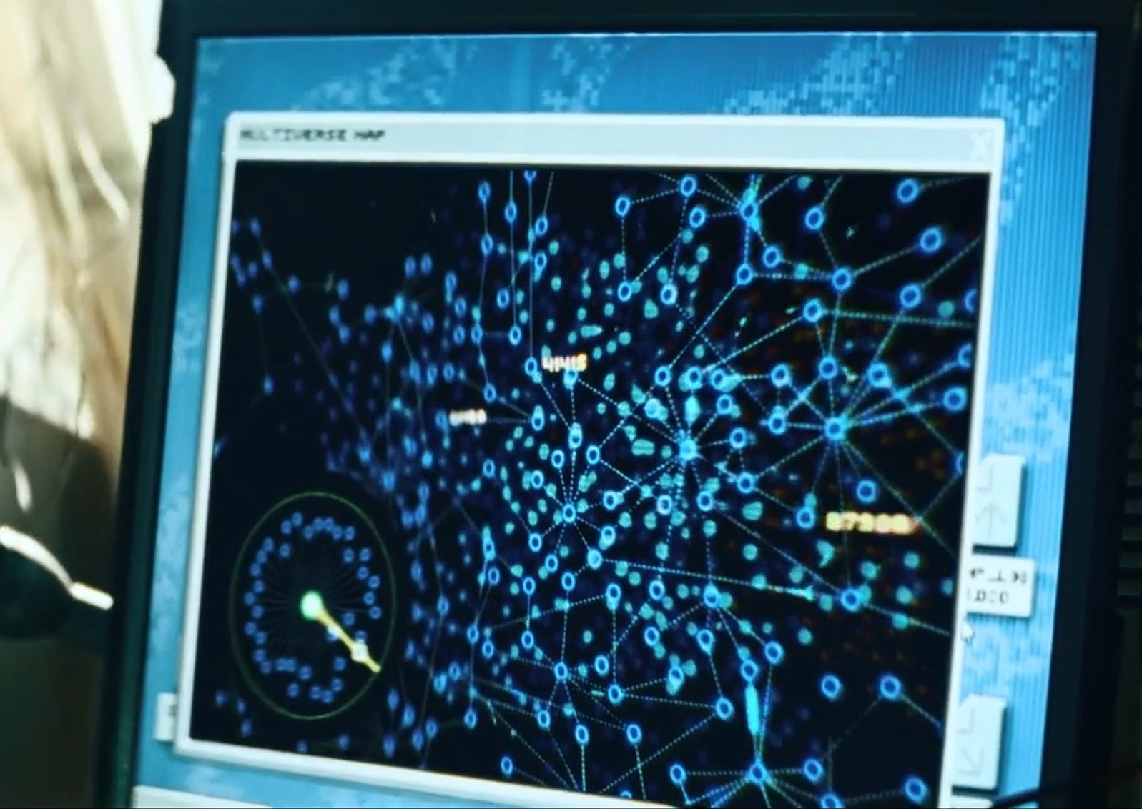
Verse Jumping
Notes:
Verse jumping is the primary driving technology for the plot of EEAAO. By doing a series of specific, unlikely actions in a row, characters can link themselves to a copy of themselves in another universe, sharing their knowledge between the universes. This technology originates from the Alphaverse and most of the movie consists of the main characters using verse jumping to get a skill they then use to fight.

Slide 5

Key Events
13:20 – Meeting Alpha Waymond and coming into contact with the Alphaverse
18:47 – First verse jumping
26:16 – Point of no return where Evelyn punches an IRS agent
43:04 – Alpha Waymond giving up on this Evelyn
56:48 – Evelyn blames Jobu Tupaki as the reason her daughter is the way she is, to which Jobu rejects the notion
1:00:44 – First look at the Everything Bagel
1:01:45 – Alpha Gong Gong rescues Evelyn and blames Waymond for corrupting another person
1:08:25 – Evelyn argues for Gong Gong to spare her daughter Joy and Tupaki lore drop
1:13:08 – Evelyn learns to better utilize her abilities to fight with one of the abilities being downloaded being self-esteem
1:25:39 – Evelyn's consciousness is split across the multiverse
1:31:39 – Evelyn talks to Jobu Tupaki
1:33:56 – Evelyn experiences every life simultaneously and finds no meaning in each individual universe
1:49:36 – Evelyn finds meaning in her husband Waymond across every universe
1:51:14 – Joy/Jobu Tupaki tries to end her existence by stepping into the everything bagel
1:54:34 – Evelyn finds peace with herself and tries to bring back her daughter as well as subdue everyone with love and kindness
2:01:12 – Evelyn accepts Becky as Joy's girlfriend
2:01:22 – Alpha Gong Gong accepts Evelyn trying to get back her daughter and stops interfering to watch her try
2:04:11 – Joy voices her annoyance at Evelyn that its too late and it hurts when they are together and that Evelyn should just let her go
2:04:58 – Evelyn agrees to let go
2:06:38 – Evelyn after living every life simultaneously tells her daughter that she wants to be here with her despite this reality's imperfections
2:09:01 – Joy accepts Evelyns help

Slide 6



Conclusion 1: Information is Powerful
Universe jumping brings information
  Characters from the alpha universe use this information for combat
Evelyn and Jobu use much more information to do just about anything
  Control the world around them and make the impossible possible
  Find enlightenment
  Gain hotdog fingers
Notes:
One of the central driving forces behind the plot of EEAAO is how easily accessible information of any kind is. Verse jumping provides a near instant way to learn anything, large or small. Many characters from the alpha verse use this at a surface level, picking up skills as they need in their multiversal adventures, but we see the full extent of this power when Jobu Tupaki first appears. The ability to instantly learn martial arts is well and good, but having instant access to any information ever conceived of can do much more. Jobu can manipulate the world around her at will using her infinite knowledge of the workings of the universe. On the right is the visualization the movie gives of this multiversal information transfer into Jobu, showing that she is fetching different information from different universes all the time. Above that is the 'everything bagel' she created which contains every single thing from every universe. Later in the movie Evelyn learns to use verse jumping like Jobu and she pulls information from a number of universes that are fundamentally different from hers, including the hotdog finger universe.

Slide 7

Information is Powerful: Laplace's Demon
"Jobu Tupaki sees all and knows all." [7]
Laplace's Demon [5]
  Thought experiment by Pierre-Simon Laplace
  A being with sufficient knowledge of the universe that they can use physics to calculate the future
[5]
Notes:
The way that Jobu and later Evelyn use their infinite instant access information is extremely similar to the famous thought experiment by mathematician and philosopher Laplace. In this thought experiment, there is a being with perfect knowledge of the current state of the universe that uses that knowledge to calculate the future. Similarly between Jobu and Laplace's demon, having infinite information kind of breaks our human outlook on the universe, may it be turning bullets to slime or knowing every position of every atom ever, having lots of knowledge is powerful. Both Jobu and the demon represent a very similar nhilistic philosophy actually. Much of the later half of EEAAO focuses on Jobu being bored and done with the world after achieving omniscience, and the entire point of Laplace's demon is to show that free will cannot coexist with deterministic physics. It wouldn't surprise me if the writers of EEAAO had the demon in mind when writing the story, you can even see a similar sentiment to the title in this image.

Slide 8
Information is Powerful: AI
Modern day AI models have been fed massive amounts of information for their training data
  GPT-4 (released in 2023) used over 1PB of data for its training [2]
  PCWorld recommends 256GB minimum for most users, with many users needing 1TB of storage [3]
  1,000-4,000× average computer's storage capacity
Jobu and Evelyn's access to nearly infinite information show an example of just how dangerous this amount of information can be
Notes:
AI has quickly become a major part of our everyday lives. The models we have come to rely on, however, use massive amount of data in order to achieve the versatility they do. GPT-4, a slightly older (at least relative to how fast AI is evolving) model, was trained on more than a petabyte of data. To put this into perspective, PCWorld recommends anywhere from 256GB to a 1TB for most computer uses. GPT-4 was trained on data between 1,000 and 4,000 times that amount. GPT-5.5 (their most recent model) likely used even more data than this in its training, but information on this has not yet been publicized.
This can be compated to what happened to Jobu and Evelyn after their minds fractured, giving them the ability to experience all multiverses at will. In Jobu's case, this lead to her becoming the movies main villian. Evelyn nearly joined Jobu as well. These unfathomable amounts of information can be incredibly dangerous if in the wrong hands, and they have been compressed into apps that we use daily without even thinking about just how wide-ranging their data is.

Slide 9
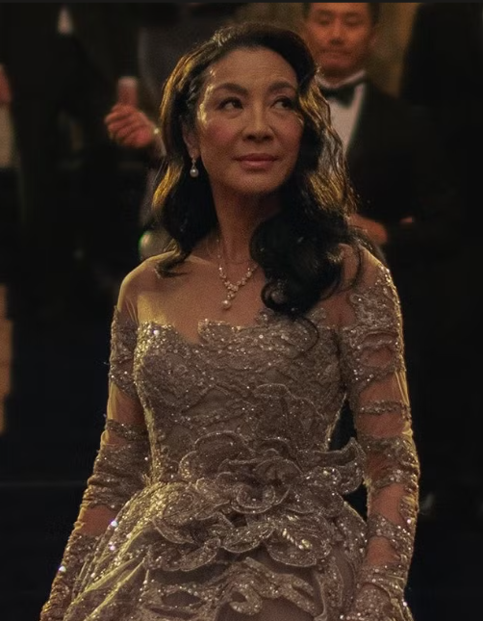
Conclusion 2: Comparison is the Thief of Joy
Social Comparison Theory and relevance with EEAAO
Definition: "Individuals' comparisons are based on their interpretations and perceptions of others" [8]
"One hour spent on Facebook daily results in a 5.574 decrease in the self-esteem score of an individual. "[4]
Notes:
The movie while not about social media tends to play the form of social media at least when it comes to social comparisons, due to Evelyn's encounters with her alternative selves in different universes some where she is spinning a pizza sign to others where she is a famous actor or a famous opera signer or even one where she had hotdog fingers and is in a lesbian relationship with the tax agent.
Social Comparison Theory is the idea that we form our own opinions and desires by comparing themselves to others. Which happens throughout the film as she traverses the multiverse.
We have seen social comparison has a negative correlation with self-esteem. A study found "One hour spent on Facebook daily results in a 5.574 decrease in the self-esteem score of an individual. "[4] From this study it was found that social media use in this case Facebook tend to decrease a person's self-esteem. This is important as though out the film she continues to feel defeated and has second ideas and doubts in her mission.

Slide 10
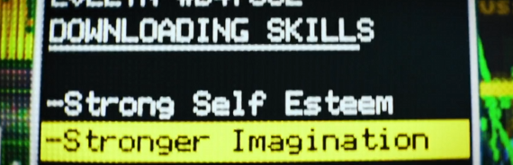
Self Esteem from Upward Social Comparisons
At a pivotal moment in the film, as Evelyn embraces her own will and begins resisting the Alphaverse there is a brief downloading skills scene where "Strong Self Esteem" appears on the list.
Self Esteem can be tied to upward social comparisons [6]
Notes:
At a pivotal moment in the film, as Evelyn embraces her own will and begins resisting the Alphaverse there is a brief downloading skills scene where "Strong Self Esteem" appears on the list. This small detail seems like a subtle signal from the directors that Evelyn is starting to change.
Throughout the film our Evelyn is constantly showed other versions of her who seem better off than the current Evelyn. In a study while it was found that "Upward Social Comparison"(the comparing of yourself to someone with a enviable life) lead to experience negative effects like lowered self-esteem. However, in the same study they also discussed that "Upward Social Comparison" could also bring positive effects like motivation or inspiration for self development. This film is the perfect example of both effects.
In the film she starts off not confident in herself and unhappy with her situation however due to her changed perspective she is happy and content with where she ended up at the end of the story in a mundane life.

Slide 11
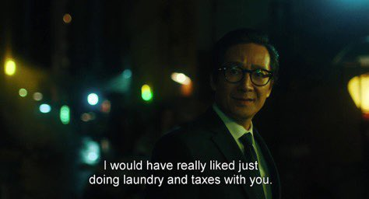
Acceptance of the Imperfect
"So, even though you have broken my heart yet again, I would have really liked just doing laundry and taxes with you." - Prime Waymond [1:47:53]
Strong relationships with others is much more important than success and achievements when measuring self-happiness score.[7]
Notes:
Here are two quotes from different points in her journey in one she was talking about how great her life would be without her husband and in the second after some growth she expresses how much she wants to be with her daughter here.
Which is especially meaningful due to here current state of mind where she has experienced almost every reality and still chooses to spend and cherish time in this universe where she is not rich, famous, talented nor skilled.
Akin to social media where you are shown many different depictions of the perfect life, Evelyn is confronted with multiple “perfect” versions of her own. However, unlike social media, these comparisons are intensified by the knowledge that these realities were genuinely possible outcomes of her own choices. Research on upward social comparisons at least when examining Facebook revealed that not only does it affect self-esteem it can also increases dissatisfaction which is shown in the film when she lashes out at her Waymond stated that her life was so much better without him.
"I saw my life... without you... I wish you could have seen it... it was beautiful."[47:28]
However rather than tying her self-worth to these comparisons Evelyn ultimately rejects it. This shift follows another study in Psycological Science where it was found that there was a good indicator for happiness and it wasn't success, it was the number of strong relationship one had. Paralleling this instead of staying as her more successful self she instead stays with the universe where her daughter and her made up.
" Why not go somewhere where your daughter is more than just this? Here, all we get are a few specks of time where any of this actually makes any sense." - Joy,"Then I will cherish these few specks of time." - Eveyln [2:07:34]
She also is affirmed in her choice by the most successful Waymond in her visted universes with one of the most tear jerking quotes "So, even though you have broken my heart yet again, I would have really liked just doing laundry and taxes with you."
Meaning that the fame, power and riches he gained does not compare to the one he loves

Slide 12
Works Cited
IMDB, "Everything everywhere all at once plot", https://www.imdb.com/title/tt6710474/plotsummary/ (5/5/26)
Casey Laizure, "Caution: ChatGPT Doesn’t Know What You Are Asking and Doesn’t Know What It Is Saying" (JPPT, Oct. 2024), https://doi.org/10.5863/1551-6776-29.5.558 (5/5/26)
Chris Hoffman, "How much SSD space do you really need? The PC buyer’s guide to storage" (PC World, April 2026), https://www.pcworld.com/article/2489675/how-much-ssd-space-do-you-really-need-the-pc-buyers-guide-to-storage.html (5/5/26)
Muqaddas Jan, "Impact of Social Media on Self-Esteem" (ESI, Aug. 2017), https://doi.org/10.19044/ESJ.2017.V13N23P329 (5/5/26)
Berkeley Lab Community, "Spooky Science: Laplace's Demon" (IBL, Oct. 2023), https://elements.lbl.gov/news/spooky-science-laplaces-demon/ (5/5/26)
Rebecca L. Collins, "For Better or Worse: The Impact of Upward Social Comparison on Self-Evaluations" (Psychological Bulletin, 1996), https://psycnet.apa.org/fulltext/1996-01401-005.html (5/5/26)
Ed Diener and others, "VERY HAPPY PEOPLE" (NIH, 2002), https://condor.depaul.edu/hstein/NAMGILES.pdf (5/5/26)
Jan Crusius and Others, "Social Comparison: Theory, Research, and Applications" (Research Gate, February 2022) https://www.researchgate.net/publication/353803747_Social_Comparison_Theory_Research_and_Applications (5/5/2026)
Everything Everywhere All at Once (A24, 2022)

