Slide 1
Brave New World(1980)
Daijiro Tanimura, Andrew LaRusso, Mel Morin, & Dezhen Zhang
Notes:
Our group watched "Brave New World" and analyzed how the technologies affect society, and the fear of overflows of technology.

Slide 2

Film synopsis: Brave new world
Future state​
Automation of human birth, education, and personality development
Stable and peaceful community
John came to the society from an area without technology
The story depicts his conflicts and anguish in the controlled and unemotional social system
[1] Brave New World(1980)
directed by Burt Brinkerhoff
Notes:
The setting of this movie is a state in the future. In this era, technologies for automation are in all facets of life, including human birth, education and even the forming of one's personality. All people are born in a factory and instilled the values of the society through hypnopaedia, sleep learning. The society made a stable and peaceful community through managing the ability and role of the people within it. Everyone is assigned their role and caste before they are born, and they are only taught just what they need for their role. Even emotions are managed with narcotics, making sure everyone is in a constant state of joy. This story centers around John, who was born outside of the society where old styles of life remain. He felt a strong sense of unease within the society, causing him to actively rebel against it.

Slide 3
Main Argument of Movie
Prioritization of technological efficiency over human dignity causes a loss of humanity.
Notes:
Through analysis and discussion, we concluded that the main argument of this movie is that technological efficiency, when ignoring human dignity, cannot be advanced. The society in the film was successfully controlled. It was predictable and stable because people are designed to fit the system. However, this society lost human rights such as freedom, individuality, family, emotional depth, and independent thought. This film warns that the true danger of technology is that it can work so efficiently that it creates an inhumane society.

Slide 4
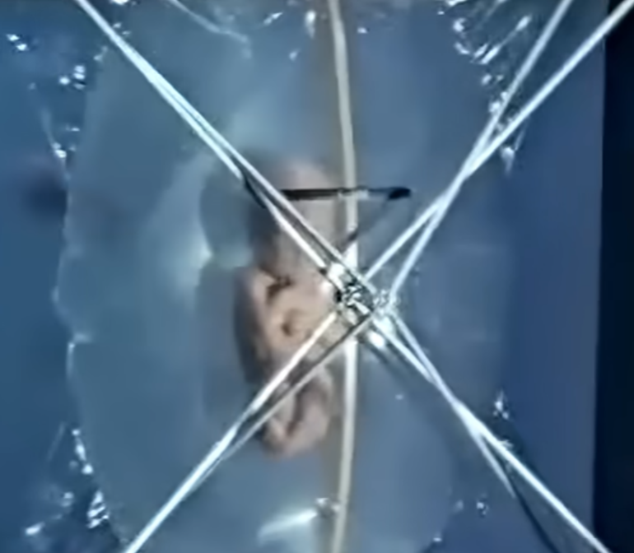

Technology in Brave new world
Technologies used in the film:
Controlled children birth with artificial wombs
Designated human abilities before birth
Conditioning with hypnopaedia to train children to be satisfied in the society
Soma: the euphoric narcotic
Notes:
Let me introduce the technologies we see in the films. A major technology symbolizing this society is Hatcheries and Conditioning Center. There, human embryos are cultured in plastic bags and conditioned with chemicals. In this era, it is possible to mass-produce human beings of every conceivable ability. Children born in the factory will be educated with hypnopaedia, which defines their personality. While they sleep, speakers will teach them values which are convenient for their role in society, like a favorable impression of their own caste and acceptance of their job and role. People who work in this society are permitted to a certain ration of Soma, a narcotic, to suppress their negative emotions. How much Soma you have on hand depends on your caste, with the highest caste of Alphas seemingly having an infinite amount. Many of these technologies were considered an impossibility at the time of the movie's release, but now some of them more close to home than ever. These technologies assist in making a stable and efficient society, but cause problems with human dignity and freedoms.

Slide 5

Automation Birth Remove Human independence
Technology in the film change human birth to "production"
・ Grown for predetermined future social role
・ Realized stable labor supply
・ Erased the concept of parent and child
・ Exist of parents is important to grow children's independence [2]
・ Human value measured based on usefulness to society
Notes:
Controlled and automated human birth in the Hatcheries Center removes the human element and connection. The birth turns into production, and the concept of parents is antiquated because no one is the parent of a child. These changes affect to the personality of people. They have less autonomy, relying solely on this authoritarian society. One academic book, "Handbook of Adolescent Psychology," reports that the attachment of parents to their child is necessary to build the base of humanity and autonomy. Without parents in people's lives, human independence will be stifled, and humanity will be at a loss.

Slide 6
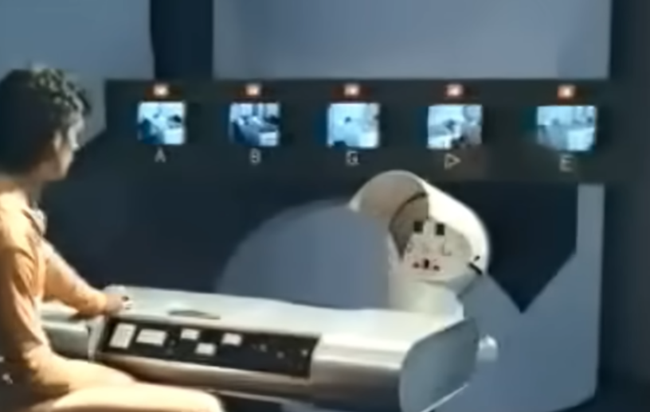
Indoctrination with Auto-Education
They automate education with Conditioning pods and hypnopaedia center.
Taught to accept their caste, role and values convenience for society
Prevent social conflict
Achieves globalization by creating shared values
Indoctrination lowers cognitive abilities and independence thought [3]
Notes:
The hypnopaedia also causes severe problems for humanity. In the film, this sleep learning education is provided to all children to ensure compliance and contentment within society. This could be seen as a type of globalization, as it succeeds in sharing values with people around the world, but it is very different from the globalization of now. It is more akin to indoctrination by radical religion or dictatorship. A report by Cambridge University Press warns that indoctrination, which would include hypnopaedia, lowers cognitive abilities and independent thought, so this uniform and biased education plays a large part in making an inhumane society.

Slide 7

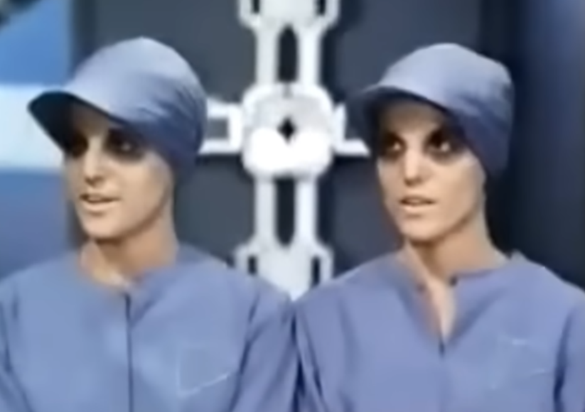
Caste System
People are divided into castes: Alphas, Betas, Gammas, Deltas, and Epsilons
Their roles and jobs depend on their caste
Takes away the chance to define their identity
Caste based practices negate humanity [4]
Notes:
The society in this film has caste system, but it is not decided through family lineage or financial means. At the embryonic stage, they will be designed a caste and be nurtured depending on it. The fact that caste is determined at birth is similar with real caste systems, but the difference is that anyone in a lower caste will never doubt their placement even if they receive unfair treatment. In the movie, the higher castes are assigned advanced and intelligent jobs, while the lower castes work more menial or dangerous labor. Human Rights Watch, an international human rights organization, reports that caste systems work as a denial of humanity and free will. The excessive Automation of this world assists the entrenchment of civilians within their unethical social system.

Slide 8
Emotional Control with SOMA
This society normalized using Soma, a narcotic that suppresses negative emotions
Makes people dependent on soma whenever they feel sadness, anxiety, anger, or discomfort
Not relief, takes the emotion out of their control
Slowly kills people
  People don't age, but they still live to about 80 because of Soma
Notes:
This film also shows the technology to control human emotion. Soma is a euphoric narcotic that suppresses negative emotions like stress, anxiety, and pain. Soma was spread and generalized throughout the whole of this world with every civilian, unlike real narcotics. Whenever people feel something bad, they can take soma like a medication, which overall maintains the peace of the society. Societal risks like rebellion and riot can be prevented and halted by taking citizens' negative emotion away quickly. On the other hand, the confiscation of negative emotion also removes the will to face difficulty and persevere. In the movie John's mother, Linda, passes due to her dependance on Soma. When she finally returned to the Brave New World, she wished to numb all her pain from the past few decades using Soma. This event is the nail in the coffin for any positive emotion John felt for this society. Global generalization of narcotics is not relief; it just makes people unfamiliar and fearful of their own negative emotions.

Slide 9
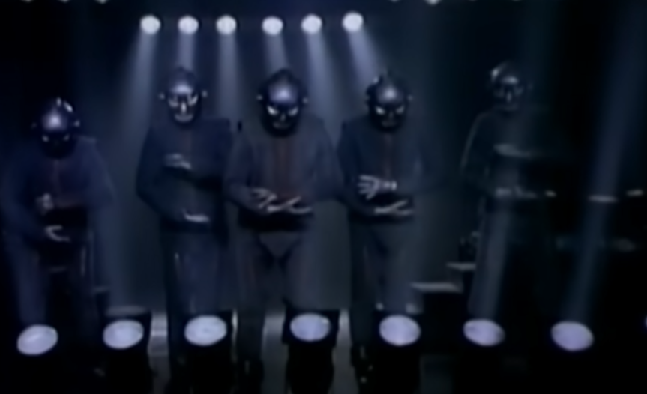
Warn to overflow of technology
The realization of a society like the film has been warned of in popular culture(ex. Mr. Roboto)
The society can be realized with modern technology
Loss of Autonomy by AI recommendation [5]
Genetic Engineering to design humans before being born[6]
Automation with computers and machines
Notes:
Controlled and inhumane societies like those seen in this movie are constantly warned of in popular culture. Mr. Roboto, introduced in the class, is a representative example. The rapid development of technologies in all sectors of people's lives goes to show how a society like seen in Brave New World is more possible than ever. AI is a major developing department, and there is a report in Frontiers in Artificial Intelligence which warns that AI recommendations affect humans' ability to think for themselves. Genetic engineering has also developed significantly since 1980. American College of Medical Genetics and Genomics reports that technology to predict the features of a human embryo by scanning it is being developed. It is expected to be used to give birth to a child who has a lower risk of disease and preferable abilities or traits. Overall, automation is being promoted around the world across a wide range of departments, bringing us ever closer to the society in Brave New World.

Slide 10
Message and lesson from the movie:
Technological efficiency established by sacrifice of human rights is not worth it
Blind faith in technology ​hides its flaws
It's important to be skeptical about technologies and to learn about it and determine the right way to use them

Slide 11
References
[1] IMDb. (n.d.). Brave New World (TV Movie 1980) [Image/film webpage]. IMDb. https://www.imdb.com/title/tt0080468/ (5/3/2026)
[2] Allen, J. P., & Miga, E. M. (2009). Attachment and autonomy during adolescence. In R. M. Lerner & L. Steinberg (Eds.), Handbook of adolescent psychology (3rd ed.). John Wiley & Sons.(5/3/2026)
[3] Armstrong, L. (2025). Autonomy-promoting indoctrination. Theory and Research in Education. https://doi.org/10.1177/14778785251340655
.(5/3/2026)
[4] Human Rights Watch. (2001). Caste discrimination: A global concern: A report by Human Rights Watch for the United Nations World Conference Against Racism, Racial Discrimination, Xenophobia and Related Intolerance. Human Rights Watch.(5/3/2026)
[5] Laitinen, A., & Sahlgren, O. (2021). AI systems and respect for human autonomy. Frontiers in Artificial Intelligence, 4, Article 705164. https://doi.org/10.3389/frai.2021.705164 (5/4/2026)
[6]Lázaro-Muñoz, G., Pereira, S., Carmi, S., & Lencz, T. (2021). Screening embryos for polygenic conditions and traits: Ethical considerations for an emerging technology. Genetics in Medicine, 23, 432–434. https://doi.org/10.1038/s41436-020-01019-3 (5/4/2026)

