Slide 1
Black Mirror: The National Anthem
Jace Bonjorno, Lucas Boynton, Cassidy D'Eposito, Paige Spalsbury

Slide 2

Synopsis
Ransom video of the princess of England
Prime minister must commit heinous acts to a pig or the princess dies
Attempts to control information from the government
Situation spreads even with attempts at restrictions

Slide 3
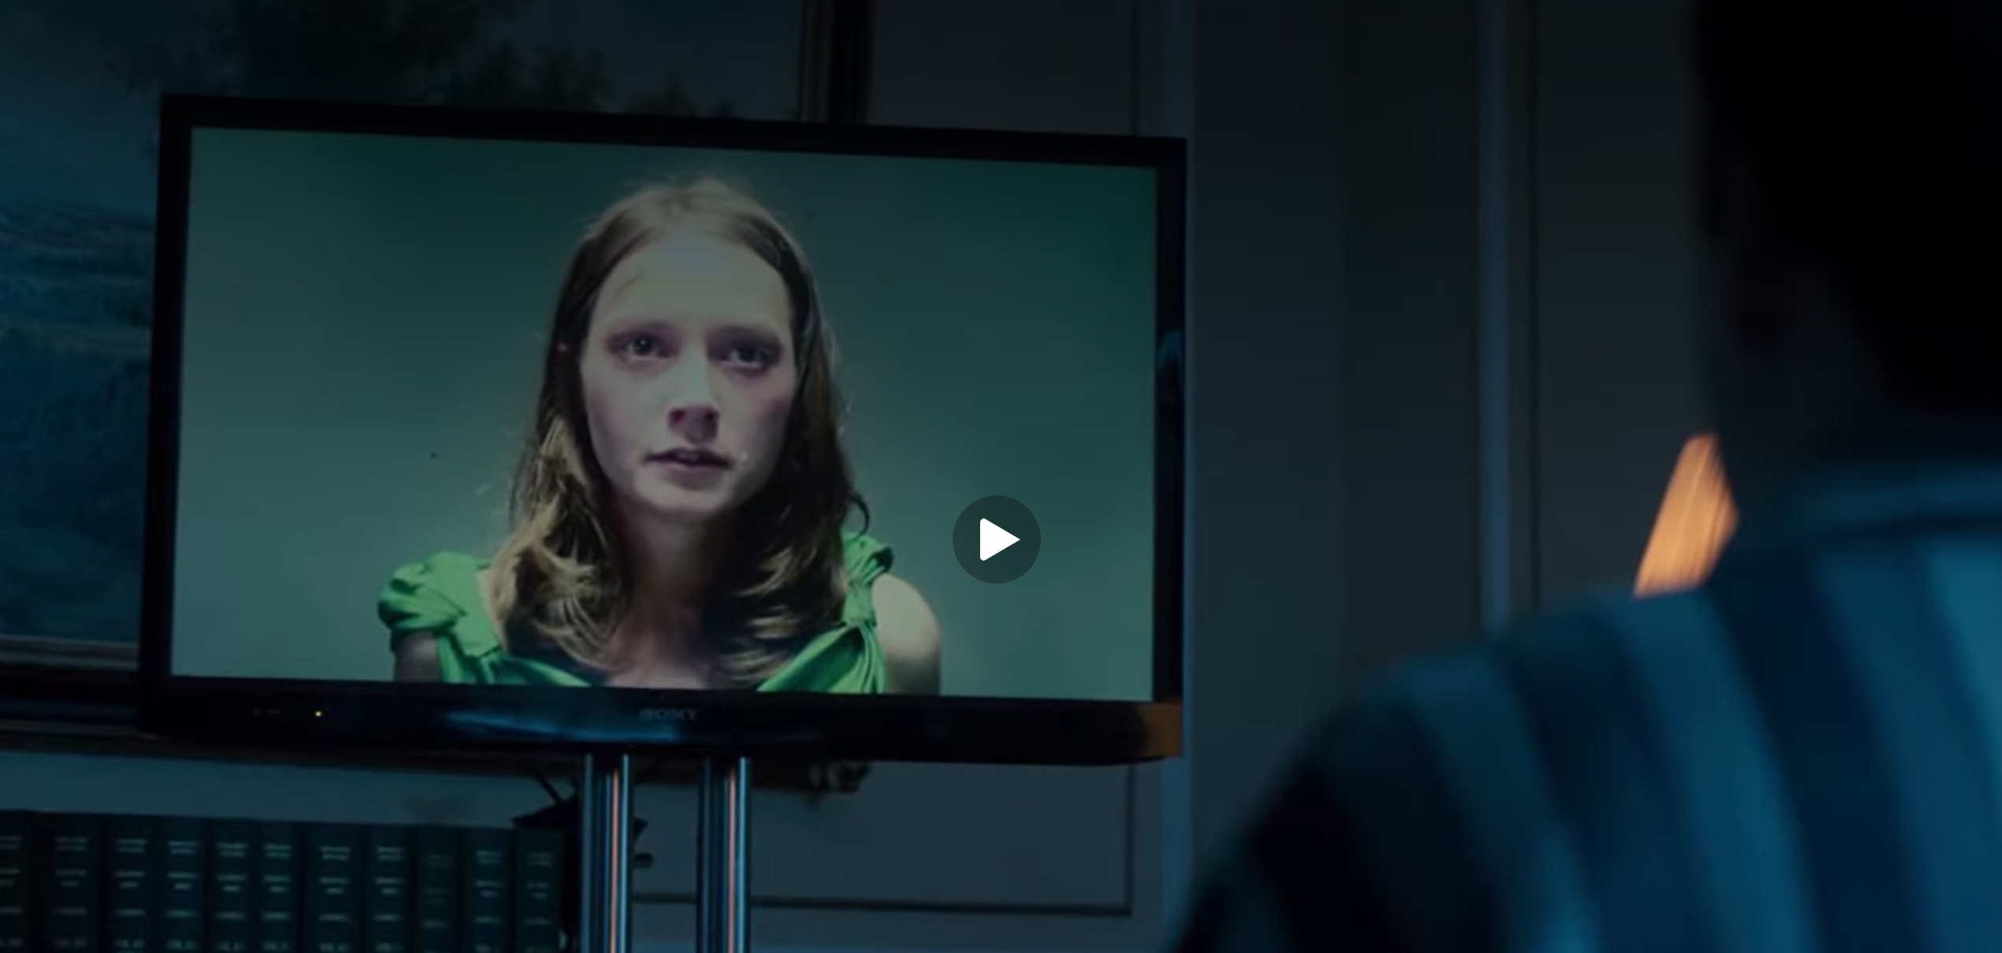
Relevant TECHNOLOGIES
Cell phones
Cameras
Social media
News outlets
Laptops
Computers
TVs
Notes:
The main technologies shown are phones, cameras, social media, news outlets, laptops, computers, and TVs. The episode is set at about the time of its release, so 2011, and all of the technology is reflective of the time period. There's no technology portrayed that was unrealistic, everything was commonplace at the time and used in a manner that was possible.

Slide 4
Sensationalized nature of the video is why it spread so fast

Slide 5
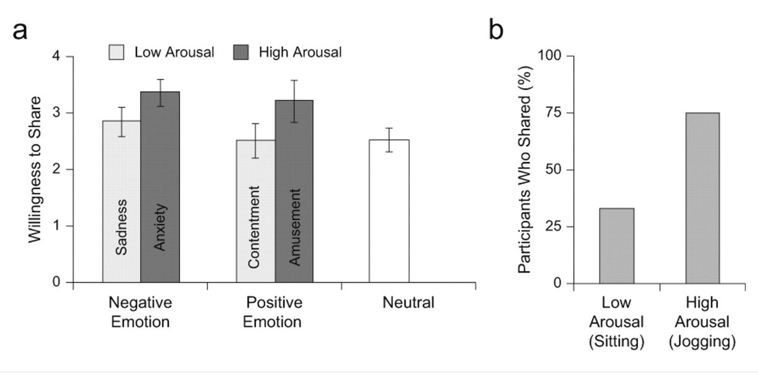
Emotional arousal contributes to the likelihood of content being shared
Despite the video being taken down quickly, the content was still shared between the public [9].
High arousal conditions are 75% more likely to share content [3]
Low arousal conditions are only 33% likely to share [3]
Sensationalized videos typically leads to high arousal conditions
[4]
Notes:
Cassidy
Although the video was quickly taken down by the government, due to the nature of the content it was still spread all over social media and news outlets. This shows that content can keep circulating once society starts spreading it themselves.
One study did experimental research to explain that emotional arousal plays a key contributors as to why people continue to share content. Within this study participants who were placed in a high arousal state were 75% more likely to share content, compared to only 33% sharing rate for those who were in a low arousal state. As we can see that is a significant difference in behavior and what is being shared based on only emotional activation. What this suggests is that emotionally intense content is much more likely to be passed along. In terms of Black Mirror: The National Anthem, the content being shared clearly lead to society feeling high intense emotions due to its content which explains why it was spread so quickly.

Slide 6
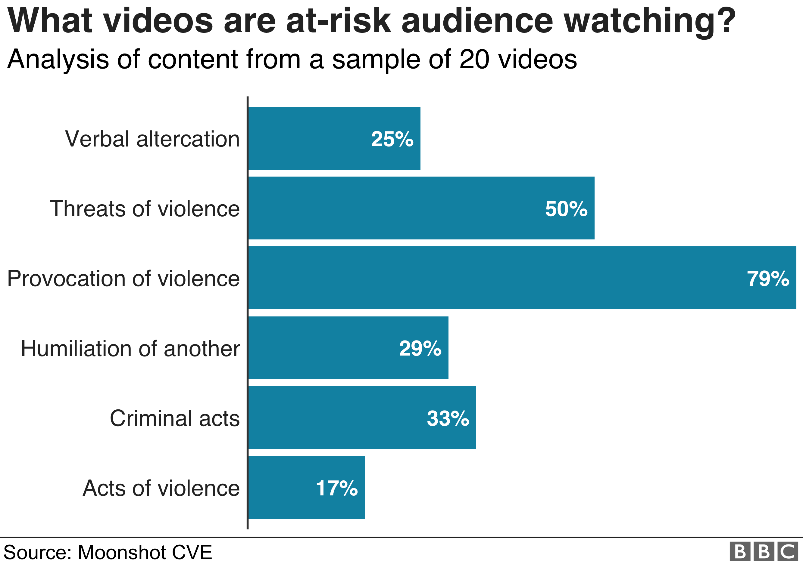
Inappropriate videos are common on the internet, which leads to normalization.
In the episode, viewers are captivated by the news coverage of the event despite its disturbing nature [9].
Media outlets, whether online or press will focus on violent or inappropriate stories.
Study of 20 YouTube videos:
  Uploaded: Jan 2018→May 2019
  “either incite or encourage violence”
  2.5 million views and 20,500 comments, likes, or shares
<Graphic as big as will fit>
Notes:
A study in 2018 to prove Social media has a substantial role in facilitating gang activity shows the frequency and distribution of violent terms used.
Some 7,500 searches were in the grouping, "violent intent". They included "best knife to fight", "where to stab" and "buy machete".
-The study also analysed a sample of 20 videos uploaded to YouTube between January 2018 and May 2019 which, analysts say, either "incite or encourage" violence.
-The videos received 2.5 million views and 20,500 comments, likes or shares.
-More than three-quarters of the films depicted people being provoked into violence. Half showed threats of violence with a named target and in a third there were "criminal acts”

Slide 7
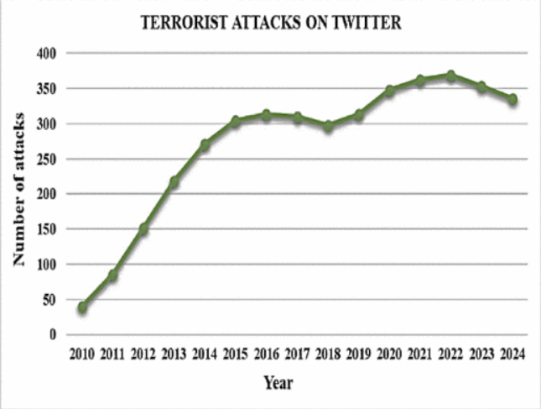
Use of social Networking for terrorism is growing
The kidnapper exploited social networking sites like YouTube and Twitter to spread information [9].
About 90% of terrorist activities online are conducted via social media platforms [7].
Real world example of the use of YouTube for ransom videos [7].
Twitter use for terrorist attacks is becoming more prevalent over time [2].
Notes:
Like all technologies, social networking sites can be used for malicious purposes
The use of social networking for terrorism is not just from movies; there are real-world examples
Quote for reference: "In 2013, ASG, a terrorist organization, kidnapped Australian Warren Rodwell and held him for about 472 days. The group made use of YouTube and Facebook for ransom videos and to demonstrate the proof of life" [7].
Twitter and Facebook are used by terrorist groups (ISIS, Al-Qaeda, etc.) for propaganda, recruitment, and attack coordination [2].

Slide 8
Media often violates personal Privacy

Slide 9
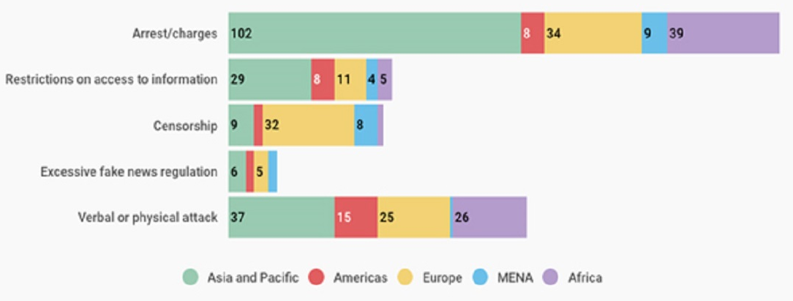
Gov’t will violate media freedoms during a time of crisis
Black Mirror: Gov’t places 5D Notice on media outlets [9].
COVID: Media Freedom Violations increased[1]
February 2020→August 2020: 426 violations
<Graphic as big as will fit>
[1]
Notes:
Paige
Title: Gov’t will violate media freedoms during a time of crisis
-According to data gathered by the International Press Institute (IPI), at least 426 media freedom violations related to COVID-19 took place around the world between February 5, 2020 and August 13, 2020.
-192 instances: journalists were arrested or charges were filed against them
in 134 instances, authorities cited the pandemic in refusing to comply with their access to information obligations;
IPI also recorded 104 incidents of verbal, physical and online attacks on journalists.
These data indicate a concerted effort by governments to limit independent information at a time of great need.
-graph: global graph of the number of media freedom violations by region

Slide 10
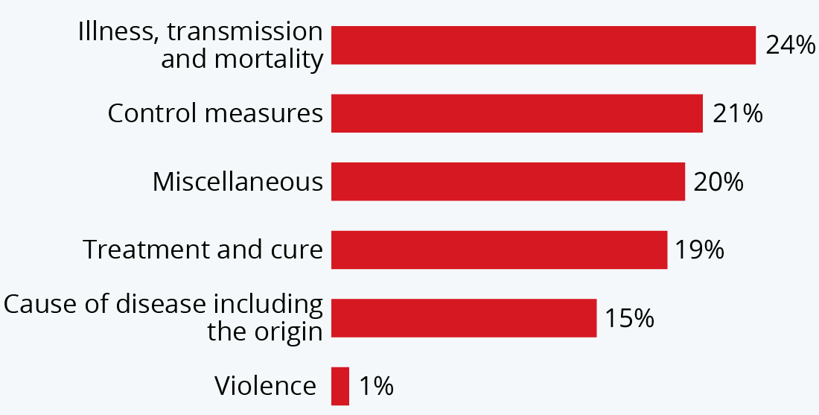
Restricting the Media manipulates the info spread
Restrictions placed on the press cannot stop the spread of news on social media [9].
America Journal of Tropical Medicine and Hygiene:
  2019→2020
  False information spread on social media about COVID
<Graphic as big as will fit>
[5]
Notes:
Paige
Title: Placing restrictions on the “free press” manipulates the spread of information
Notes:
-they place a “5D Notice” on the country's news outlets, preventing them from running the story. This is not, however, enough to stop the spread of the video on social media, such as Twitter
-in the news room, it shows reporters getting more and more desperate to run the story, mentioning how none of the media have broken the D notice
-one reporter laughs because “Facebook can run it, but they can’t”
-shows how the government exercises control over the free press, forcing the story to less reliable platforms, and it will get out eventually.
-graph: the composition of coronavirus misinformation.(stigma and conspiracy theories circulating on social media, based on 2,311 reports from 87 countries between 2019-2020) Source: American journal of tropical medicine and hygiene statista

Slide 11
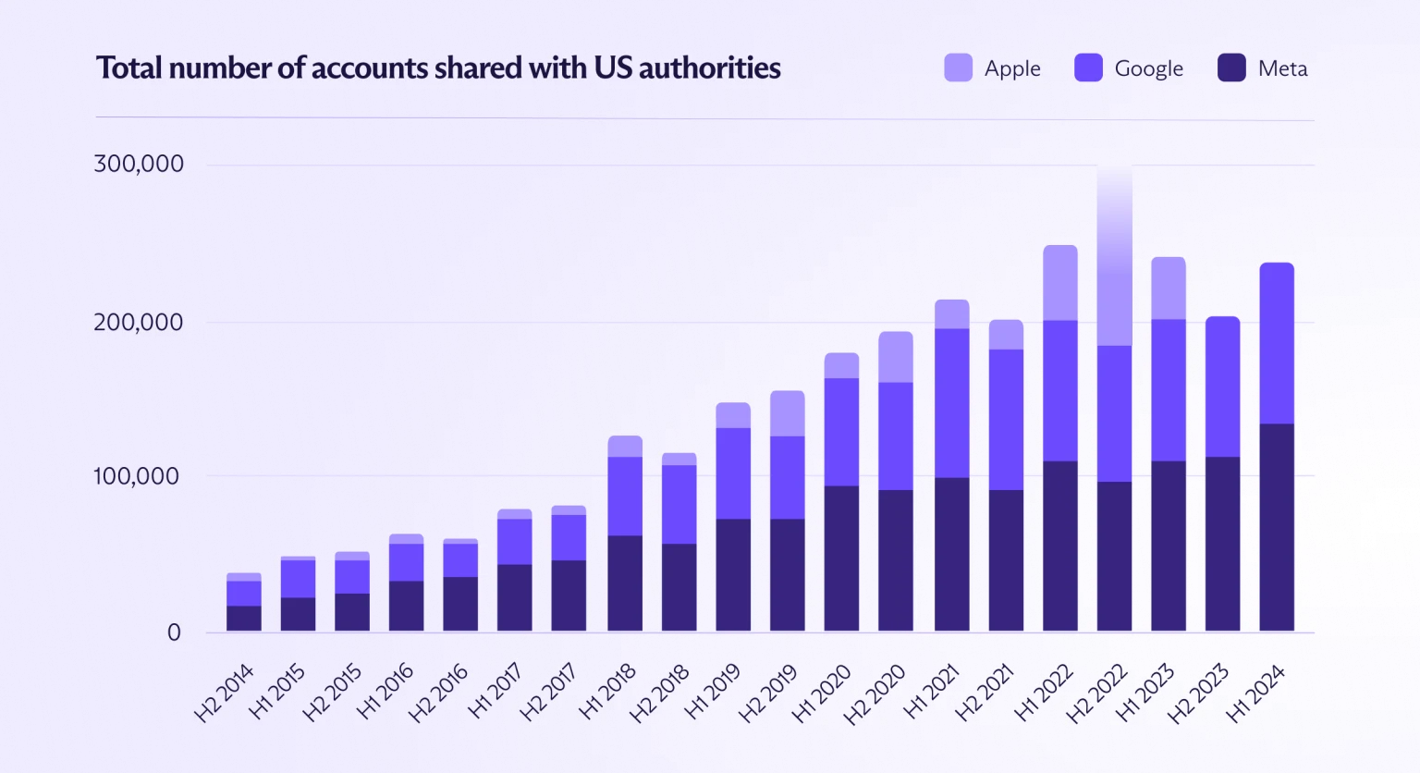
Governments can gain private info via data shared on social media platforms
Gov’t was able to find location where the video was posted from the link [9].
Location data tracking is a common practice for gov’t
2018: CBP obtained records containing ~113,654 location points [6].
  more than 26 points/min
<Graphic as big as will fit>
2014→2024: over 3 million user profiles shared [4]
Notes:
Paige
Gov’t was able to find location where the video was posted from the link
-Location data tracking is a common practice for government organizations,
-In early 2020, a Wall Street Journal report revealed that both Immigration and Customs Enforcement (ICE) and Customs and Border Protection (CBP) bought access to millions of smartphone users’ location data to track undocumented immigrants and suspected tax dodgers. 336,000 in total
-revealted that in 2018, CBP(Customs and Border Protection) obtained records containing around 113,654 location points in the southwestern United States — more than 26 location points per minute
-Graph: between 2014 and 2024, all three companies significantly increased the number of accounts they shared with law enforcement agencies. Google jumped 530%; at Meta (formerly Facebook), it surged 675%; and at Apple, it climbed 621% . In total, the social media platforms shared over 3 million user profiles

Slide 12
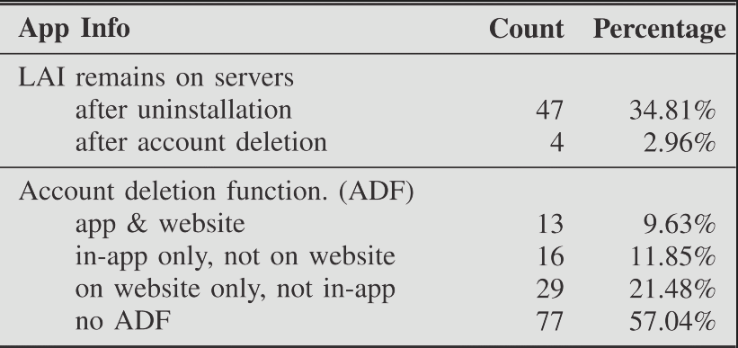
Deleting content off the internet does not remove it fully
The government was able to do all the tracking after the video was taken off YouTube [9].
57% of apps have no option to delete a user account [8].
35% of apps keep information after uninstalling and 3% of apps retain information after deleting [8].
Invasion of privacy when no way to remove information.
Notes:
Jace: personal privacy
Most of the tracking the government did in the episode was done after the video was taken off YouTube, which brings up the question of control of your own data. A study on apps from the Google Play Store found that 57% of apps that require an account give no option to delete account information, and on the 43% that allows account deletion 35% keep information after uninstalling, and 3% keep information after deleting the account. The graph expands more of the cases, but it shows the amount of leftover account information and the apps with account deletion function. This is a problem since you should have control over the personal data a company has, and that should include being able to delete any information you provided.

Slide 13
References
[1] Canada, G. A. Media Freedom and COVID-19. (GAC, 2020) https://www.international.gc.ca/world-monde/issues_development-enjeux_developpement/human_rights-droits_homme/policy-orientation-covid-19.aspx?lang=eng
[2] Divya S and B Ben Sujitha, The Impact of Social Media in Terrorist Attack Detection: A Comprehensive Study, (IEEE, 4/25/2025), https://ieeexplore.ieee.org/document/10967634 (5/3/2026)
[3] Jonah Berger, Arousal Increases Social Transmission of Information (Sage Journals, June 20, 2011) https://journals.sagepub.com/doi/full/10.1177/0956797611413294 (Accessed May 3, 2026)
[4] Koch, R. Authorities worldwide can see more than ever, with Big Tech as their eyes. (Proton, 2025). https://proton.me/blog/big-tech-data-requests-surge
[5] McCarthy, N. Infographic: The Composition Of Coronavirus Misinformation. (Statista Infographics, 2020). https://www.statista.com/chart/22527/composition-of-covid-19-misinformation/
[6] Page, C. Scale of US government’s cell phone location data tracking. (TechCrunch, 2022). https://techcrunch.com/2022/07/18/homeland-security-cell-phone-tracking/
[7] Pooja N. Jain and Archana S. Vaidya, Analysis of Social Media Based on Terrorism | A Review, (World Scientific, 7/9/2020), https://www.worldscientific.com/doi/epdf/10.1142/S2196888821300015 (5/3/2026)
[8] Preethi Santhanam, Hoang Dang, Zhiyong Shan, Iulian Neamtiu, Scraping Sticky Leftovers: App User Information Left on Servers After Account Deletion (IEEE, July 27, 2022) https://ieeexplore.ieee.org/document/9833720?denied= (May 3, 2026)
[9] Otto Bathurst et al., Black Mirror: The National Anthem, (Netflix, 12/4/2011)

